Slide 1
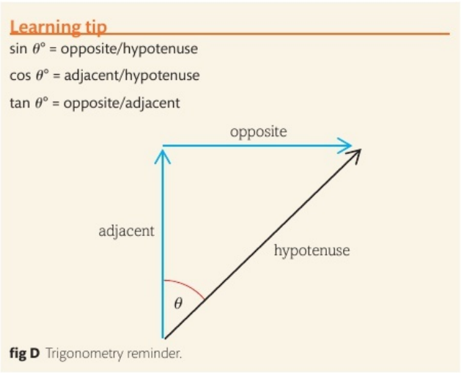
Review: resolving vectors
projectiles
Example:
Find the vertical and horizontal components of the following:
16 m/s
32°

Slide 2
projectiles
Review: resolving vectors
Example:
Find the vertical and horizontal components of the following:
45°
16 m/s

Slide 3
projectiles
Review: resolving vectors
Example:
Find the vertical and horizontal components of the following:
Using SUVAT, calculate the highest distance the ball will go.
14°
16 m/s

Slide 4
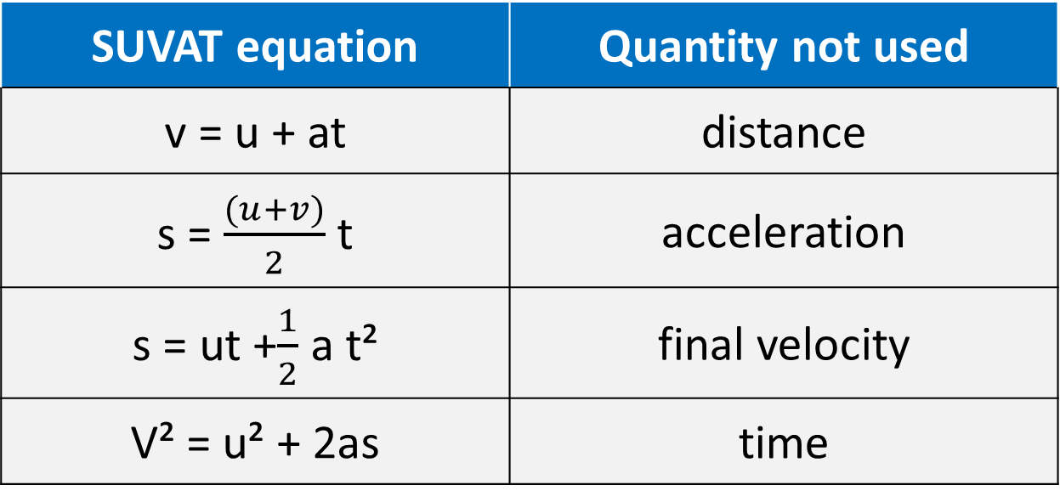
SUVAT
Page 50
SUVAT eqns. are equations that describe the motion of objects under constant acceleration
S - distance
u – initial speed
v – final speed
a - acceleration
t - time
SUVAT equation | Quantity not used
v = u + at | distance
s = $\frac{(u+v)}{2}$ t | acceleration
s = ut +$\frac{1}{2}$ a t² | final velocity
V² = u² + 2as | time
Similar to s = v x t
* Falling objects have an acceleration of 9.8 m/s²

Slide 5
projectiles
Review: resolving vectors
Example:
Find the vertical and horizontal components of the following:
Calculate the horizontal distance the ball will cross ?
14°
16 m/s

Slide 6
projectiles
Review: resolving vectors
Example:
Find the vertical and horizontal components of the following:
Calculate the horizontal distance the ball will cross ?
14°
16 m/s

Slide 7
projectiles
Review: resolving vectors
Example:
Find the vertical and horizontal components of the following:
Calculate the horizontal distance the ball will cross ?
14°
16 m/s

Slide 8
projectiles
Review: resolving vectors
Example:
Find the vertical and horizontal components of the following:
Calculate the horizontal distance the ball will cross ?
14°
16 m/s

