Slide 1
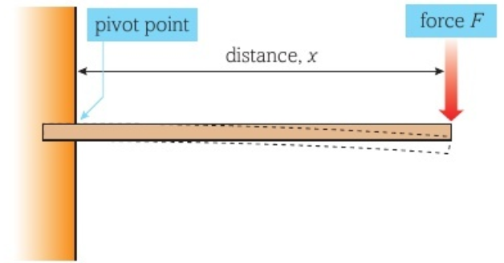
Moment
Is the rotational or turning effect of a force
Moment is increased the longer the lever
Moment = force x perpendicular distance from the pivot
*Note: the force has to be perpendicular to the pivot
Pivot: is the point of rotation Force Must be perpendicular to the pivot
N m
3 2 1
Notes:
N x m = n m
Or Kg m²/s²
It’s basically 1 newton acting 1 meter away using a lever
So what that means is that the green arrow, should be at 90 degree from the pivot, if the arrow were towards the pivot, then the moment is less effectively
1Nm = 100Ncm

Slide 2
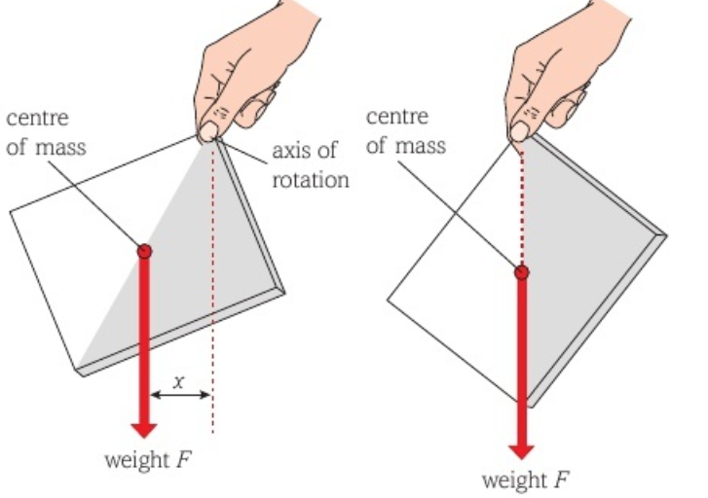
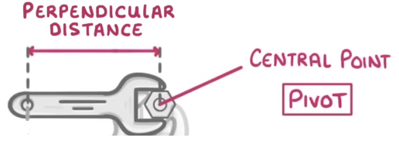
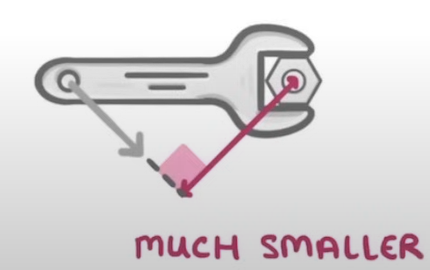
Moment
Consider holding a book, the moment of the book only acts until the centre of the mass (where the force of the weight seems to act) is at 0m perpendicular to the pivot (hand)
x
X = 0
Notes:
Center of mass is where the force of the weight seems to act.
Force Must be perpendicular to the pivot

Slide 3
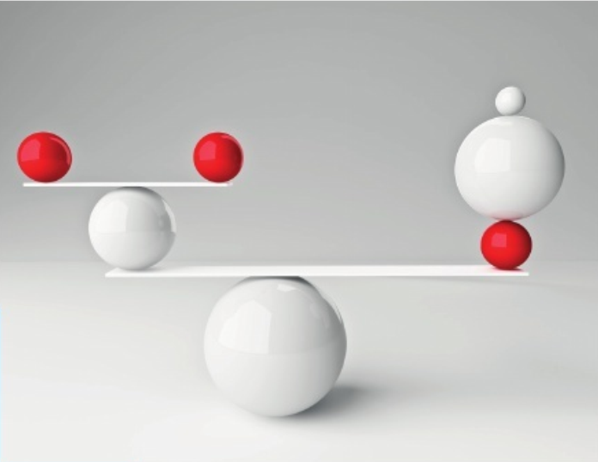
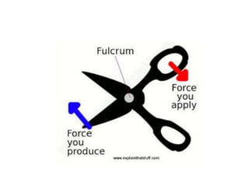
1st class lever
Moment
Pivot is between the two forces (or weights/objects)
Example: scissors, see-saw game, pliers
Force₁ x distance₁ = Force₂ x distance₂

Slide 4
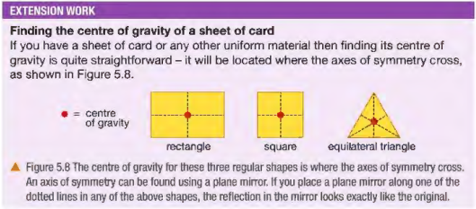
1st class lever
Moment
the weight of a body acts through its centre of gravity
Pivot is between the two forces (or weights/objects)
Example: scissors, see-saw game, pliers
Force₁ x distance₁ = Force₂ x distance₂
Example: find the weight of the beam

Slide 5
1st class lever
Moment
Pivot is between the two forces (or weights/objects)
Example: scissors, see-saw game, pliers
Force₁ x distance₁ = Force₂ x distance₂
Example: find the weight of the beam
Ans: The weight of the beam is assumed to act at the center of the beam
3kg
0.13m
1.8 m

Slide 6
1st class lever
Moment

Slide 7
1st class lever
Moment
Hints: check your units

Slide 8
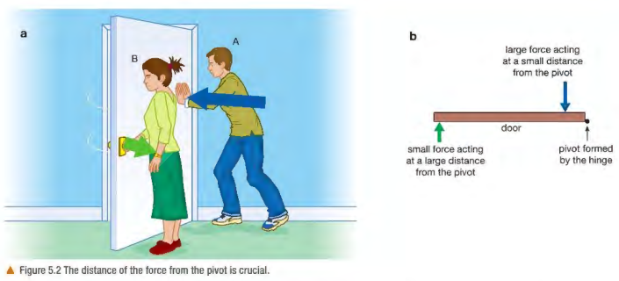
2nd class lever
Moment
Hints: check your units
Notes:
Example: nutcracker, bottle opener, pushcart

Slide 9
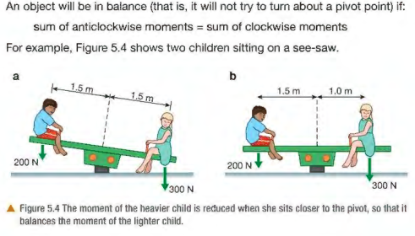
1st class lever
Moment

Slide 10
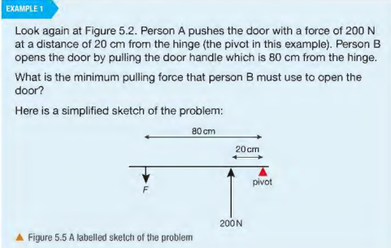
1st class lever
Moment

Slide 11
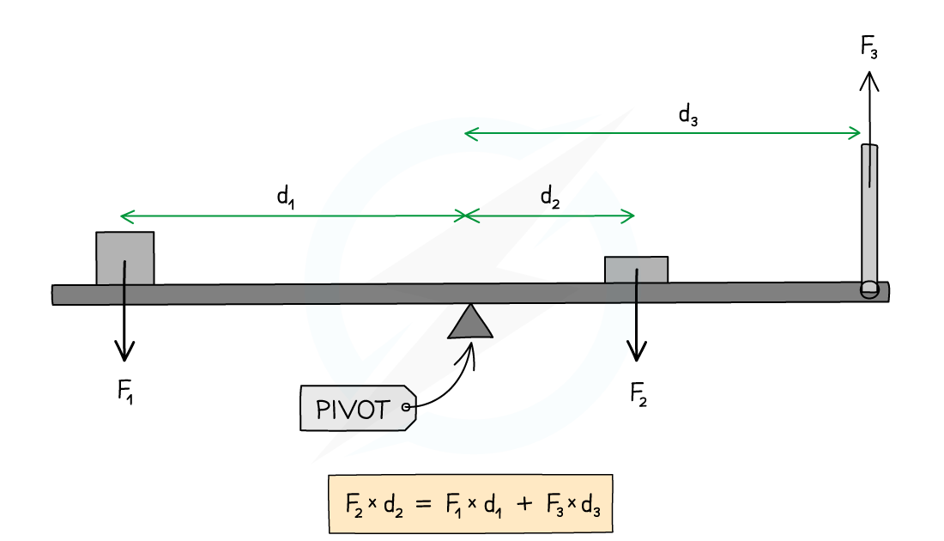
Moment
The principle of moments states that when the clockwise moments are equal to the anticlockwise moments a body will be in equilibrium.

Slide 12
Moment
Calculate the force acting on the right side of the bridge
400kg
9m
28m
Notes:
https://www.savemyexams.com/igcse/physics/edexcel/19/revision-notes/1-forces-and-motion/1-4-moments/1-4-2-the-principle-of-moments/

Slide 13
Moment
A person is trying to open a door by applying a force of 50 N at a distance of 0.8 m from the hinges. What is the moment of the force?

Slide 14
Moment

