Slide 1
Work
Page 373
Unit 4 Energy resources and energy transfer

Slide 2
Energy
Energy: is the ability to do work, it is measured in joules
Types of energy storage:
Kinetic Energy
Chemical Energy
Gravitational Energy
Elastic Energy
Thermal Energy
Magnetic Energy
Electrostatic Energy
Nuclear Energy

Slide 3
Energy
Energy: is the ability to do work, it is measured in joules
Types of energy Transfer ←→ :
Mechanically
Electrically
By Heat
By radiation (sound, light)

Slide 4
Law of conservation of energy
Energy
Energy is not created nor destroyed but it is rather changed from one state to another

Slide 5
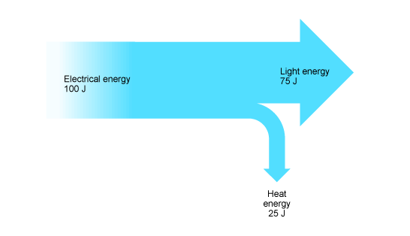
Sankey Diagrams
Energy
Page 376

Slide 6
Sankey Diagrams
Energy

Slide 7
Efficiency
Energy
$Efficiency= \frac{useful energy output}{Total energy output}$ x 100 %

Slide 8
Work
Page 38
Work: is the product of the force applied upon an object and the displacement that the object is moved.
Unit = Newton
Work = Force x displacement
Unit = meter

Slide 9
Work
Potential energy: is the energy stored by an object because of its position relative to other objects
Calculating for potential energy
Potential Energy = mass × gravitational force × height
mass in kg
is always 10 N/kg
in meters

Slide 10
Work
Potential energy: is the energy stored by an object because of its position relative to other objects
Calculating for potential energy:
PE
m
g
h

Slide 11
Work
Work: is the product of the force applied upon an object and the displacement that the object is moved.
W = F x d
Unit = Newton
Unit = meter
Unit of Work is Newton meter (Nm), also called Joule (J)

Slide 12
Work
Work: is the product of the force applied upon an object and the displacement that the object is moved.
So, 1 Newton meter = 1 Joule
Unit of Work is Newton meter (Nm), also called Joule (J)

Slide 13
Work
Work: is the product of the force applied upon an object and the displacement that the object is moved.
Quick example:
A student pushes a box for 8 meters with a force of 340 N, calculate the work done.

Slide 14
Work
Work: is the product of the force applied upon an object and the displacement that the object is moved.
Quick example:
A student pushes a box for 3 meters with a force of 720 N, calculate the work done.

Slide 15
Work
Work: is the product of the force applied upon an object and the displacement that the object is moved.
Quick example:
A student pushes a box for 0.22 meters with a force of 3000 N, calculate the work done.

Slide 16
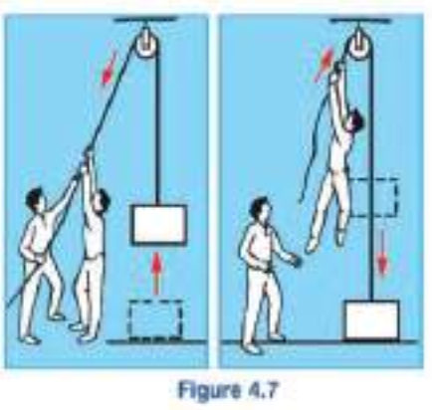
Work
Potential energy: is the energy stored by an object because of its position relative to other objects
Potential energy is stored and used, it depends on ¹the height of the object, and ²the weight of the object.

Slide 17
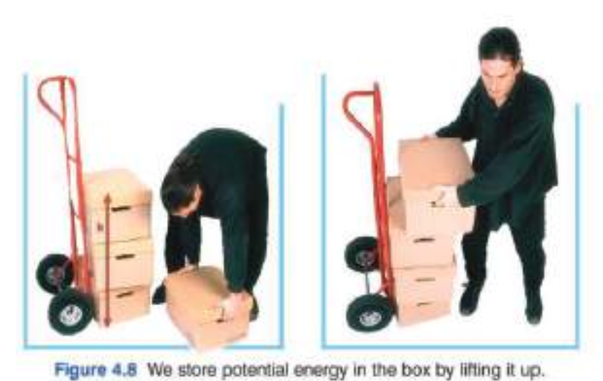
Work
Potential energy: is the energy stored by an object because of its position relative to other objects
Potential energy is stored and used, it depends on ¹the height of the object, and ²the weight of the object.

Slide 18
Work
Potential energy: is the energy stored by an object because of its position relative to other objects
Calculating for potential energy
Potential Energy = mass × gravitational force × height

Slide 19
Work
Potential energy: is the energy stored by an object because of its position relative to other objects
Calculating for potential energy:
PE = m g h

Slide 20
Work
Potential energy: is the energy stored by an object because of its position relative to other objects exercise
Calculating for potential energy:
a 46 kg box is raised 13 meters, calculate its potential energy in joules

Slide 21
Work
Potential energy: is the energy stored by an object because of its position relative to other objects exercise
Calculating for potential energy:
a 2 kilogram box is raised 67 meters, calculate its potential energy in joules

Slide 22
Work
Potential energy: is the energy stored by an object because of its position relative to other objects exercise
Calculating for potential energy:
a 2200 gram box is raised 8 meters, calculate its potential energy in joules

Slide 23
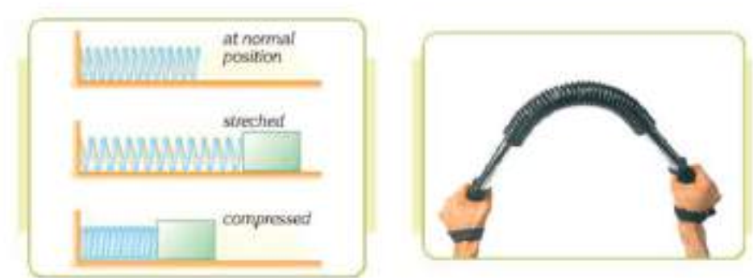
Work
Potential energy: is the energy stored by an object because of its position relative to other objects
Another example of potential energy is energy stored in a spring, when a spring is pressed or twisted, the energy is stored as potential energy

Slide 24
Work
Kinetic Energy (KE): The energy of an object due to its motion.
$$K E= \frac{1}{2}mv_{}^{2}$$
In m/s

Slide 25
Work
Kinetic Energy (KE): The energy of an object due to its motion.
$$K E= \frac{1}{2}mv_{}^{2}$$
In kg
KE
½ m
V²
In m/s

Slide 26
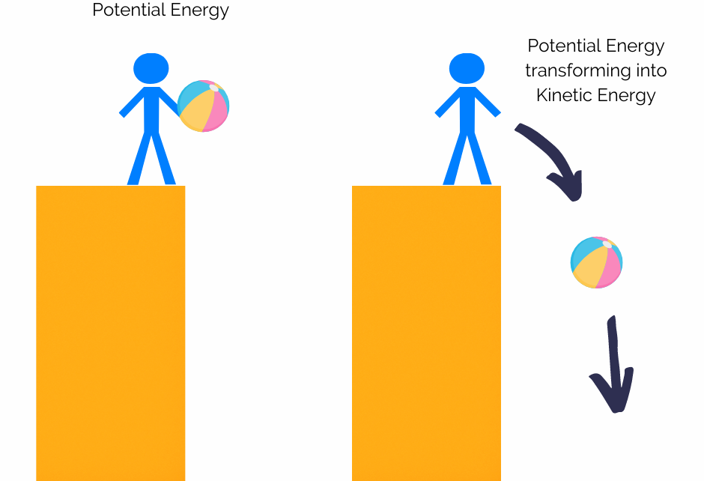
Kinetic Energy (KE):
The total energy of an object does not change, rather it is converted from kinetic to potential energy, or vice versa.

Slide 27
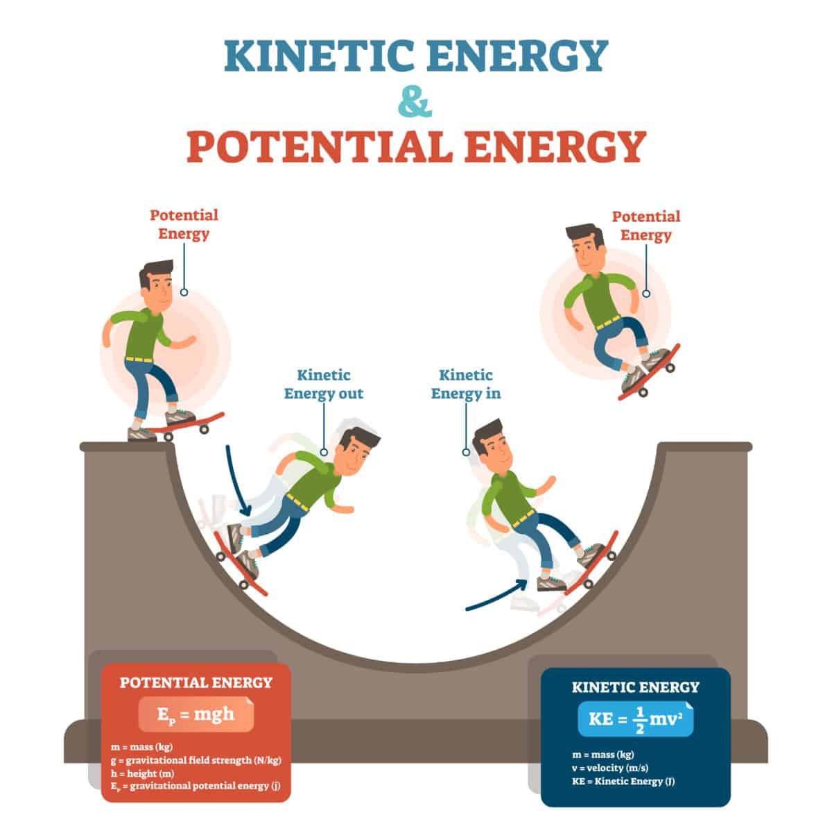
Kinetic Energy (KE):
The total energy of an object does not change, rather it is converted from kinetic to potential energy, or vice versa.

Slide 28
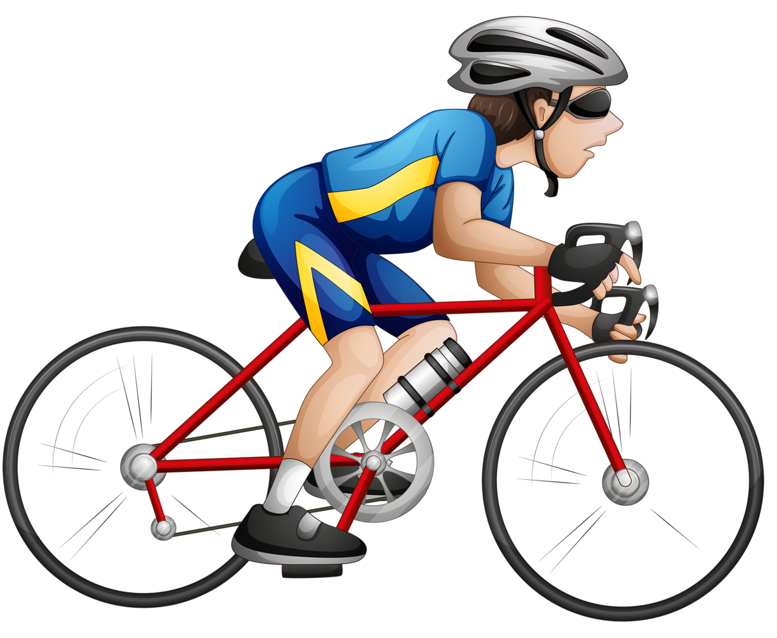
Kinetic Energy (KE):
Example1: a cyclist has a mass of 54 kg and moves at a speed of 5 m/s, find the kinetic energy in Joules.

Slide 29
Kinetic Energy (KE):
Example2: a skater moves down a ramp, his initial potential energy is 384 Joules, knowing his mass is 48 kg, find his speed at the bottom of the ramp.

Slide 30
Kinetic Energy (KE):
Example2: a skater moves down a ramp, his initial potential energy is 384 Joules, knowing his mass is 48 kg, find his speed at the bottom of the ramp.
Example3: a snowball rolls down a hill, its initial Potential energy is 768 J, and its speed was 16 m/s , find the mass.

Slide 31
Kinetic Energy (KE):
Example2: Which has higher kinetic energy ?
a 5 kg bowling ball rolls on an alley at 8 m/s
a 24 kg child is walking at 2 m/s,

Slide 32
Power
Work
Power: the amount of work done per unit of time or : the amount of energy spent per unit time
Power = $\frac{Work}{Time}$

Slide 33
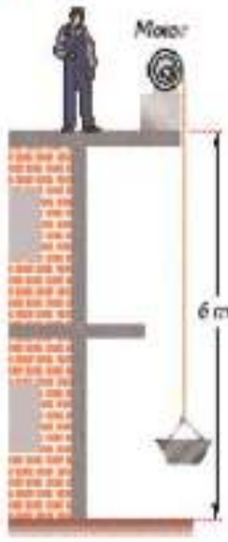
example
Work
A machine raises a 120 kg load up 6m in 5sec, calculate:
The work done
Calculate the power of the machine

