Slide 1
Worksheet
Graph the Following data for velocity vs time
Find the total distance covered during the first 6 seconds
Time (s) | velocity (m/s)
0 | 0
1 | 0.88
2 | 1.76
3 | 2.64
4 | 3.52
5 | 4.4
6 | 5.28

Slide 2
Worksheet
Graph the Following data for velocity vs time
Find the total distance covered during the first 6 seconds
Time (s) | velocity (m/s)
0 | 0
1 | 0.88
2 | 1.76
3 | 2.64
4 | 3.52
5 | 4.4
6 | 5.28

Slide 3
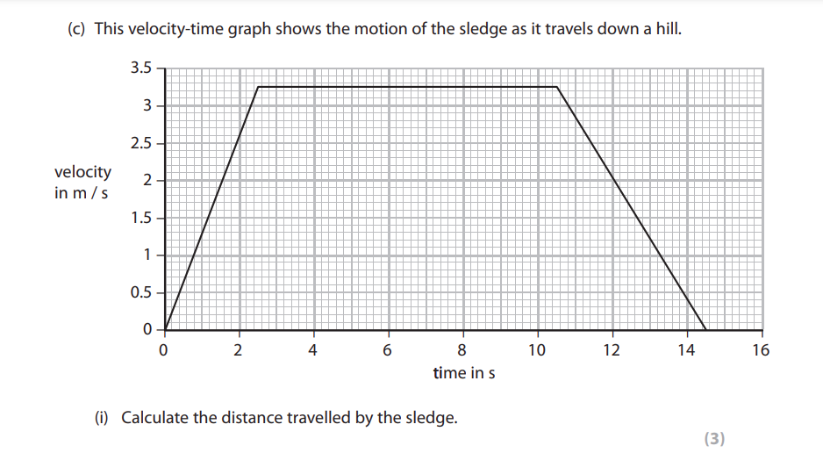
Worksheet

Slide 4
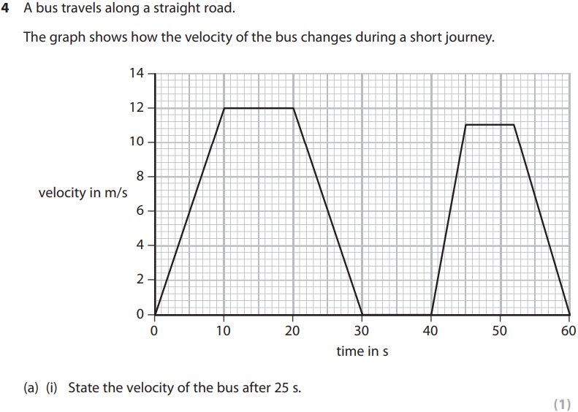
Worksheet
for how long will the bus be stationary during its journey ?

