Slide 1
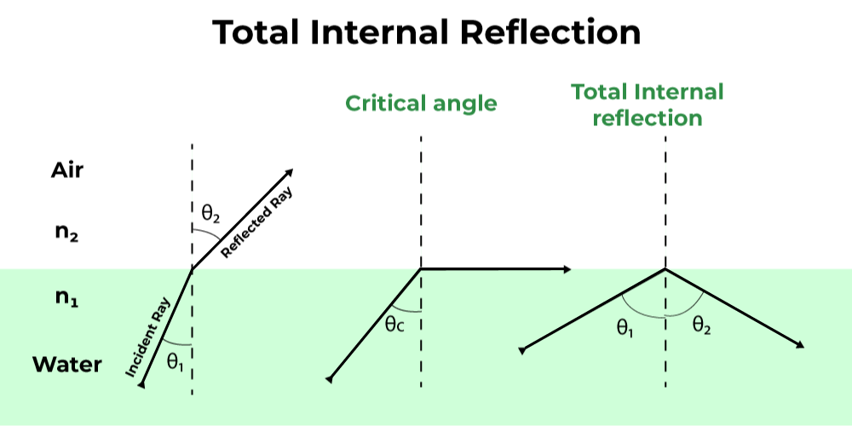
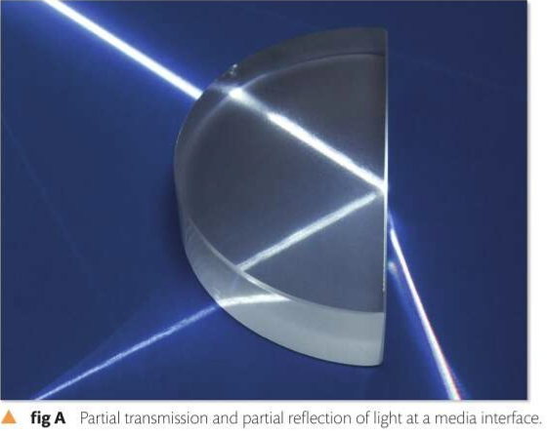
3C 2 Total internal refraction
Refraction: The change in direction of light as it passes between media of different optical densities
Some of the refracted wave energy is reflected
This depends on: amount of refraction + angle of incidence
https://phet.colorado.edu/en/simulations/bending-light
Notes:
When light passes between two media,some of it is refracted, some of it is reflected.

Slide 2
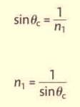
3C 2 Total internal refraction
Refraction: The change in direction of light as it passes between media of different optical densities
Some of the refracted wave energy is reflected
This depends on: amount of refraction + angle of incidence
$$θ_{2}=90°$$
$$θ_{1}>θ_{critical}$$
https://phet.colorado.edu/en/simulations/bending-light
Notes:
When light passes between two media,some of it is refracted, some of it is reflected.

Slide 3
3C 2 Total internal refraction
Critical angle: is the angle of incidence at which light traveling from one medium to another is bent at a 90-degree angle
$$θ_{2}=90°$$
$$θ_{1}>θ_{critical}$$
https://phet.colorado.edu/en/simulations/bending-light
Notes:
When light passes between two media,some of it is refracted, some of it is reflected.

Slide 4
3C 2 Total internal refraction
Example: knowing the critical angle of glass as 42° , calculate the index of refraction
https://phet.colorado.edu/en/simulations/bending-light
Notes:
When light passes between two media,some of it is refracted, some of it is reflected.

Slide 5
3C 2 Total internal refraction
Example: what is the critical angle of refraction of diamond, knowing its index of refraction is 2.3
Example: a prism made of fused quartz with an index of refraction of 1.55, calculate its critical angle
https://phet.colorado.edu/en/simulations/bending-light
Notes:
When light passes between two media,some of it is refracted, some of it is reflected.

Slide 6
3C 2 Total internal refraction
Example: what is the critical angle of refraction of diamond, knowing its index of refraction is 2.3
Example: a prism made of fused quartz with an index of refraction of 1.55, calculate its critical angle
https://phet.colorado.edu/en/simulations/bending-light
Notes:
When light passes between two media,some of it is refracted, some of it is reflected.

Slide 7
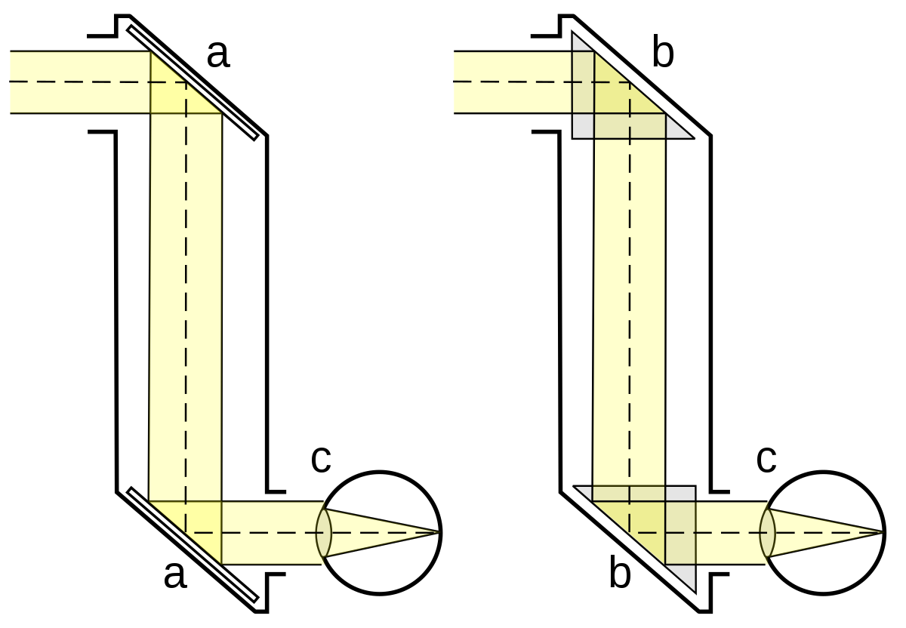
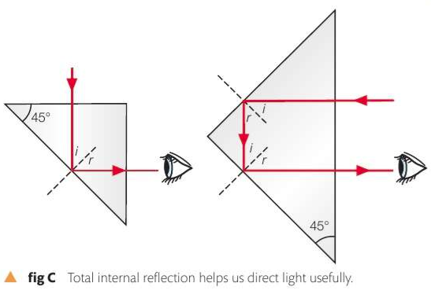
3C 2 Total internal refraction
Practical example: some periscopes are made using mirrors, other periscopes use prisms to reflect the light instead.
https://phet.colorado.edu/en/simulations/bending-light
Notes:
When light passes between two media,some of it is refracted, some of it is reflected.

Slide 8
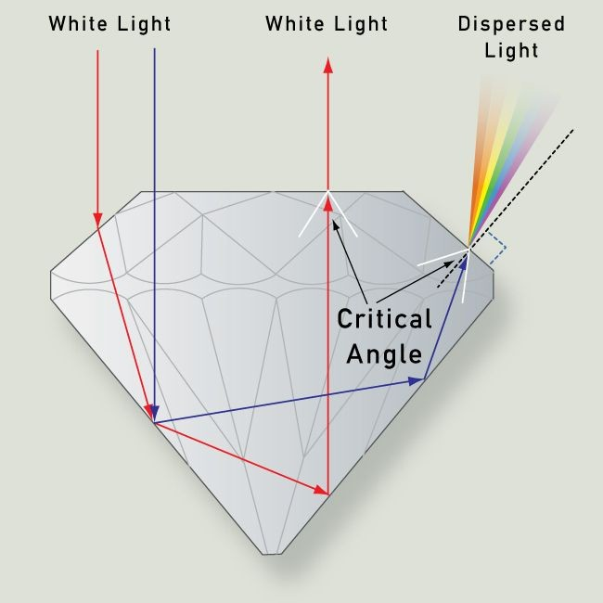
3C 2 Total internal refraction
Total internal refraction: occurs when light is directed from a medium having a higher index of refraction towards one having a lower index of refraction (ex. glass to air)
At exactly the critical angle, the light will travel along the boundary (90° to the normal)
At ϴi > ϴc , the light is entirely reflected
The sparkling of diamonds is due to T.I.R
Notes:
When light passes between two media,some of it is refracted, some of it is reflected.

Slide 9
Assumptions for T.I.R
3C 2 Total internal refraction
happens only when light passes from a denser material to a less dense material
Angle of incidence > critical angle
Two materials must have significantly different refractive indices
https://phet.colorado.edu/en/simulations/bending-light
Notes:
When light passes between two media,some of it is refracted, some of it is reflected.

Slide 10
Applications of T.I.R
3C 2 Total internal refraction
Fiber optics: a thin glass fiber with a higher index of refraction is surrounded by a cladding with lower index of refraction (less density)
https://phet.colorado.edu/en/simulations/bending-light
Notes:
When light passes between two media,some of it is refracted, some of it is reflected.

Slide 11
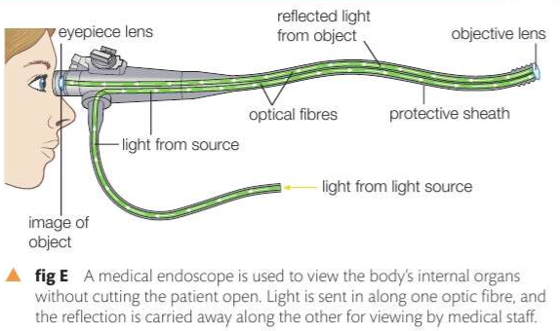
Applications of T.I.R
3C 2 Total internal refraction
Applications:
Medical endoscopy
Telecommunication
spectroscopy
https://phet.colorado.edu/en/simulations/bending-light
Notes:
When light passes between two media,some of it is refracted, some of it is reflected.

Slide 12
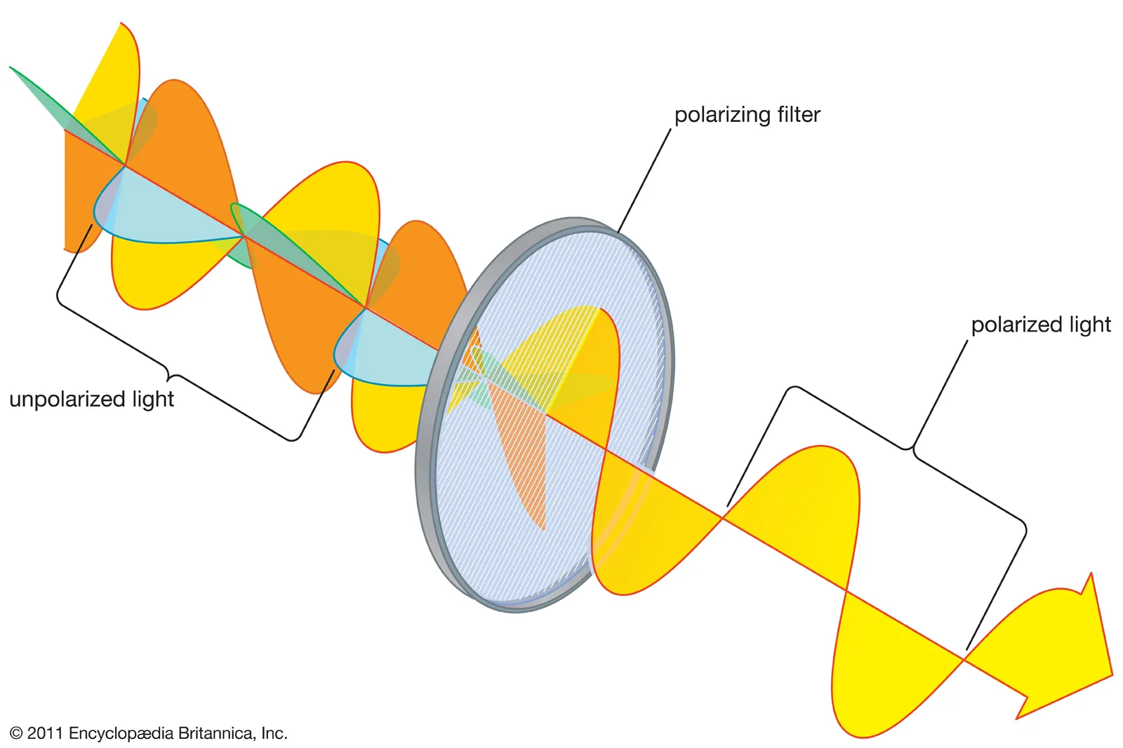
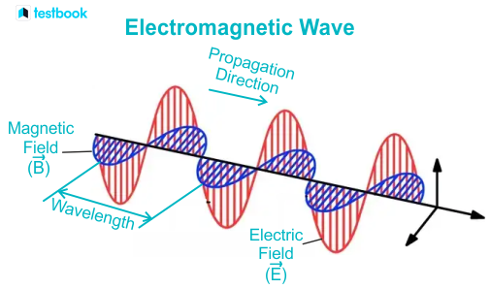
Polarisation of light
3C 3 Polarisation
EM waves are made of oscillating electric and magnetic fields
Polarization: is the orientation of the electric field vector of light as it propagates through space
Notes:
When light passes between two media,some of it is refracted, some of it is reflected.

Slide 13
Polarisation of light
3C 3 Polarisation
EM waves are made of oscillating electric and magnetic fields
Polarization: is the orientation of the electric field vector of light as it propagates through space
Notes:
When light passes between two media,some of it is refracted, some of it is reflected.

Slide 14
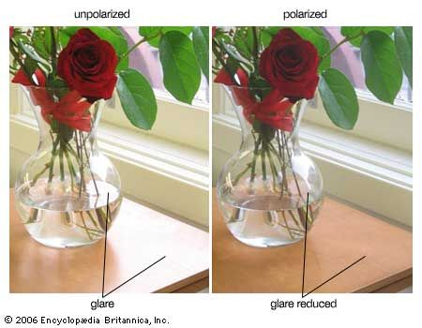
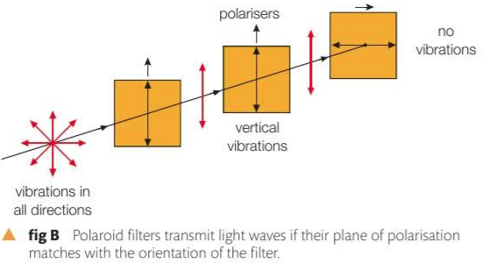
Polarisation of light
3C 3 Polarisation
Polarizing filters allows only one orientation of light to pass through
Notes:
When light passes between two media,some of it is refracted, some of it is reflected.

Slide 15
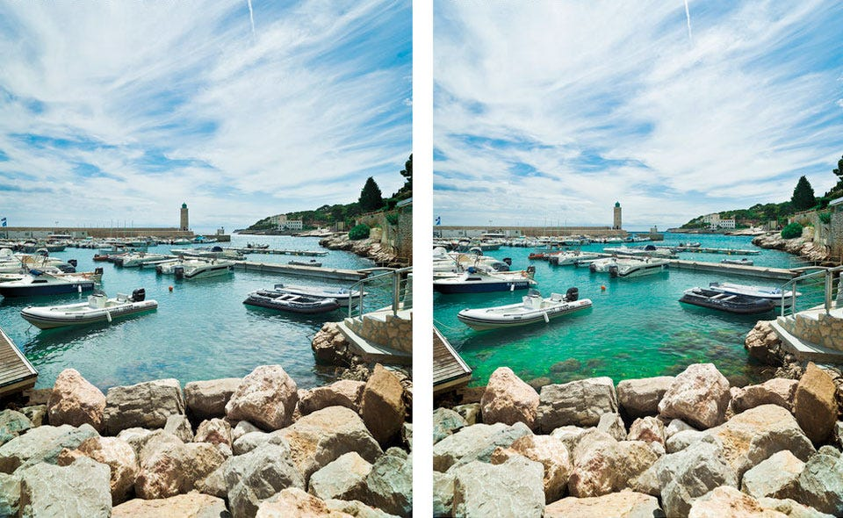
Polarisation of light
3C 3 Polarisation
Polarizing filters allows only one orientation of light to pass through
Notes:
When light passes between two media,some of it is refracted, some of it is reflected.

Slide 16
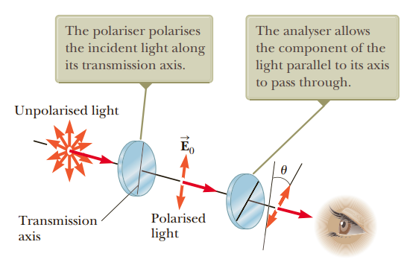
Polarisation of light
3C 3 Polarisation
Polarizing filters allows only one orientation of light to pass through
Notes:
https://petapixel.com/2017/03/10/use-polarized-lighting-techniques-capture-cool-color-effects/

Slide 17
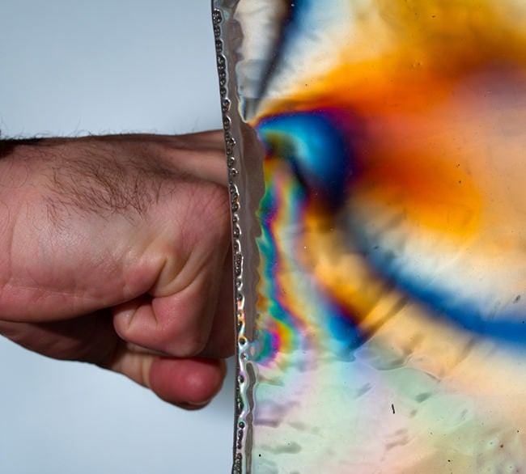
Polarisation of light
3C 3 Polarisation
Polarizing filters allows only one orientation of light to pass through
Notes:
https://petapixel.com/2017/03/10/use-polarized-lighting-techniques-capture-cool-color-effects/

Slide 18
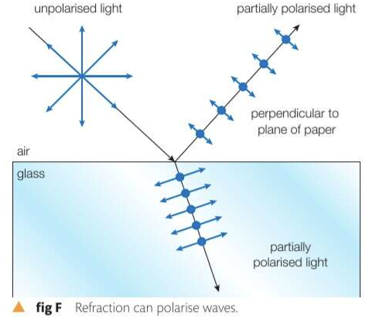
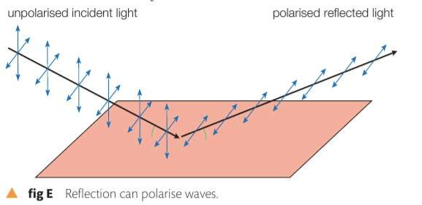
Polarisation of light
3C 3 Polarisation
Reflection: when light is reflected off a (especially smooth) surface it becomes polarized.
Notes:
https://petapixel.com/2017/03/10/use-polarized-lighting-techniques-capture-cool-color-effects/

Slide 19
Polarisation of light
3C 3 Polarisation
Polarizing filters allows only one orientation of light to pass through
Notes:
https://petapixel.com/2017/03/10/use-polarized-lighting-techniques-capture-cool-color-effects/

Slide 20
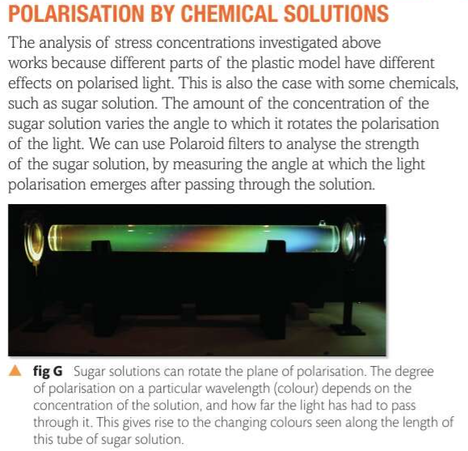
Polarisation of light
3C 3 Polarisation
Notes:
https://petapixel.com/2017/03/10/use-polarized-lighting-techniques-capture-cool-color-effects/

Slide 21
HW
3C 3 Polarisation
Discuss why do fishermen wear polarised glasses ?
Notes:
https://petapixel.com/2017/03/10/use-polarized-lighting-techniques-capture-cool-color-effects/

