Slide 1
STELLAR EVOLUTION
The universe has billions of galaxies and is mostly empty space
the universe is a large collection of billions of galaxies
a galaxy is a large collection of billions of stars
our Solar System is in the Milky Way galaxy.
https://scaleofuniverse.com/en

Slide 2
STELLAR EVOLUTION
The sun is the center of our solar system, it is a star that is 150,000,000 km away from earth
It is the largest object in our solar system
https://scaleofuniverse.com/en

Slide 3
STELLAR EVOLUTION
The sun is the center of our solar system, it is a star that is 150,000,000 km from earth
It is the largest object in our solar system
https://scaleofuniverse.com/en
Notes:
15M C

Slide 4
STELLAR EVOLUTION
Our solar system is a small part of our galaxy called the milky way
The milky way is a spiral galaxy
We are 2/3 out of way out of the galaxy
https://scaleofuniverse.com/en

Slide 5
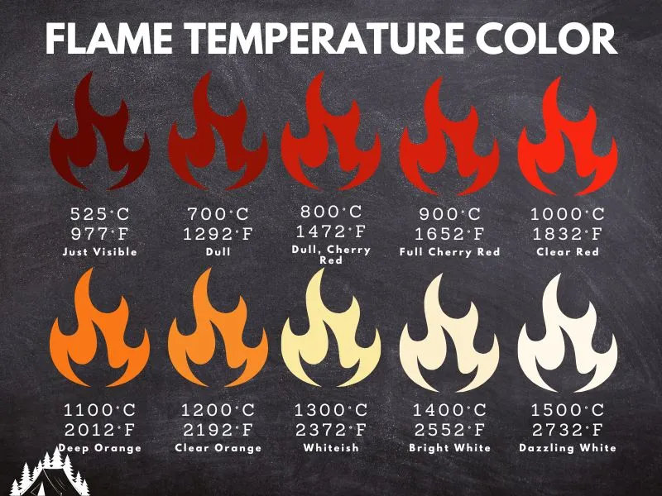
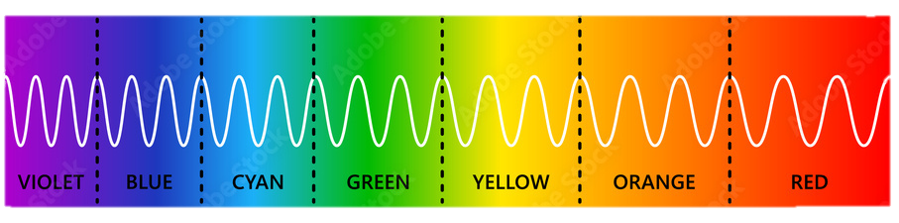
STELLAR EVOLUTION
_{Classifying stars:} stars can be classified according to their temperature (color), _{and their brightness(size)}
The brighter a star is, the larger and _{closer it is}
The hotter a star is the higher is its color temperature (emits higher energy colors)
800K 973K 1073K 1173K 1273K
1373K 1473K 1573K 1673K 1773K
https://scaleofuniverse.com/en

Slide 6
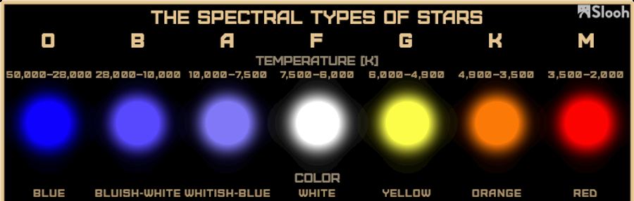
STELLAR EVOLUTION
_{Classifying stars:}
800K 973K 1073K 1173K 1273K
1373K 1473K 1573K 1673K 1773K
https://scaleofuniverse.com/en

Slide 7
STELLAR EVOLUTION
_{Classifying stars:}
800K 973K 1073K 1173K 1273K
1373K 1473K 1573K 1673K 1773K
https://scaleofuniverse.com/en
https://phet.colorado.edu/sims/html/blackbody-spectrum/latest/blackbody-spectrum_all.html

Slide 8
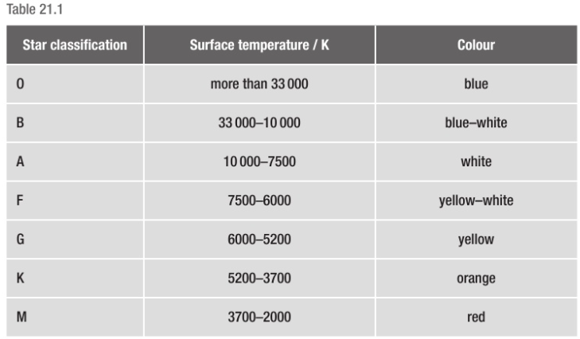
STELLAR EVOLUTION
_{Classifying stars:}
800K 973K 1073K 1173K 1273K
1373K 1473K 1573K 1673K 1773K
https://scaleofuniverse.com/en

Slide 9
STELLAR EVOLUTION
Stars are formed from dust and gas forming a nebulae, these are compressed by the force of gravity to form a star.
Gravity pulls these particles together tightly increasing temperature and pressure
As a result, Nuclear fusion happens and releases energy
https://scaleofuniverse.com/en

Slide 10
STELLAR EVOLUTION
Stars are formed from dust and gas forming a nebulae, these are compressed by the force of gravity to form a star.
Gravity pulls these particles together tightly increasing temperature and pressure
As a result, Nuclear fusion of Hydrogen to Helium starts and releases energy
https://scaleofuniverse.com/en

Slide 11
STELLAR EVOLUTION
Life of a star: a young star is called a main sequence star, it has a balance of two forces (gas expansion, and gravity) , it is in its main stable period. (sun is an example)
At the end of main sequence H is exhausted, gravity is stronger and forces the star into a smaller size, yielding higher temperatures to fuse Helium
This causes the star to then expand to a red giant, emitting lower energy red light
https://scaleofuniverse.com/en

Slide 12
STELLAR EVOLUTION
Late life of a star: after Helium fuses to heavier elements, gravity becomes stronger compressing the star into a smaller size called a white dwarf
This causes a high increase in temperature, the star emits whiteish blue light
White dwarfs are very dense stars
https://scaleofuniverse.com/en

