Slide 2
SOLID MATERIAL PROPERTIES
HOOKE’S LAW: the strain of the material is proportional to the applied stress within the elasticity limit.
The extension or compression of a material is proportional to the applied force on it within the elasticity limit of the material
F = k x
Notes:
Applied force, K = constant of expansion , x = STRAIN , first extension in meters (delta L) = Lfinal – L initial
X in units of N/m
The value of k is a measure of the stiffness of the spring

Slide 3
SOLID MATERIAL PROPERTIES
HOOKE’S LAW: the strain of the material is proportional to the applied stress within the elasticity limit.
F = k x
Force
Strain
Coefficient of expansion
Notes:
Applied force, K = constant of expansion , x = extension in meters (delta L) = Lfinal – L initial
X in units of N/m

Slide 4
SOLID MATERIAL PROPERTIES
HOOKE’S LAW: the strain of the material is proportional to the applied stress within the elasticity limit.
F = k x
How are strain and force correlated ?
Notes:
Applied force, K = constant of expansion , x = extension in meters (delta L) = Lfinal – L initial
X in units of N/m

Slide 5
SOLID MATERIAL PROPERTIES
HOOKE’S LAW: the strain of the material is proportional to the applied stress within the elasticity limit.
F = k x
What is the unit of k ?
Notes:
Applied force, K = constant of expansion , x = extension in meters (delta L) = Lfinal – L initial
X in units of N/m

Slide 6
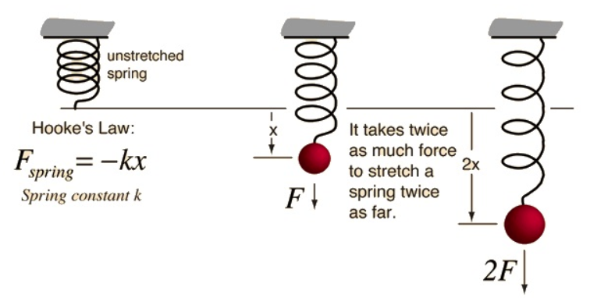
SOLID MATERIAL PROPERTIES
HOOKE’S LAW: the strain of the material is proportional to the applied stress within the elasticity limit.
Notes:
Applied force, K = constant of expansion , x = extension in meters (delta L) = Lfinal – L initial
X in units of N/m

Slide 7
SOLID MATERIAL PROPERTIES
HOOKE’S LAW: the strain of the material is proportional to the applied stress within the elasticity limit.
Notes:
Applied force, K = constant of expansion , x = extension in meters (delta L) = Lfinal – L initial
X in units of N/m

Slide 8
SOLID MATERIAL PROPERTIES
Practice: A spring has a spring constant (k) of 500 N/m. How much force is required to stretch the spring by 0.02 meters?
Notes:
Applied force, K = constant of expansion , x = extension in meters (delta L) = Lfinal – L initial
X in units of N/m

Slide 9
SOLID MATERIAL PROPERTIES
Practice: A spring follows Hooke's Law up to the elastic limit. If a spring has a spring constant of 400 N/m and an elastic limit of 0.05 meters, calculate the maximum force that can be applied to the spring before it stops obeying Hooke's Law.
Notes:
Applied force, K = constant of expansion , x = extension in meters (delta L) = Lfinal – L initial
X in units of N/m
Bonus : calculate the work done

Slide 10
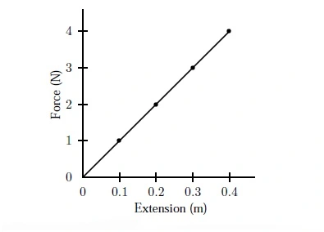
SOLID MATERIAL PROPERTIES
F = k x Graph:
Elasticity limit
Notes:
Bonus : calculate the work don

Slide 11
SOLID MATERIAL PROPERTIES
F = k x Graph:
Notes:
What is the area under the curve ?

Slide 12
SOLID MATERIAL PROPERTIES
Elastic potential energy: the energy (work done) stored in a spring , it is measured in Joules
$$EPE= \frac{1}{2} k x²$$
Assumption: it follows Hooke’s law within elasticity limits
Notes:
X = the displacement in meters
K is in n/m
Y = F/A // DeltaL / L0

