Slide 2
SUVAT
Page 50
SUVAT eqns. are equations that describe the motion of objects under constant acceleration
S - distance
u – initial speed
v – final speed
a - acceleration
t - time
SUVAT equation | Quantity not used
v = u + at | distance
s = $\frac{(u+v)}{2}$ t | acceleration
s = ut +$\frac{1}{2}$ a t² | final velocity
V² = u² + 2as | time
Similar to s = v x t
* Falling objects have an acceleration of 9.8 m/s²

Slide 3
SUVAT
Page 50
SUVAT eqns. are equations that describe the motion of objects under constant acceleration
S - distance
u – initial speed
v – final speed
a - acceleration
t - time
SUVAT equation | Quantity not used
v = u + at | distance
s = $\frac{(u+v)}{2}$ t | acceleration
s = ut +$\frac{1}{2}$ a t² | final velocity
V² = u² + 2as | time
Similar to s = v x t
* Falling objects have an acceleration of 9.8 m/s²

Slide 4
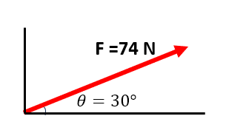
Resolving vectors _{p32}

Slide 5
Resolving vectors _{p32}
To find the horizontal component x , use Fx = F s$inθ$
Fx = 74 x sin(30)
= 74 x 0.5 = 37 N
F =74 N
$$θ=30°$$

Slide 6
Resolving vectors _{p32}
To find the horizontal component x , use Fx = F s$inθ$
Fx = 74 x sin(30)
= 74 x 0.5 = 37 N
F =74 N
$$θ=30°$$

Slide 7
Resolving vectors _{p32}
To find the horizontal component x , use Fx = F s$inθ$
Fx = 74 x sin(30)
= 74 x 0.5 = 37 N
F =74 N
$$θ=30°$$
To find the vertical component x , use Fx = F c$osθ$

Slide 8
Resolving vectors _{p32}
To find the horizontal component x , use Fx = F s$inθ$
Fx = 74 x sin(30)
= 74 x 0.5 = 37 N
F =74 N
$$cos$$
$$θ=30°$$
To find the Vertical component x , use Fx = F c$osθ$
Fy = 74 x cos(30) = 74 * 0.866 = 64 N
$$sin$$

Slide 9
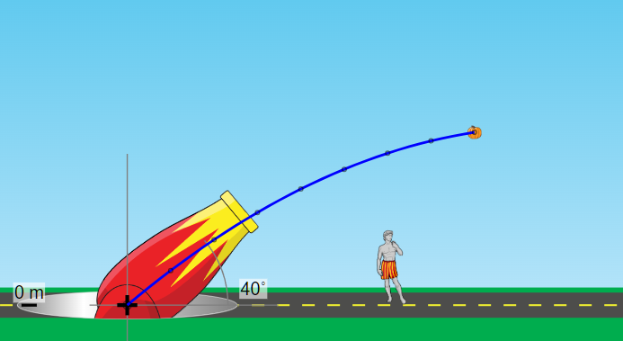
Resolving vectors _{p32}
Example: a cannon shoots a pumpkin at an angle of 40$°$ with a velocity of 18 m/s , calculate: - its horizontal velocity - its vertical velocity

Slide 10
Resolving vectors _{p32}
Example: a cannon shoots a pumpkin at an angle of 40$°$ with a velocity of 18 m/s , calculate: - its horizontal velocity - its vertical velocity
Hint:
Sin40$°$ = 0.642
Cos40$°$ = 0.766

Slide 11
Resolving vectors _{p32}
exercise: a cannon shoots a pumpkin at an angle of 70$°$ with a velocity of 15 m/s , calculate: - its horizontal velocity - its vertical velocity
Hint:
Sin70$°$ = 0.939
Cos70$°$ = 0.342

