Slide 1
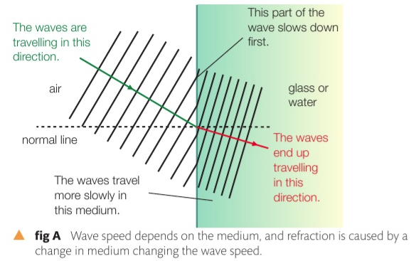
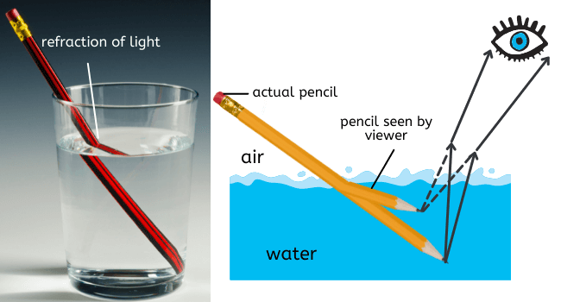
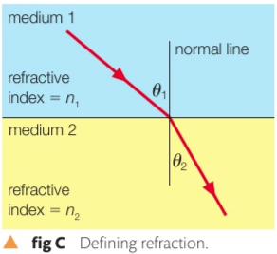
3C Refraction of light
Refraction: The change in direction of light as it passes between media of different optical densities
Light bends direction as it moves from different density media
c = speed of light in vacuum = $3 ×{10}_{}^{8}$m/s
Notes:
Light refracts because the speed in the more optically dense medium is slower,

Slide 2
3C Refraction of light
Refraction: The change in direction of light as it passes between media of different optical densities because its speed changes.
c = speed of light in vacuum = $3 ×{10}_{}^{8}$m/s
$$n_{1}^{}{sinϴ}_{1}^{}=n_{2}^{}{sinϴ}_{2}^{}$$
Sin of the angle of refraction
Index of refraction of 1st medium
Index of refraction of 2nd medium
Notes:
Called snell’s law

Slide 3
3C Refraction of light
Refraction: The change in direction of light as it passes between media of different optical densities
Index of refraction: is how much slower the light is in that medium compared to vacuum.
$n_{1}^{}{sinϴ}_{1}^{}=n_{2}^{}{sinϴ}_{2}^{}$
n=$\frac{speed of light in vacuum}{speed of light in medium}$ = $\frac{3 ×{10}_{}^{8} \text{m}\text{/}\text{s}}{speed of light in medium}$
*n can’t be smaller than 1.00
Notes:
The best gap is the same size as the wavelength

Slide 4
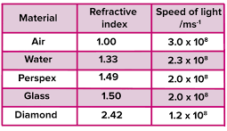
3C Refraction of light
Refraction: The change in direction of light as it passes between media of different optical densities
Index of refraction: is how much slower the light is in that medium compared to vacuum.
$n_{1}^{}{sinϴ}_{1}^{}=n_{2}^{}{sinϴ}_{2}^{}$
n=$\frac{speed of light in vacuum}{speed of light in medium}= \frac{c}{v}$
Notes:
The best gap is the same size as the wavelength.
V = f/ lambda

Slide 5
3C Refraction of light
Optical density = Index of refraction: is how much slower the light is in that medium compared to vacuum.
$n_{1}^{}{sinϴ}_{1}^{}=n_{2}^{}{sinϴ}_{2}^{}$
n=$\frac{speed of light in vacuum}{speed of light in medium}= \frac{c}{v}$

Slide 6
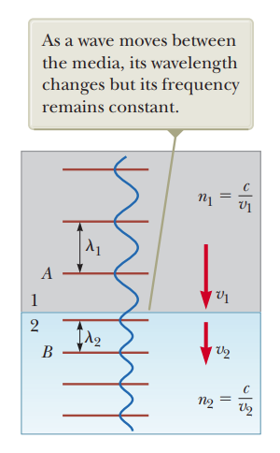
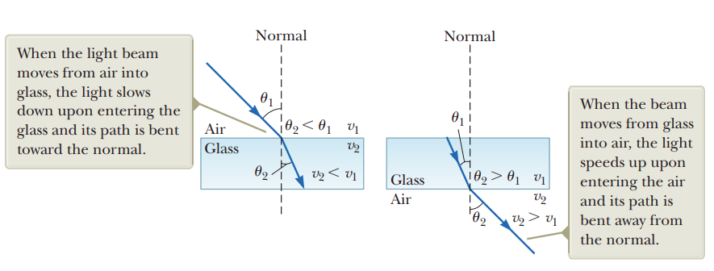
3C Refraction of light
Notes:
The speed becomes slower too

Slide 7
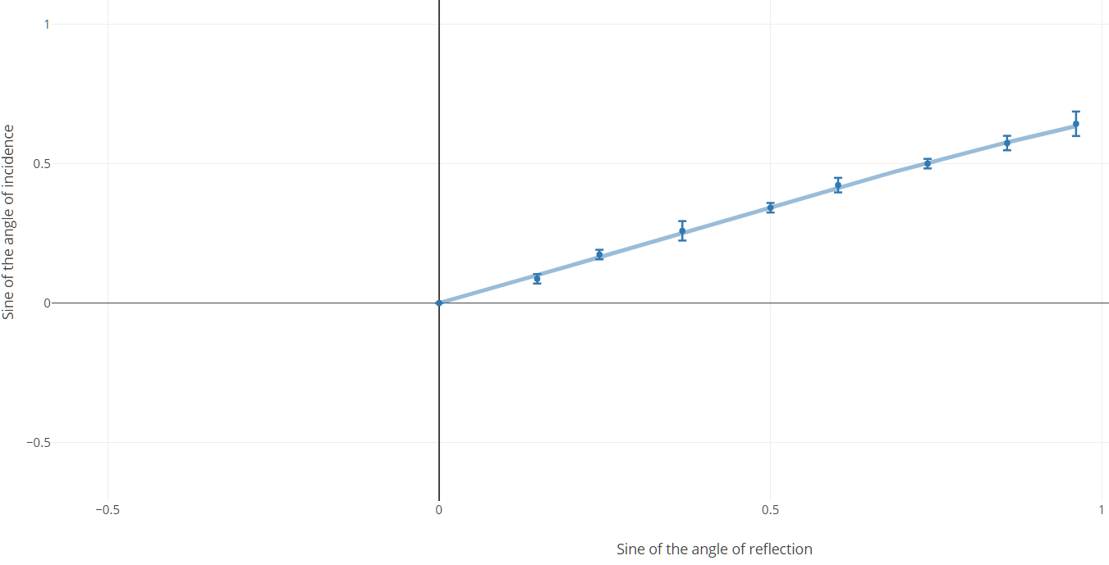
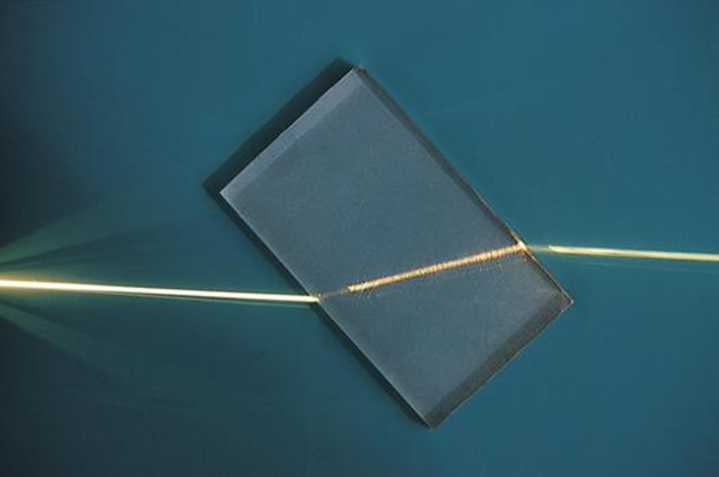
3C Refraction of light
There’s a linear relation between ${sinϴ}_{1}^{}$ and ${sinϴ}_{2}^{}$ $The gradient of{sinΘ}_{1}^{}$ and ${sinΘ}_{2}^{}$ yields the index of refraction
https://chart-studio.plotly.com/~timtjtim/51.embed
Notes:
STUDENT MUST WRITE THIS IN THEIR NOTES
Light usually bends inwards when going from lower to higher density media, outward from higher to lower density media

Slide 8
3C Refraction of light
A light ray fell from air on the water surface in an incidence angle of (60°) and its refraction angle in water was (40.5°), find the index of refraction of water?
Notes:
1 * sin 60 = sin40 * n2
1.33
Light usually bends inwards when going from lower to higher density media, outward from higher to lower density media

Slide 9
3C Refraction of light
Notes:
Do checkpoint questions first after this

Slide 10
Assumptions
3C Refraction of light
Diffraction angle is measured from the normal line, not the horizontal surface
The light rays are assumed to be parallel and with the same frequency
Air has index of refraction = 1
Mediums are truly transparent
Notes:
But n = c/ v , and v = flambda . Using cross multiplication, we can relate the wavelength of light with

Slide 11
Assumptions: how do we reduce measurement errors in practical
3C Refraction of light
Use accurate instruments
Use a consistent coherent light source (example, a laser)
Repeat measurements several times
Reduce vibration
Measure in a dark room
Notes:
But n = c/ v , and v = flambda . Using cross multiplication, we can relate the wavelength of light with

Slide 12
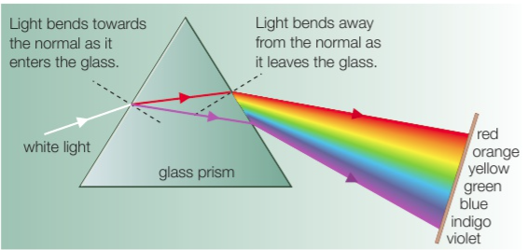
3C Refraction of light
Light dispersion through a prism
$$n_{1}^{}{sinϴ}_{1}^{}=n_{2}^{}{sinϴ}_{2}^{}$$
Notes:
But n = c/ v , and v = flambda . Using cross multiplication, we can relate the wavelength of light with

