Slide 1
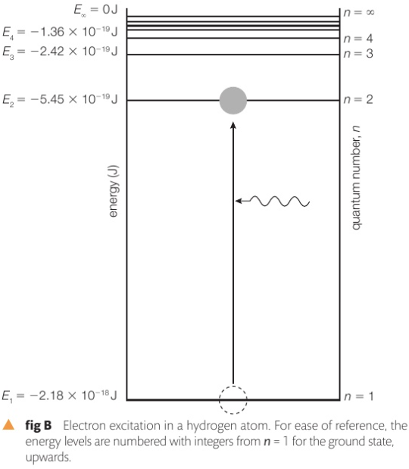
3D.4 Quantum Physics
Atoms have orbitals of varying energy levels, for electrons to rise from an energy level to a higher one, work (energy) must be supplied
The orbital levels are in discrete levels (n)
The lowest orbital is called the ground state (n=1)
The photon energy must be exactly equal to a discrete level for the electron to move to a higher level
Else, the photon will not be absorbed
The downward transition of an electron involves emission of a photon
e
Notes:
Lowest one is called ground state,
Excitation is when the electron takes up some energy, then goes to a higher level,
P 141
For ground state to
So just like standing waves, you can have discrete number of nodes and antinodes…

Slide 2
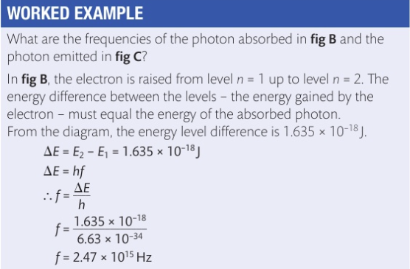
3D.4 Quantum Physics
e
Notes:
Lowest one is called ground state,
Excitation is when the electron takes up some energy, then goes to a higher level,
P 141
* For ground state to 2.18E-18 – 5.45E-19 , then use E = hf

Slide 3
3D.4 Quantum Physics
e
Notes:
Lowest one is called ground state,
Excitation is when the electron takes up some energy, then goes to a higher level,
P 141
* For ground state to 2.18E-18 – 5.45E-19 , then use E = hf

Slide 4
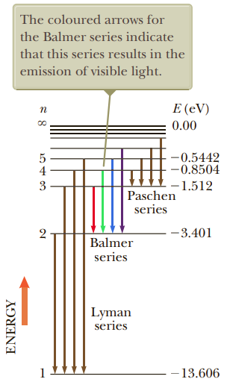
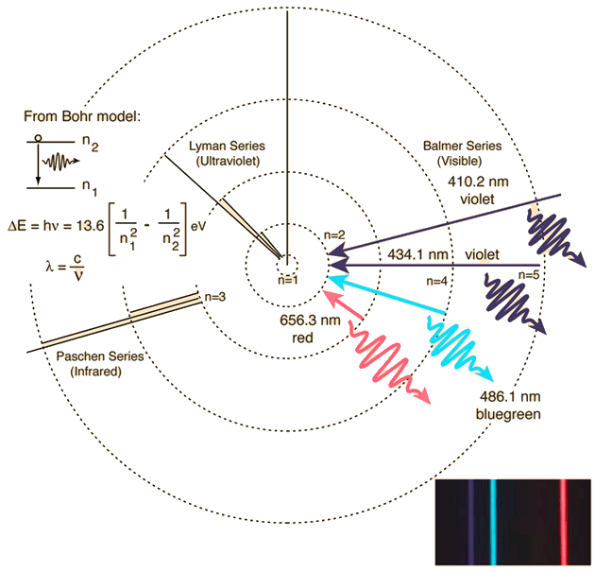
3D.4 Quantum Physics
Appreciation: Hydrogen energy levels
Notes:
Lowest one is called ground state,
Excitation is when the electron takes up some energy, then goes to a higher level,
P 141
* For ground state to

Slide 5
3D.4 Quantum Physics
Example: an electron in a hydrogen atom makes a transition from the n=2 energy level to the ground level (n=1). Find the wavelength and frequency of the emitted photon.
Notes:
Lowest one is called ground state,
Excitation is when the electron takes up some energy, then goes to a higher level,
P 141
* For ground state to

Slide 6
3D.4 Quantum Physics
Example: an electron in a hydrogen atom makes a transition from the n=2 energy level to the ground level (n=1). Find the wavelength and frequency of the emitted photon.
First, let’s find the energy difference
13.606 – 3.401 = 10.205 eV
E = hf
$f= \frac{(10.205 eV ×1.602×{10}_{}^{−19} J/eV)}{6.63×{10}_{}^{−34} J s}= 2.46 ×{10}_{}^{15} Hz$
$λ= \frac{3 × {10}_{}^{8}}{2.46 ×{10}_{}^{15}}$ = 122 nm
Notes:
Lowest one is called ground state,
Excitation is when the electron takes up some energy, then goes to a higher level,
P 141
* For ground state to

Slide 7
3D.4 Quantum Physics
Example: an electron in a hydrogen atom makes a transition from the n=2 energy level to the ground level (n=1). Find the wavelength and frequency of the emitted photon.
First, let’s find the energy difference
13.606 – 3.401 = 10.205 eV
E = hf
$f= \frac{(10.205 eV ×1.602×{10}_{}^{−19} J/eV)}{6.63×{10}_{}^{−34} J s}= 2.46 ×{10}_{}^{15} Hz$
$λ= \frac{3 × {10}_{}^{8}}{2.46 ×{10}_{}^{15}}$ = 122 nm
Notes:
Lowest one is called ground state,
Excitation is when the electron takes up some energy, then goes to a higher level,
P 141
* For ground state to

Slide 8
3D.4 Quantum Physics
Example: an electron in a hydrogen atom makes a transition from the n=2 energy level to the ground level (n=1). Find the wavelength and frequency of the emitted photon.
First, let’s find the energy difference
13.606 – 3.401 = 10.205 eV
E = hf
$f= \frac{(10.205 eV ×1.602×{10}_{}^{−19} J/eV)}{6.63×{10}_{}^{−34} J s}= 2.46 ×{10}_{}^{15} Hz$
$λ= \frac{3 × {10}_{}^{8}}{2.46 ×{10}_{}^{15}}$ = 122 nm
13.606 eV is the energy required to ionize the Hydrogen atom (the electron has left the H+) , how many Joules is that ?
Notes:
Lowest one is called ground state,
Excitation is when the electron takes up some energy, then goes to a higher level,
P 141
* For ground state to

Slide 9
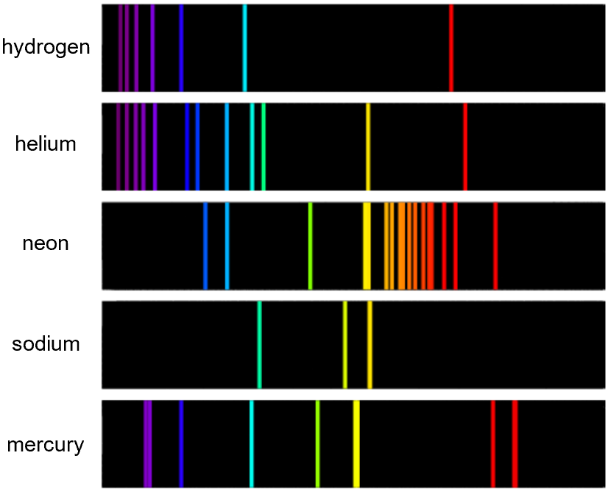
3D.4 Quantum Physics
Line spectra: Light is made of multiple wavelengths, we can obtain spectral line by exciting a gas
Notes:
Lowest one is called ground state,
Excitation is when the electron takes up some energy, then goes to a higher level,
P 141
* For ground state to

Slide 10
3D.4 Quantum Physics
Intensity of radiation:
Any emitter of light has an intensity
$Intensity \left(in \frac{Watt}{m^{2}}\right)=\frac{Power\left(W\right)}{area m²}$
Notes:
Lowest one is called ground state,
Excitation is when the electron takes up some energy, then goes to a higher level,
P 141
* For ground state to

