Slide 1
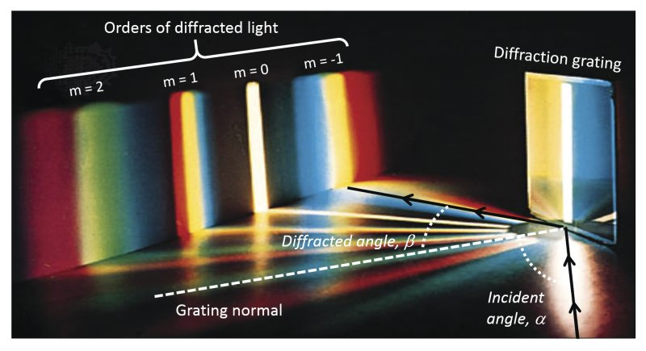
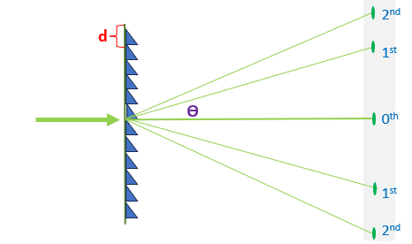
3D Quantum Physics
Review
Different wavelengths of light diffract at different angles
Shorter wavelengths diffract less and have shorter gaps between them
Notes:
This is a revision of diffraction in light. Today we’ll talk about diffraction of electrons
Unfortunately, we can’t just use v = f lambda with electrons

Slide 2
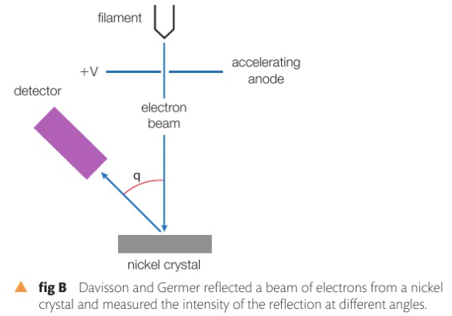
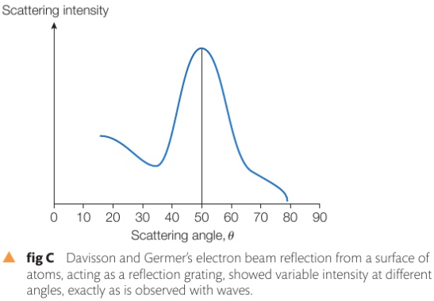
3D Quantum Physics
De Broglie’s wave hypothesis states that particles of matter moving under the right conditions may behave like a wave.
Notes:
Davisson germer experiment, shone a beam of electrons at a nickel crystal and the electrons diffracted in a way and at specific angles, the diffraction has shown that electrons behave as particles, and they were able to calculate (maximas and minimas) and conduct crystallography

Slide 3
3D Quantum Physics
Louis De Broglie’s wavelength: the wavelength of the particle (wave):
$\text{λ}=\frac{h}{p}$ = $\frac{6.63 ×{10}_{}^{−34}}{9.11×{10}_{}^{−31} × v }$
Planck’s constant
Wavelength in m
momentum of an electron = mass $×$ speed
Notes:
Electrons aren’t purely waves, cause they’re particles that can behave as waves and vice versa
The faster the electron the shorter is its wavelength.
How do we accelerate electrons

Slide 4
3D Quantum Physics
Louis De Broglie’s wavelength: the wavelength of the particle (wave):
Notes:
Page 138.

Slide 5
3D Quantum Physics
Louis De Broglie’s wavelength: the wavelength of the particle (wave).
Example: what is the De Broglie’s wavelength of a proton travelling at 10% the speed of light mass of a proton =1.67 × 10⁻²⁷ kilograms
Notes:
Page 138.

Slide 6
3D Quantum Physics
Louis De Broglie’s wavelength: the wavelength of the particle (wave).
Example: what is the De Broglie’s wavelength of a proton travelling at 10% the speed of light mass of a proton =1.67 × 10⁻²⁷ kilograms
$\text{λ}=\frac{h}{p}$ = $\frac{6.63 ×{10}_{}^{−34}}{\text{1.67 × 10}\text{-27}×0.1× \text{3}\text{ × 10} \text{8}}$ = 1.32 $\text{× 10 }\text{-14}$ m
Notes:
Page 138.

Slide 7
3D Quantum Physics
Electron diffraction
Notes:
Electrons aren’t purely waves, cause they’re particles that can behave as waves and vice versa

Slide 8
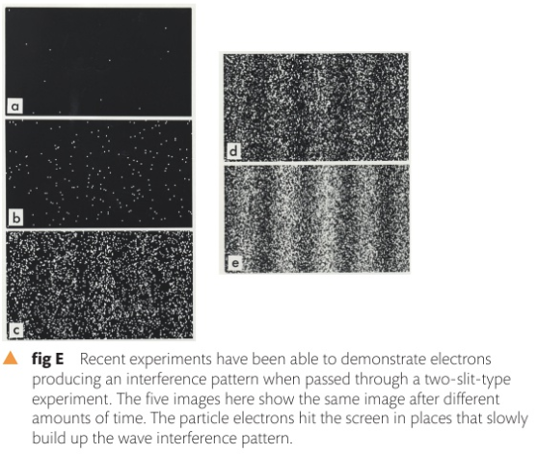
3D Quantum Physics
Electrons can behave as waves
Notes:
Inb 1965, Feynman suggested electrons could produce 2 slit patterns just like light. They show wave-particle duality

Slide 9
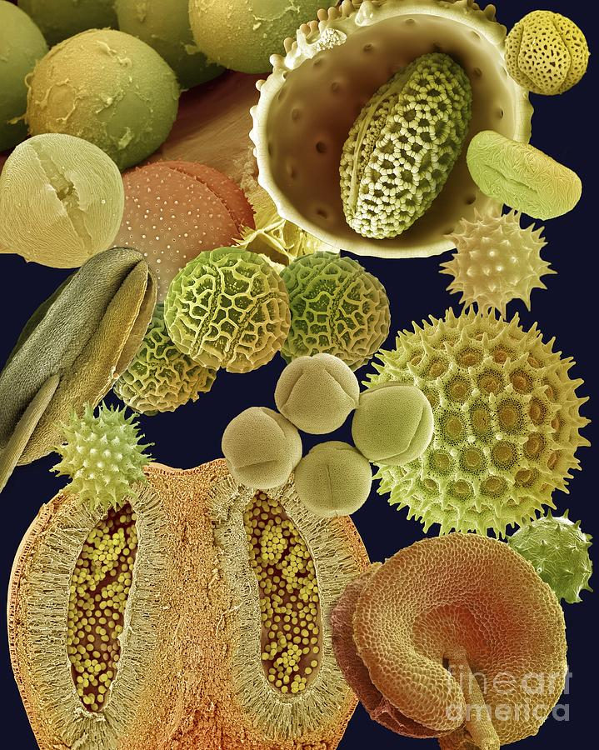
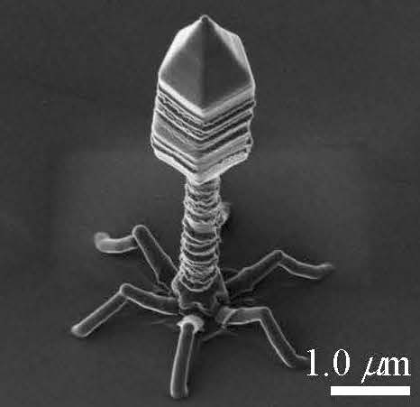
3D Quantum Physics
Scanning Electron microscope:
Electrons can behave as light with very short wavelength, this makes them much more useful in microscopy.
By adjusting the voltage of the SEM , we can obtain electron wavelengths in the sub-nanometer range and thus can observe infinitesimally small objects.
The minimum sized object that can that can be imaged by a wave must be at least same size as the wavelength
Notes:
Inb 1965, Feynman suggested electrons could produce 2 slit patterns just like light. They show wave-particle duality

Slide 10
3D Quantum Physics
Assumptions:
The faster an electron is travelling ,the shorter is its wavelength (more frequency)
Electrons are deflected by magnetic fields
Electrons are accelerated using electric fields
De Broglie’s wavelengths applies only to very small moving particles
Notes:
Electrons aren’t purely waves, cause they’re particles that can behave as waves and vice versa
https://science.cleapss.org.uk/Resource-Info/Bulletin-144-Summer-2012.aspx
Larger particles do not satisfy Heisenberg;s uncertainty principle

Slide 11
3D Quantum Physics
Think about it:
A proton, an electron, and a helium particle are moving with a speed v, which one has the largest de Broglie’s wavelength ?
Why is an electron microscope more suitable than an optical microscope for ‘seeing’ objects less than 1 µm in size?
If all matter has a wave-like nature, why is this wave-like characteristic not observable in our daily experiences?
Notes:
Checkpoint questions
higher energy and momentum result in a shorter de Broglie wavelength, allowing electrons to probe structures on a smaller scale (increases resolution).
Why don’t students diffract noticeably when they walk through a doorway?

Slide 12
3D Quantum Physics
Notes:
Checkpoint questions
higher energy and momentum result in a shorter de Broglie wavelength, allowing electrons to probe structures on a smaller scale (increases resolution).
Why don’t students diffract noticeably when they walk through a doorway?

