Slide 1
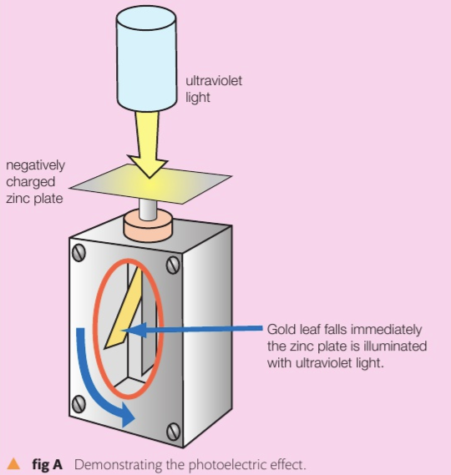
3D Quantum Physics
There’s a certain amount of energy needed for the photoelectrons to escape the surface of a metal, it is called the work function Φ.
If the energy of the photon carries more energy than the work function, the remaining energy will be transferred as kinetic energy to the photoelectron
6 eV
2 eV of KE
4 eV
e

Slide 2
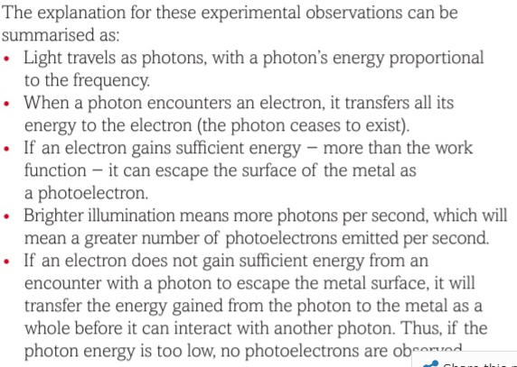
3D Quantum Physics
There’s a certain amount of energy needed for the photoelectrons to escape the surface of a metal, it is called the work function Φ.
If the energy of the photon carries more energy than the work function, the remaining energy will be transferred as kinetic energy to the photoelectron
6 eV
2 eV of KE
4 eV
e
observed

Slide 3
3D Quantum Physics
Photoelectric effect equation:
K.E = Energy of a photon – work function
$\frac{1}{2}mv^{2}=h f − Φ$
Maximum KE of a photoelectron
h f = $Φ$ + $\frac{1}{2}mv^{2}$
6 eV
2 eV of KE
4 eV
e

Slide 4
3D Quantum Physics
What is the work function of potassium if green light 510 nm shining on it produces photoelectrons with a maximum energy of 0.14 eV
Hint: use Joules
Find the frequency

Slide 5
3D Quantum Physics
What is the work function of potassium if green light 510 nm shining on it produces photoelectrons with a maximum energy of 0.14 eV
Notes:
Page 136

Slide 6
3D Quantum Physics
A sodium surface is illuminated with light having a wavelength of 300 nm. The work function for sodium metal is 2.46 eV. Find the maximum kinetic energy of the ejected photoelectrons.
Notes:
Page 136

Slide 7
3D Quantum Physics
A sodium surface is illuminated with light having a wavelength of 300 nm. The work function for sodium metal is 2.46 eV. Find the maximum kinetic energy of the ejected photoelectrons.
Solution:
E = hf
f = 9.99E14 Hz
KE = h f - 𝛷
KE = 6.63x10⁻³⁴ $×$ 9.99x10¹⁴-2.46
KE = 1.67 eV
Notes:
Page 136

Slide 8
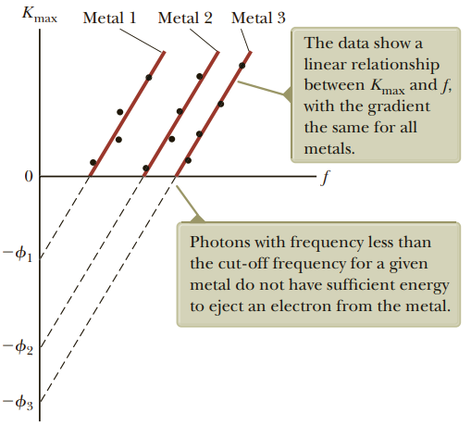
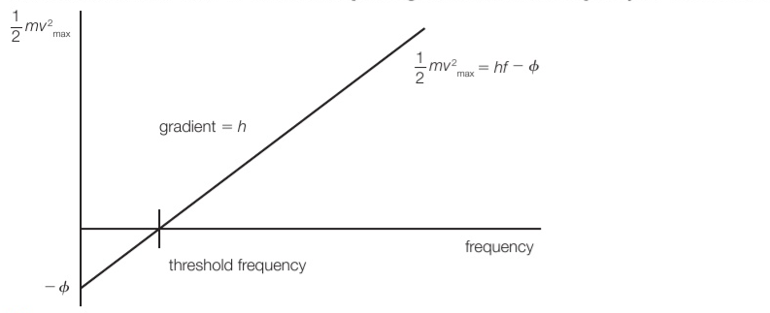
3D Quantum Physics
The gradient of KE and frequency = h
Notes:
See checkpoint questions page 136

Slide 9
3D Quantum Physics
The gradient of KE and frequency = h
Notes:
See checkpoint questions page 136

Slide 10
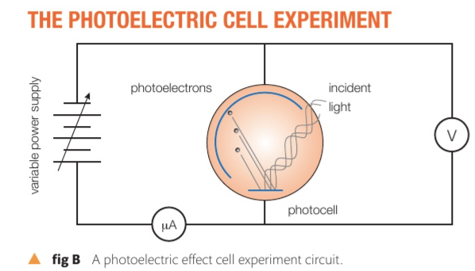
3D Quantum Physics
The photoelectric cell
$\frac{1}{2}mv^{2}=e ×V$
Notes:
Figure page 136.
If we have an evacuated vacuum chamber as shown in the figure, then we shine light on the photoelectric cell, then there will be photoelectrons emitted from the surface of the metal, at some point, when reverse polarizing the metal with voltage, the photoelectrons will stop being emitted at
e = 1.602 x 10-19 C
V stopping voltage

Slide 11
3D Quantum Physics
Is a branch of physics that describes the behavior of matter and energy on an atomic scale
Wave-particle nature: Light, electrons, nucleons can act as waves and as particles.
Matter can be thought of as energy, and vice-versa
A Photon is the basic unit of light (energy) it is massless
Photon as a wave: reflection, refraction, interference,…
Photon as a particle: photoelectric effect , double slit interaction

Slide 12
3D Quantum Physics
Notes:
Alfizia alkamie

