Slide 1
3D Quantum Physics
Is a branch of physics that describes the behavior of matter and energy on an atomic scale
Wave-particle nature: Light, electrons, nucleons can act as waves and as particles.
Matter can be thought of as energy, and vice-versa
A Photon is the basic unit of light (energy) it is massless
Photon as a wave: reflection, refraction, interference,…
Photon as a particle: photoelectric effect , double slit interaction
Notes:
Alfizia alkamie

Slide 2
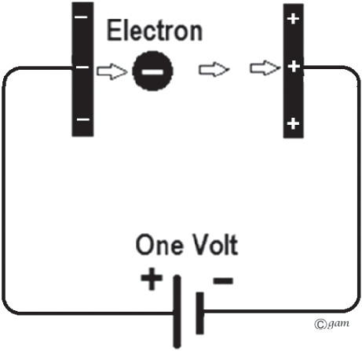
3D Quantum Physics
Electronvolt (eV): the amount of energy gained by an electron moving through a potential of 1 volt.
1 eV = $1.602 ×{10}_{}^{−19}$Joule
How many eV in a Joule ?
Notes:
This is a definition, memorize it, you’ll learn more later.

Slide 3
3D Quantum Physics
Electrons can behave as particles
a beam of electron was shot through a vacuum tube what behavior of the electron does the image show ?
Notes:
https://www.youtube.com/watch?v=bPCA9EClpBg

Slide 4
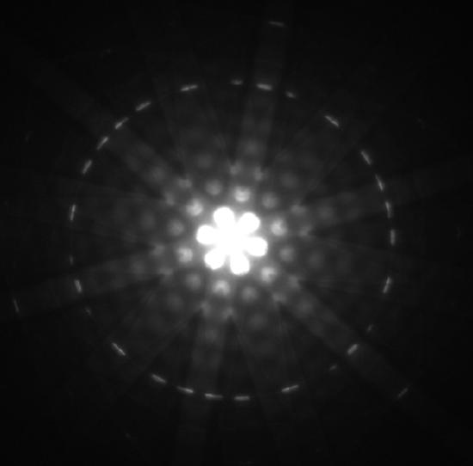
3D Quantum Physics
Electrons can behave as waves
a beam of electron was shot at a silicon crystal. what behavior of the electron does the image show ?
Notes:
This is a definition, memorize it, you’ll learn more later.

Slide 5
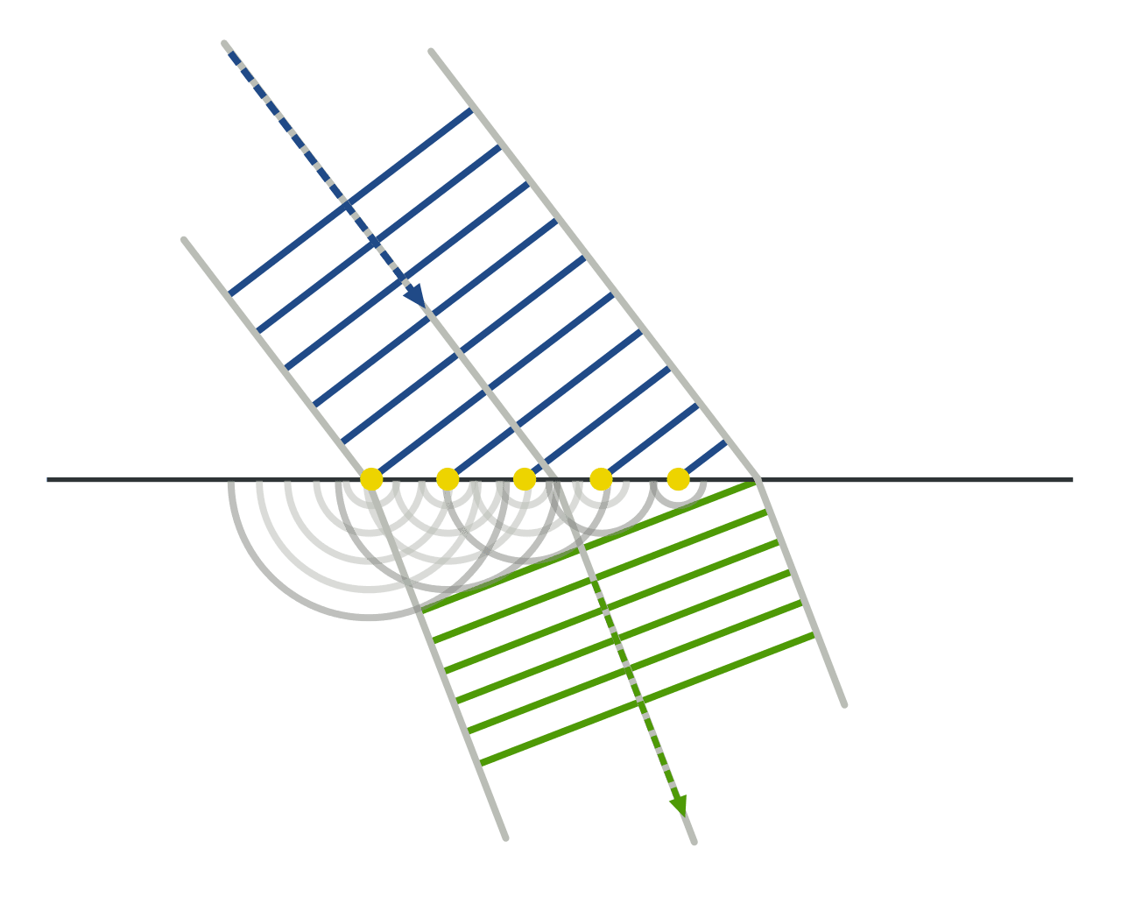
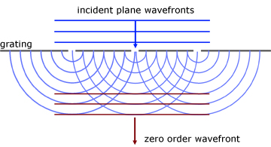
3D Quantum Physics
Huygen’s principle: states that any point in a wavefront can be considered as a source of circular waves.
Notes:
This is a definition, memorize it, you’ll learn more later.

Slide 6
3D Quantum Physics
Huygen’s principle: states that any point in a wavefront can be considered as a source of circular waves.
Notes:
This is a definition, memorize it, you’ll learn more later.

Slide 7
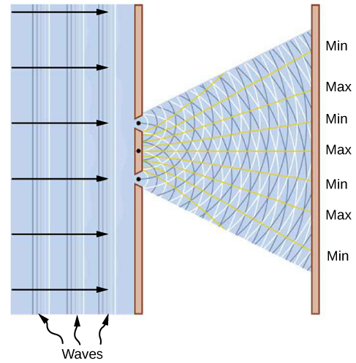
3D Quantum Physics
Light as a wave: the interference pattern arising from the diffraction of light is evidence of its wavelike nature
Notes:
Maximas and minimas are technically nodes and antinodes

Slide 8
3D Quantum Physics
Light as a particle: light is made of individual packets of energy known as photons
Photoelectric effect: photons of a certain energy can release electrons from a surface
Notes:
Use a gamma ray source to demonstrate the discreteness of photons.

Slide 9
3D Quantum Physics
Light as a particle: light is made of individual packets of energy known as photons
Photoelectric effect: photons of a certain energy can release electrons from a surface
Conditions:
Light particles must have a certain minimum threshold energy to release electrons from a surface, this happens as long as the minimum frequency is met regardless of intensity.
Notes:
Maximas and minimas are technically nodes and antinodes

Slide 10
3D Quantum Physics
Light as a particle: light is made of individual packets of energy known as photons
Photoelectric effect: photons of a certain energy can release electrons from a surface
Conditions:
Light particles must have a certain minimum threshold energy to release electrons from a surface, this happens as long as the minimum frequency is met regardless of intensity.
https://phet.colorado.edu/en/simulations/photoelectric
Notes:
Maximas and minimas are technically nodes and antinodes

Slide 11
3D Quantum Physics
Light as a particle: light is made of individual packets of energy known as photons
Photoelectric effect: photons of a certain energy can release electrons from a surface
Conditions:
Light particles must have a certain minimum threshold energy to release electrons from a surface, this happens as long as the minimum frequency is met regardless of intensity.
https://phet.colorado.edu/en/simulations/photoelectric
Notes:
Maximas and minimas are technically nodes and antinodes

Slide 12
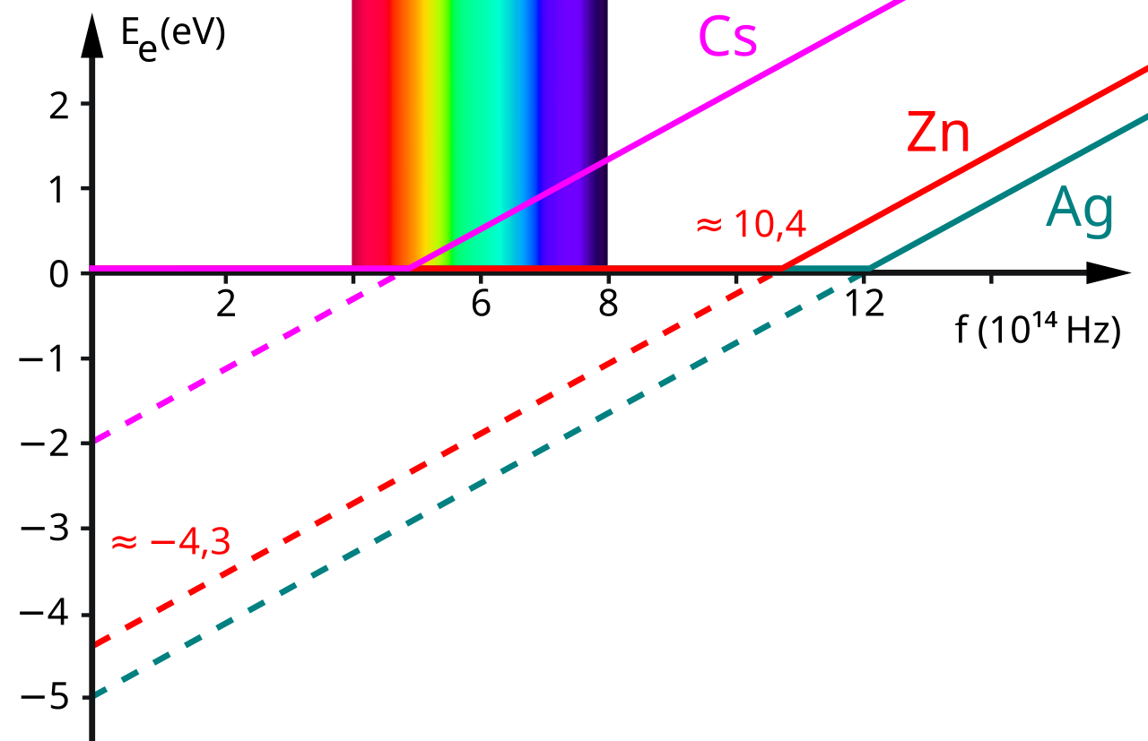
3D Quantum Physics
Light as a particle: light is made of individual packets of energy known as photons
Photoelectric effect: photons of a certain energy can release electrons from a surface
Conditions:
Light particles must have a certain minimum threshold energy to release electrons from a surface, this happens as long as the minimum frequency is met regardless of intensity.
https://phet.colorado.edu/en/simulations/photoelectric
Notes:
Maximas and minimas are technically nodes and antinodes

Slide 13
3D Quantum Physics
Energy of a photon: given by Planck’s constant.
$E = h f$
Frequency in Hz
$6.63×{10}_{}^{−34}$ J s
Energy of a photon
Notes:
Maximas and minimas are technically nodes and antinodes

Slide 14
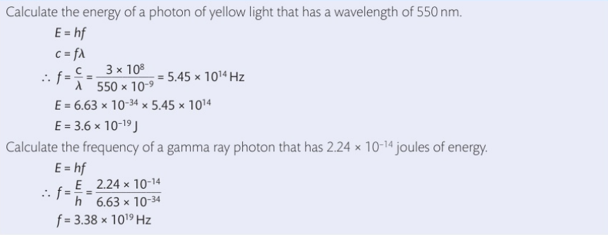
3D Quantum Physics
Energy of a photon: given by Planck’s constant.
$E = h f$
Frequency in Hz
$6.63×{10}_{}^{−34}$ J s
Energy of a photon
Notes:
Maximas and minimas are technically nodes and antinodes

Slide 15
3D Quantum Physics
Example: calculate the energy of a photon with a wavelength of 632 nm
Notes:
Maximas and minimas are technically nodes and antinodes

Slide 16
3D Quantum Physics
Example: calculate the energy of a photon with a wavelength of 632 nm
c = f λ → f= $\frac{c}{\text{λ}} \text{→ }\text{f}\text{ = }\frac{{3x 10}_{}^{8}}{632 {x 10 }_{}^{−9}}$
f = 4.74 ${x 10 }_{}^{14}$ Hz
E = ${6.63× 10}_{}^{−34}$ $×$ 4.74 ${x 10 }_{}^{14}$ Hz = 3.14262 ${x 10 }_{}^{−19}$ J
Notes:
Maximas and minimas are technically nodes and antinodes

Slide 17
3D Quantum Physics
Example: calculate the energy of a photon with a wavelength of 632 nm
c = f λ → f= $\frac{c}{\text{λ}} \text{→ }\text{f}\text{ = }\frac{{3x 10}_{}^{8}}{632 {x 10 }_{}^{−9}}$
f = 4.74 ${x 10 }_{}^{14}$ Hz
E = ${6.63× 10}_{}^{−34}$ $×$ 4.74 ${x 10 }_{}^{14}$ Hz = 3.14262 ${x 10 }_{}^{−19}$ J
Notes:
Maximas and minimas are technically nodes and antinodes

