Slide 2
Momentum
Define momentum
Idea of momentum
Law of momentum
Its relation with newton’s laws
Law of conservation of momentum

Slide 3

Momentum
Momentum is a measure of the amount of motion an object has, and it is the product of an object's mass and its velocity.
$$p=m x v$$
momentum
mass
velocity
Notes:
The amount of motion an object has, not to be confused with inertia which is the resistance of an object to the change in its movement.
Momentum is a vector quantity, it is measured in kg*m/s

Slide 4


Momentum
Calculate the momentum for:
- a 620 gram basketball travelling at 8.76 m/s
- a 46 gram golf ball travelling at -81.3 m/s

Slide 5
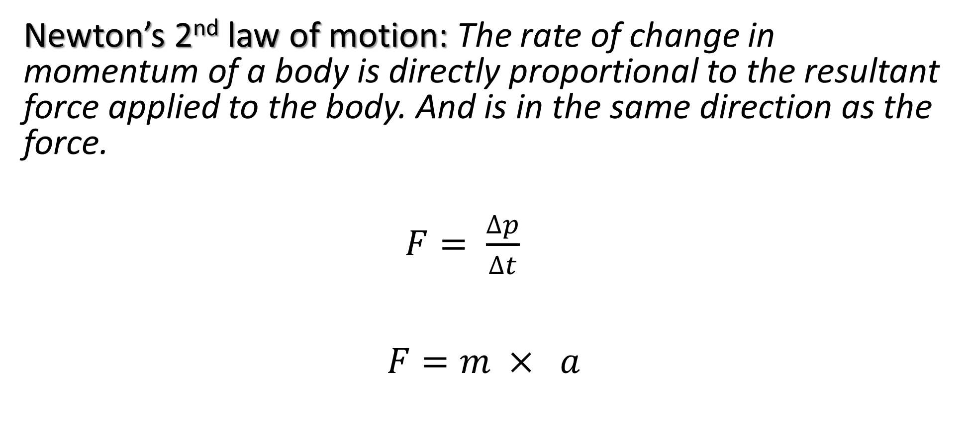
Momentum
Newton’s 2nd law of motion: The rate of change in momentum of a body is directly proportional to the resultant force applied to the body. And is in the same direction as the force.
$F= \frac{∆p}{∆t}$
$$F=m × a$$
Notes:
Focused talk.

Slide 6

Collisions: Law of conservation of momentum
Momentum
Total momentum before interaction = Total momentum after interaction
(the sum of the moments before interaction = the sum of the moments before interaction )

Slide 7
Momentum

Slide 8
Momentum

Slide 9
Momentum

Slide 10
Momentum

