Slide 1
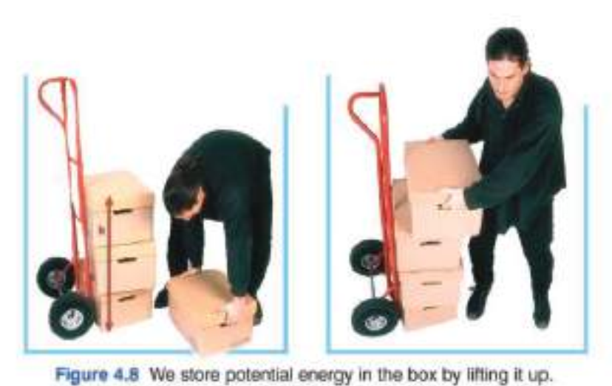
Energy
GPE,KE
Potential energy: is the energy stored by an object because of its position relative to other objects
Potential energy is stored and
used, it depends on ¹the height
of the object, and ²the weight of
the object.

Slide 2
Work
Energy
GPE,KE
Potential energy: is the energy stored by an object because of its position relative to other objects
Calculating for potential energy
Potential Energy = mass × gravitational force × height
mass in kg
is always 9.81 N/kg
in meters

Slide 3
Work
Energy
GPE,KE
Potential energy: is the energy stored by an object because of its position relative to other objects
Calculating for potential energy:
PE
m
g
h

Slide 4
Energy
GPE,KE
Potential energy: is the energy stored by an object because of its position relative to other objects
exercise
Calculating for potential energy:
a 2 kilogram box is raised 67 meters, calculate its potential energy in joules

Slide 5

Energy
GPE,KE
Kinetic Energy (KE): The energy of an object due to its motion.
$$K E= \frac{1}{2}mv_{}^{2}$$
In kg
KE
½ m
V²
In m/s

Slide 6
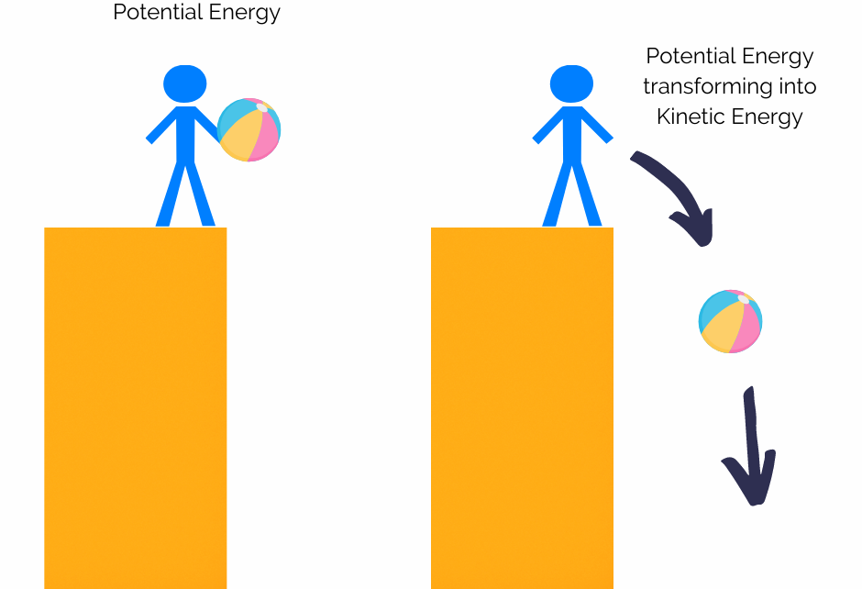
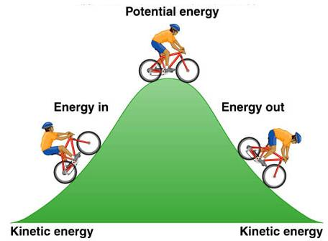
Kinetic Energy (KE):
Energy
GPE,KE
The total energy of an object does not change, rather it is converted from kinetic to potential energy, or vice versa.

Slide 7
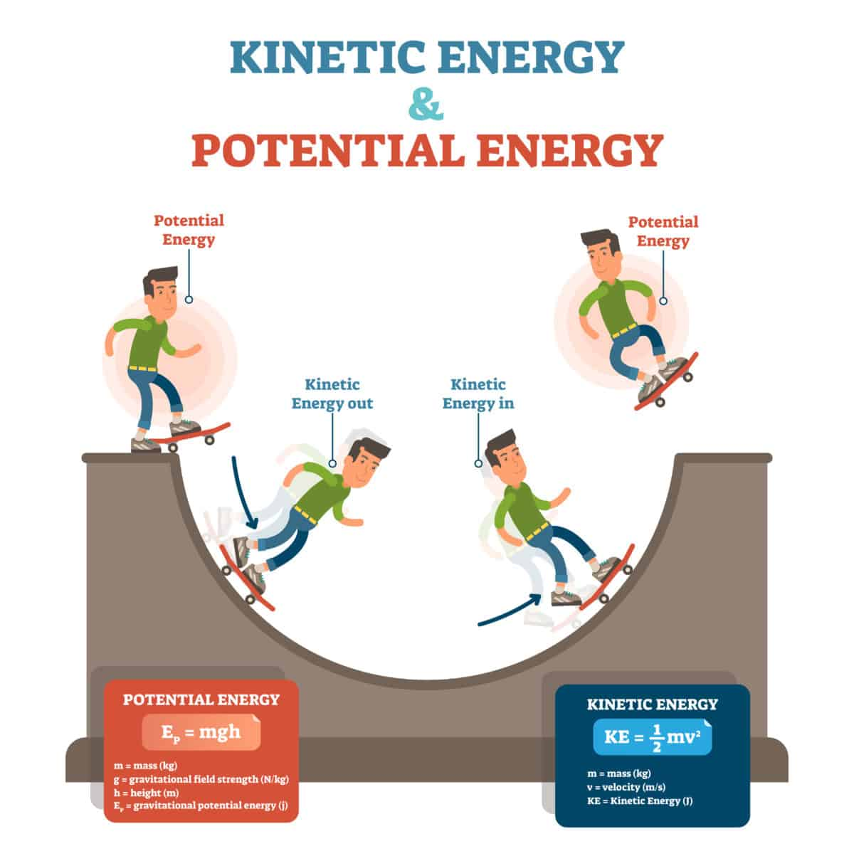
Kinetic Energy (KE):
Energy
GPE,KE
The total energy of an object does not change, rather it is converted from kinetic to potential energy, or vice versa.

Slide 8
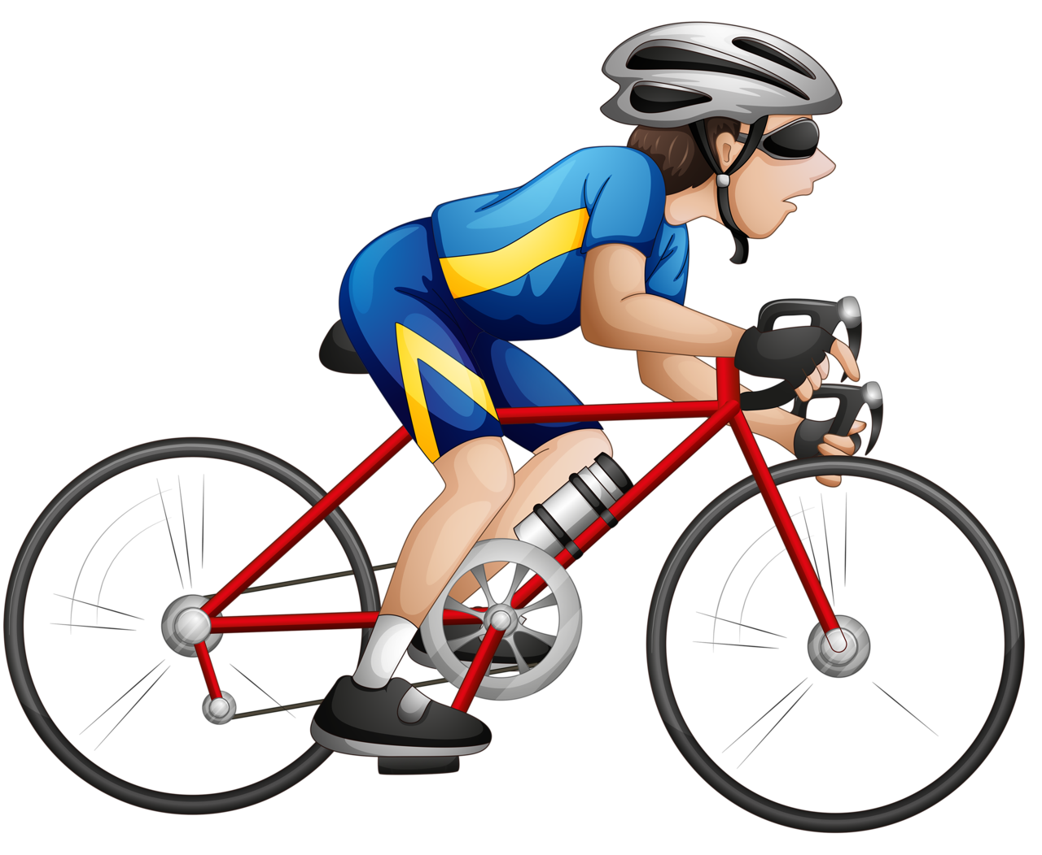
Kinetic Energy (KE):
Energy
GPE,KE
Example1:
a cyclist has a mass of 54 kg and moves at a speed of 5 m/s,
find the kinetic energy in Joules.

Slide 9
Kinetic Energy (KE):
Example2:
a skater moves down a ramp, his initial potential energy is
384 Joules, knowing his mass is 48 kg, find his speed at the bottom of the ramp.
Example3:
a snowball rolls down a hill, its initial Potential energy is 768 J,
and its speed was 16 m/s , find the mass.

Slide 10
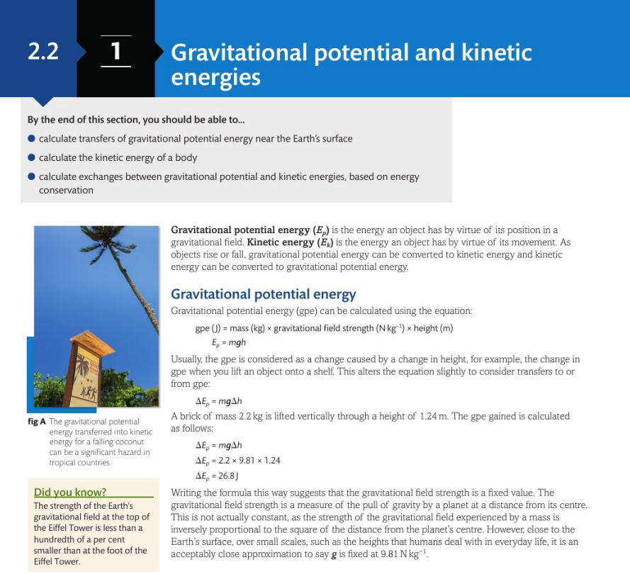
Energy
GPE,KE

Slide 11
2 WORK AND POWER
Page 39
Energy: is the ability to do work, it is measured in Joules (Nm)
Work done is a transfer in energy

Slide 12

Work
Page 38
Work: is the product of the force applied upon an object and the displacement that the object is moved.
Unit = Newton
Work = Force x displacement
Unit = meter

Slide 13

WORK
Newton
meter
$$Work=Force ×distance$$
If force is applied at an angle..
$Work=Force ×distance×\cos{θ}$
Nm or Joule
32 N
4m

Slide 14

WORK
Newton
meter
$$Work=Force ×distance$$
If force is applied at an angle..
$Work=Force ×distance×\cos{θ}$
Nm or Joule
32 N
$$θ=30°$$
4m

Slide 15

WORK
Newton
meter
$$Work=Force ×distance$$
If force is applied at an angle..
$Work=Force ×distance×\cos{θ}$
Nm or Joule
32 N
$$θ=45°$$
4m

Slide 16
WORK
Newton
meter
$$Work=Force ×distance$$
If force is applied at an angle..
$Work=Force ×distance×\cos{θ}$
Nm or Joule
32 N
$$θ=45°$$
4m

Slide 17


WORK
Newton
meter
$$Work=Force ×distance$$
Nm or Joule
d = 4m
m= 1 kg

Slide 18

Power
$Power=$ $\frac{Work (Nm) }{time (s)}$
$Power=$ $\frac{F × s cosθ}{t}$
d = 4m
t = 3s
m= 1 kg

Slide 19
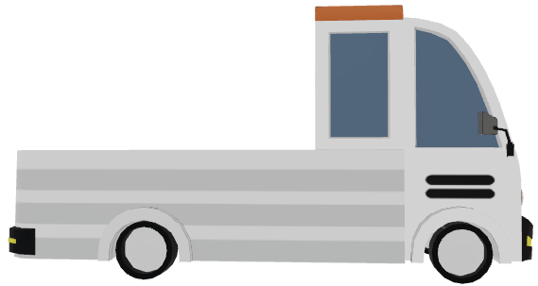
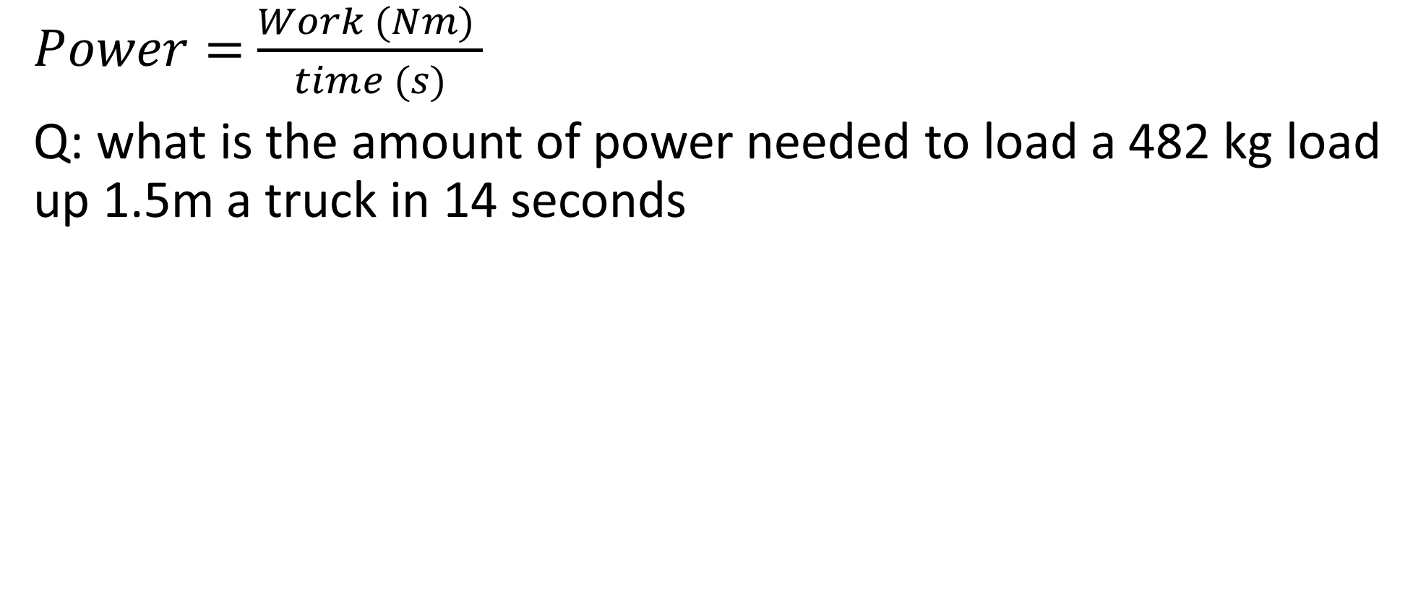


Power
$Power=$ $\frac{Work (Nm) }{time (s)}$
Q: what is the amount of power needed to load a 482 kg load up 1.5m a truck in 14 seconds

Slide 20
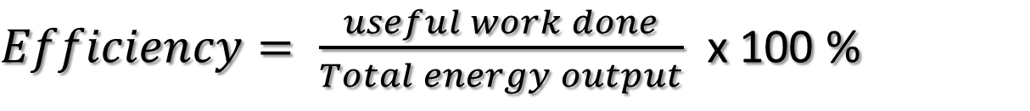

Efficiency
Efficiency is the ratio of useful work done to the total energy input
$Efficiency= \frac{useful work done}{total energy input}$
$Efficiency= \frac{useful work done}{Total energy output}$ x 100 %

Slide 21
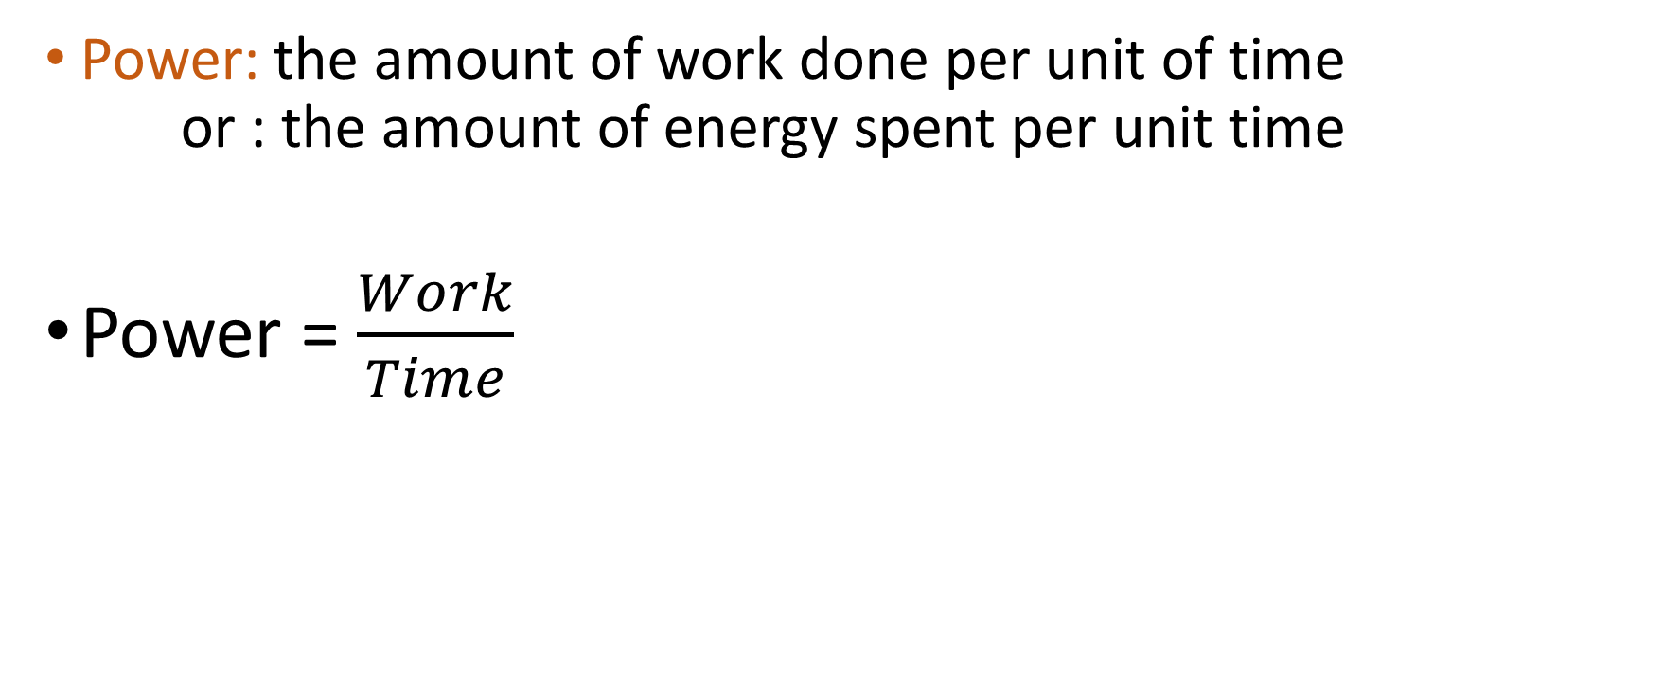
Power
Power
Power: the amount of work done per unit of time
or : the amount of energy spent per unit time
Power = $\frac{Work}{Time}$

Slide 22
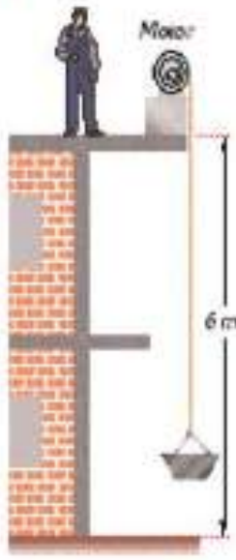
example
Power
A machine raises a 120 kg load up 6m in 5sec, calculate:
  The work done
  Calculate the power of the machine

Slide 23

example
Power
A winch pulls a car with a mass of 1650 kg up in 15 seconds, knowing the power it consumes as 1880w , calculate the distance travelled..

