Slide 1
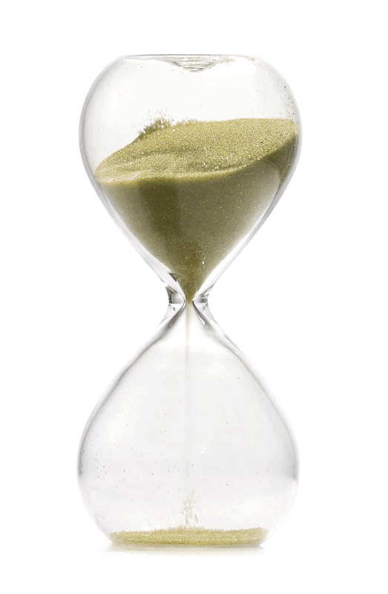
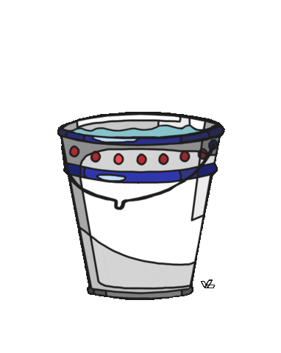
Fluids, Density and upthrust
Fluid: is any substance that can flow.
Can be : - gases
- liquids
- small solid particles (hourglass sand)
Fluids
Gases
Liquids

Slide 2
Fluids, Density and upthrust
Density: is a measure of mass per unit volume
ρ $= \frac{mass}{volume}$
m
ρ
v
Density in kg/m³ = Density in g/cm³× 1,000
Notes:
Ex 8g/cm³×1,000=8,000kg/m³
0.854 g / cm³ = 854 kg / m³

Slide 3
Fluids, Density and upthrust
Example: a tank holding a liquid has a mass of 9300 kg, the tank is 3m high, 2m long and 1.5 m wide, calculate its density.
Notes:
1033.3 kg/m3

Slide 4
Fluids, Density and upthrust
Exercise: calculate the mass of a tank holding a liquid, the tank is 0.6m high, 0.8 m long and 0.5 m wide, its density is known to be 2300 kg/m³
Notes:
0.24 m³
552 kg

Slide 5
Fluids, Density and upthrust
Behaviour of gases and liquids at temperature:
At higher temperatures:
Density of gases decrease (due to volume expansion)
Density of liquids decrease (due to volume expansion)

Slide 6
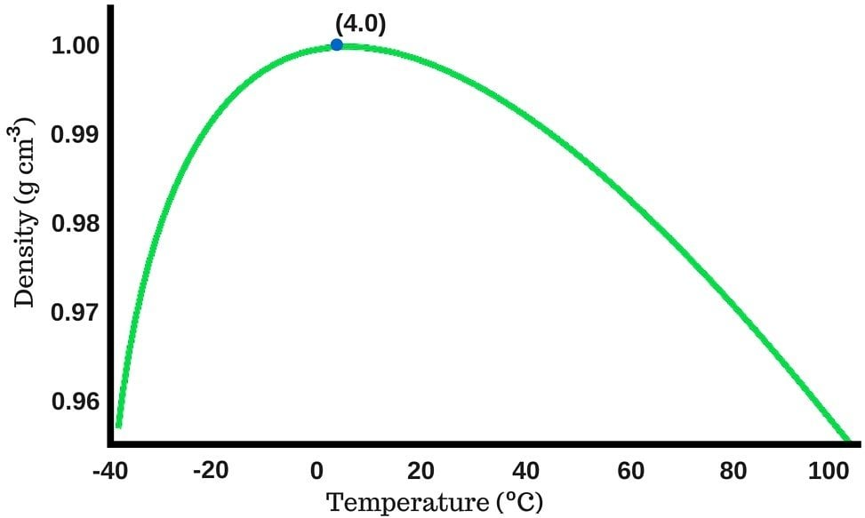
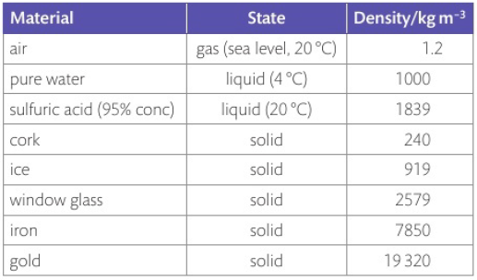
Fluids, Density and upthrust
Behaviour of gases and liquids at temperature:
Behavior of water density at different temperatures
Page 60

Slide 7
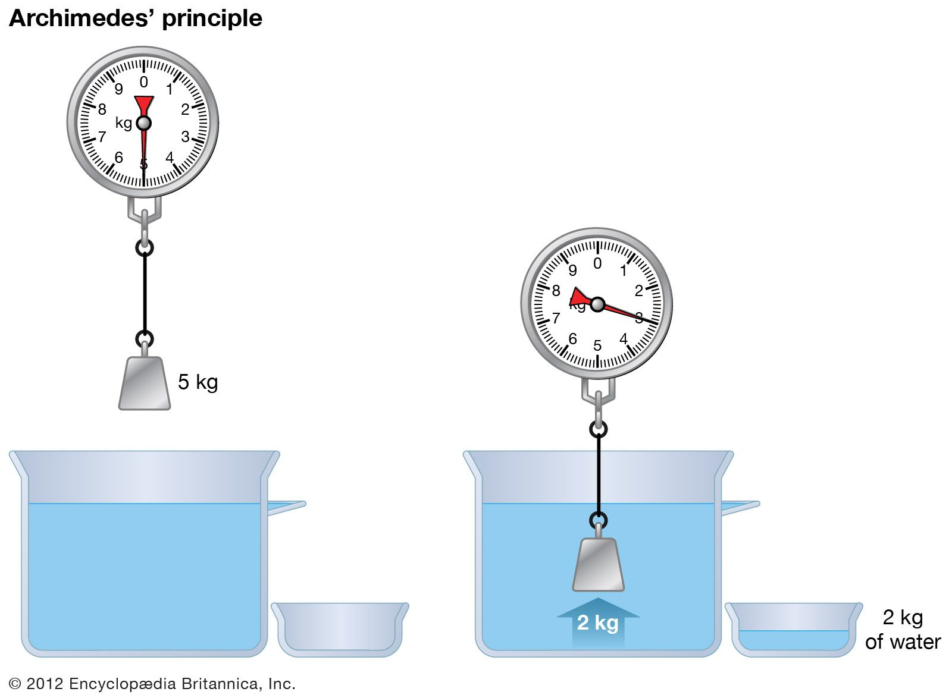
Fluids, Density and upthrust
Archimedes principle
the upward buoyant force on a body immersed in a fluid is equal to the weight of the displaced fluid

Slide 8
Fluids, Density and upthrust
Upthrust: is the upwards force experienced by a submerged object in a fluid.
The lost weight of the submerged object is equal to the weight of displaced liquid

Slide 9
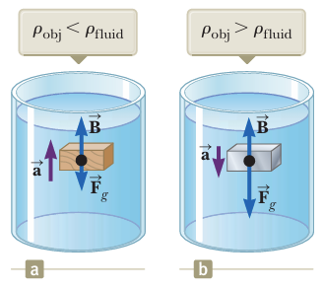
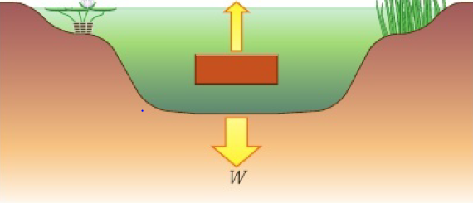
Fluids, Density and upthrust
Upthrust exerted on a body submerged in a fluid, it depends on:
Volume of the submerged object
Density of the fluid
Gravity
Notes:
We can find the mass of the displaced fluid using m = v x p
Since we know the volume of displaced fluid = volume of submerged object.

Slide 10
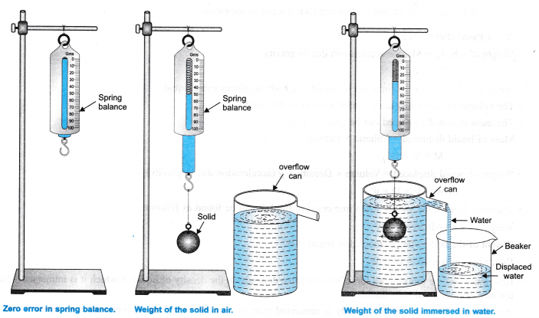
Fluids, Density and upthrust
Archimedes principle
the upward buoyant force on a body immersed in a fluid is equal to the weight of the displaced fluid

Slide 11
Fluids, Density and upthrust
Upthrust exerted on a body submerged in a fluid, it depends on:
Volume of the submerged object
Density of the fluid
Gravity
Notes:
We can find the mass of the displaced fluid using m = v x p
Since we know the volume of displaced fluid = volume of submerged object.

Slide 12
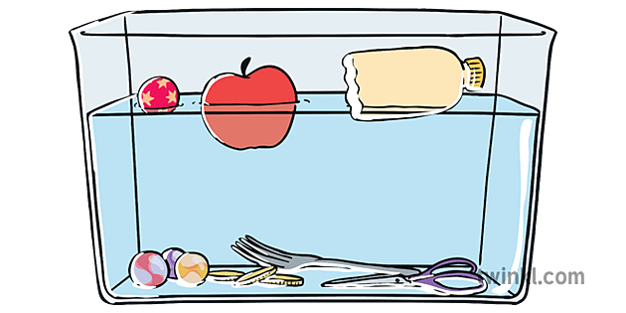
Notes for floating objects:
Fluids, Density and upthrust
The instant the object touches the fluid, there’s NO upthrust on a body being lowered into a fluid
A floating object will have to (partially)sink until it has displaced its own weight in fluid
The Weight of the displaced fluid = the weight of the floating object
The density of the object < the density of the fluid
Notes:
That is because no fluid is being displaced yet.

Slide 13
Fluids, Density and upthrust
Upthrust exerted on a body submerged in a fluid depends on:
Volume of the submerged object
Density of the fluid
Gravity
Page 61
Notes:
We can find the mass of the displaced fluid using m = v x p
Since we know the volume of displaced fluid = volume of submerged object.

Slide 14
To find the upthrust force on an object:
Fluids, Density and upthrust
Find the volume of the submerged part of the object
The volume of the submerged part of the object = the volume of displaced fluid
2. Find the mass of the displaced liquid, then x 9.81 to find the weight
The weight of the displaced fluid is the same as the upthrust force on the object
Hint: volume of a cuboid: length x width x height
Volume of a sphere: $\frac{4}{3}π r³$
Notes:
We can find the mass of the displaced fluid using m = v x p
Since we know the volume of displaced fluid = volume of submerged object.

Slide 15
Example
Fluids, Density and upthrust
A diver jumps in seawater (d = 1.03 g/cm³) knowing his volume as 0.075m³, calculate the upthrust on his body
Notes:
Weight of displaced fluid = upthrust
We can find the mass of the displaced fluid using m = v x p
Since we know the volume of displaced fluid = volume of submerged object.

Slide 16
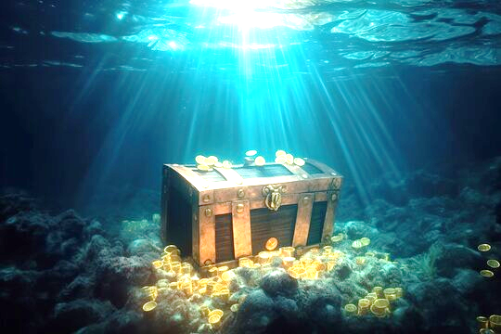
Example
Fluids, Density and upthrust
A treasure box completely submerged in seawater (d=1030 kg/m³) measures 0.8 m long, 0.3 m wide, and 0.25m high, calculate the upthrust force acting on it.
Notes:
We can find the mass of the displaced fluid using m = v x p
Since we know the volume of displaced fluid = volume of submerged object.

Slide 17
To find the upthrust force on an object:
Fluids, Density and upthrust
Find the volume of the submerged part of the object
The volume of the submerged part of the object = the volume of displaced fluid
2. Find the mass of the displaced liquid, then x 9.81 to find the weight
The weight of the displaced fluid is the same as the upthrust force on the object
Hint: volume of a cuboid: length x width x height
Volume of a sphere: $\frac{4}{3}π r³$
Notes:
We can find the mass of the displaced fluid using m = v x p
Since we know the volume of displaced fluid = volume of submerged object.

Slide 18
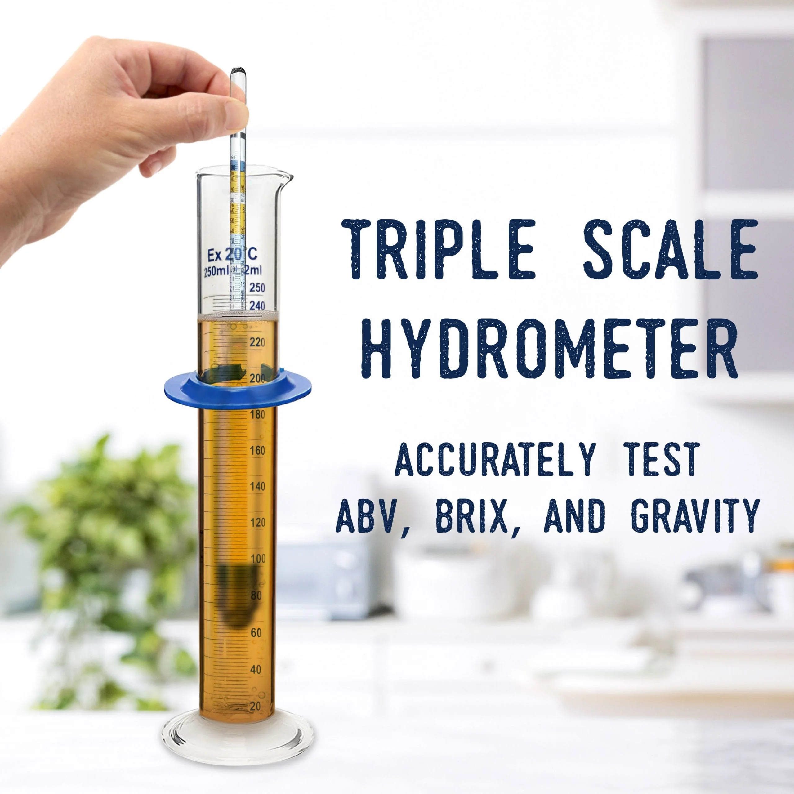
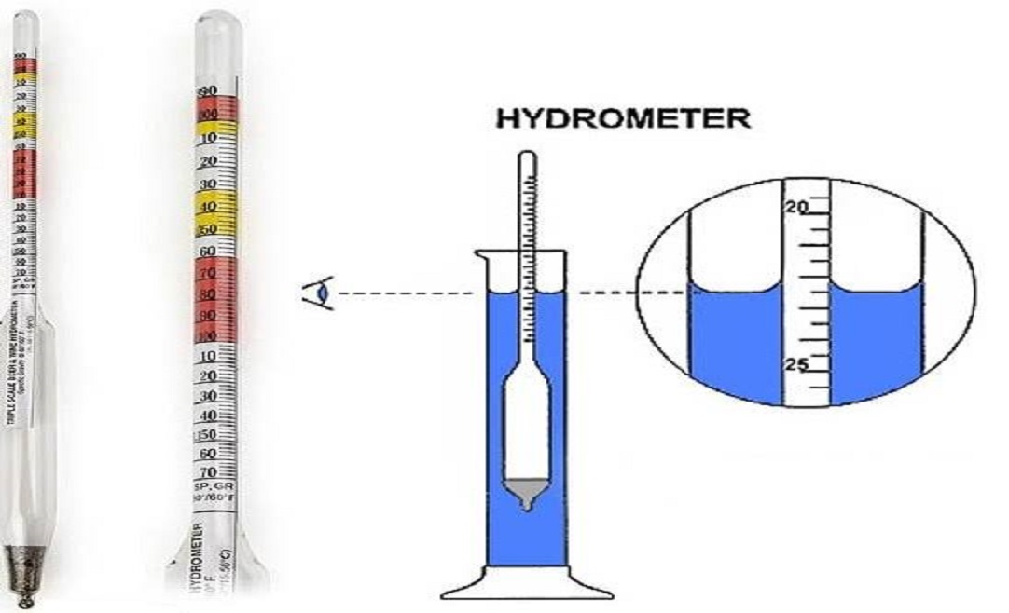
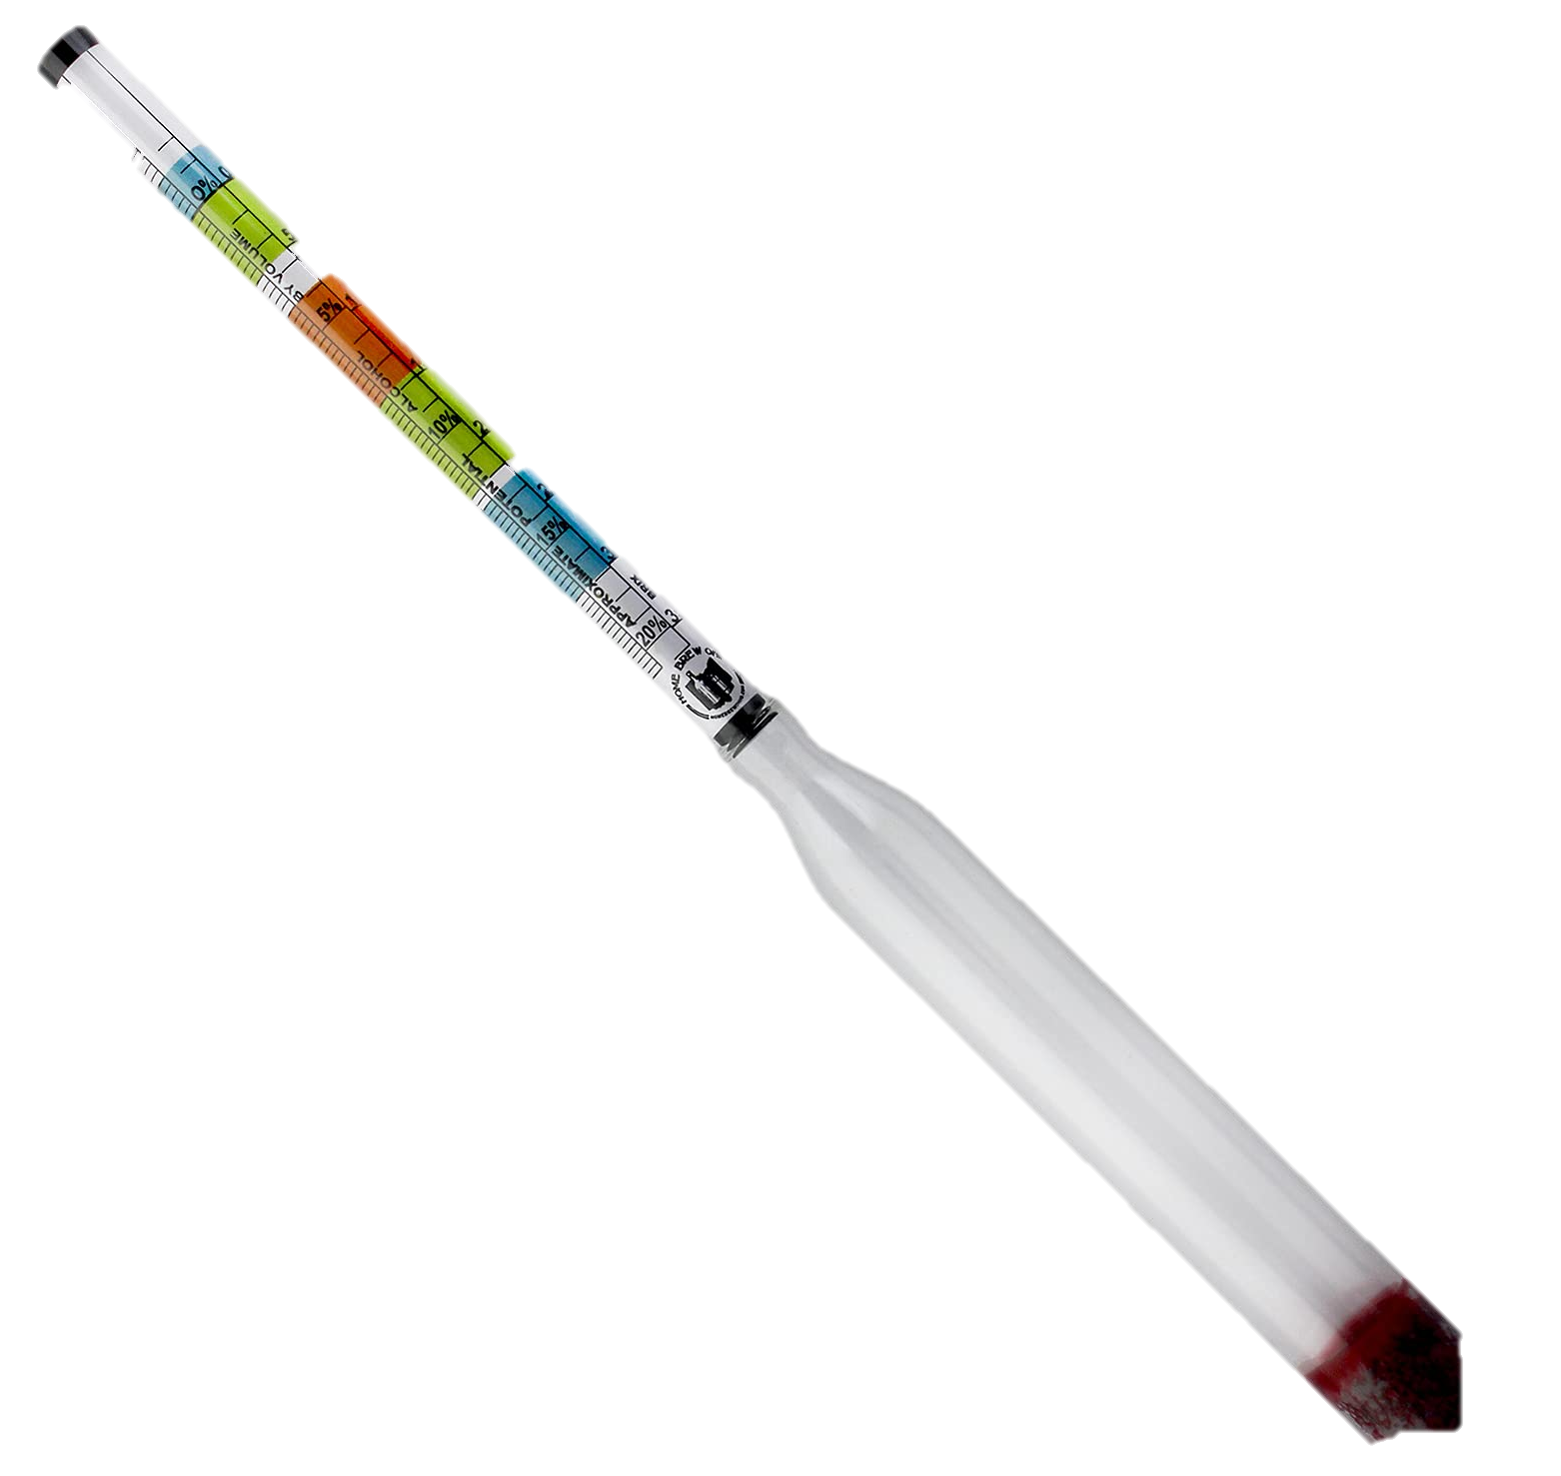
Applications of density and upthrust
Fluids, Density and upthrust
Hydrometer: an instrument used to determine the density of a fluid

Slide 19
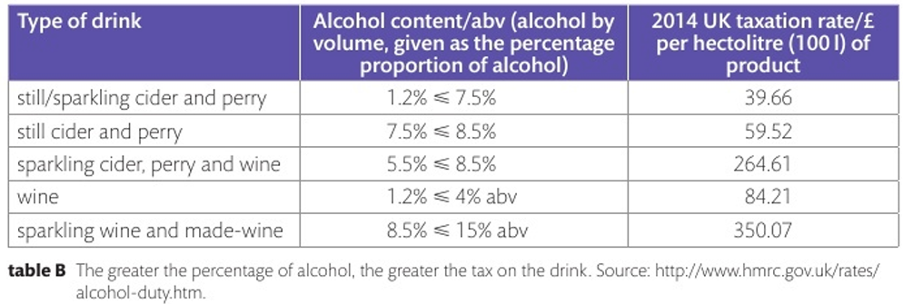
Applications of density and upthrust
Fluids, Density and upthrust
Hydrometer: an instrument used to determine the density of a fluid

Slide 20
Applications of density and upthrust
Fluids, Density and upthrust
Example question: will a hydrometer sink more or less in lower density fluids, why ?

Slide 21
Applications of density and upthrust
Fluids, Density and upthrust
Example question: will a hydrometer sink more or less in lower density fluids, why ?
A) a hydrometer will sink more in less dense fluids this is because the weight of the displaced fluid is less so the upthrust force on it will be less.

Slide 22
Applications of density and upthrust
Fluids, Density and upthrust
Example question: will a hydrometer sink more or less in lower density fluids, why ?
A) a hydrometer will sink more in less dense fluids this is because the weight of the displaced fluid is less so the upthrust force on it will be less.

