Slide 1
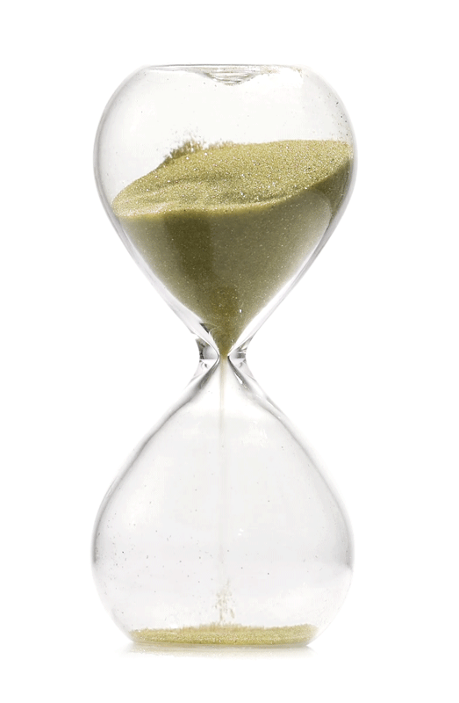
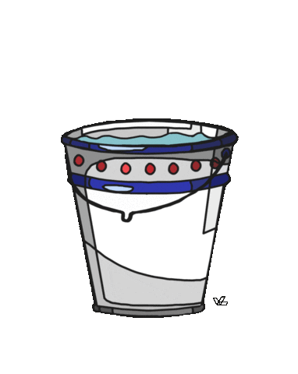
Fluids, Density and upthrust
Fluid: is any substance that can flow.
Can be : - gases
- liquids
- small solid particles
(hourglass sand)
Fluids
Gases
Liquids

Slide 2

Fluids, Density and upthrust
Density: is a measure of mass per unit volume
ρ $= \frac{mass}{volume}$
m
ρ
v
Density in kg/m³ = Density in g/cm³× 1,000
Notes:
Ex 8g/cm³×1,000=8,000kg/m³
0.854 g / cm³ = 854 kg / m³

Slide 3
Fluids, Density and upthrust
Example: a tank holding a liquid has a mass of 9300 kg, the tank is 3m high, 2m long and 1.5 m wide, calculate its density.
Notes:
1033.3 kg/m3

Slide 4
Fluids, Density and upthrust
Exercise: calculate the mass of a tank holding a liquid, the tank is 0.6m high, 0.8 m long and 0.5 m wide, its density is known to be 2300 kg/m³
Notes:
0.24 m³
552 kg

Slide 5
Fluids, Density and upthrust
Behaviour of gases and liquids at temperature:
At higher temperatures:
Density of gases decrease (due to volume expansion)
Density of liquids decrease (due to volume expansion)

Slide 6
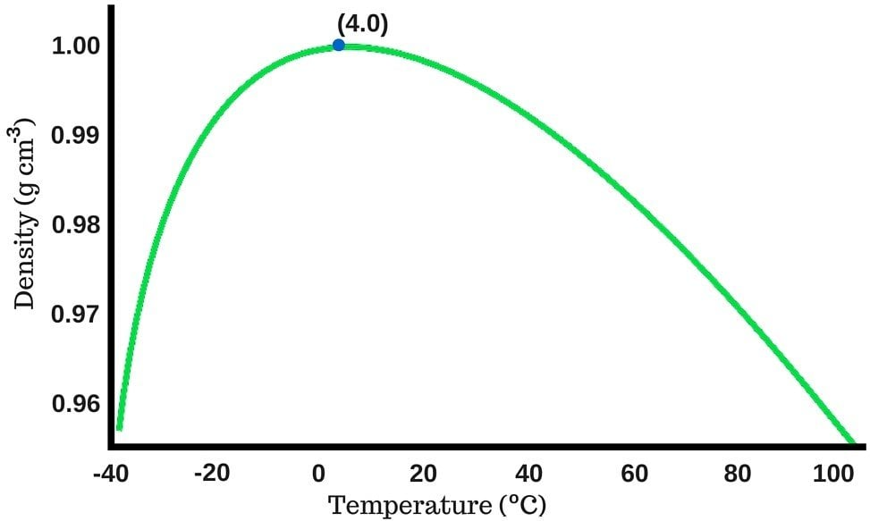
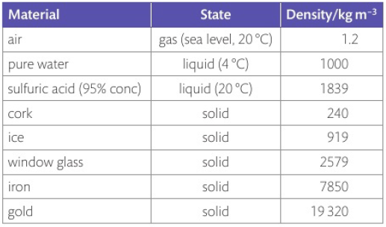
Fluids, Density and upthrust
Behaviour of gases and liquids at temperature:
Behavior of water density at different temperatures
Page 60

Slide 7
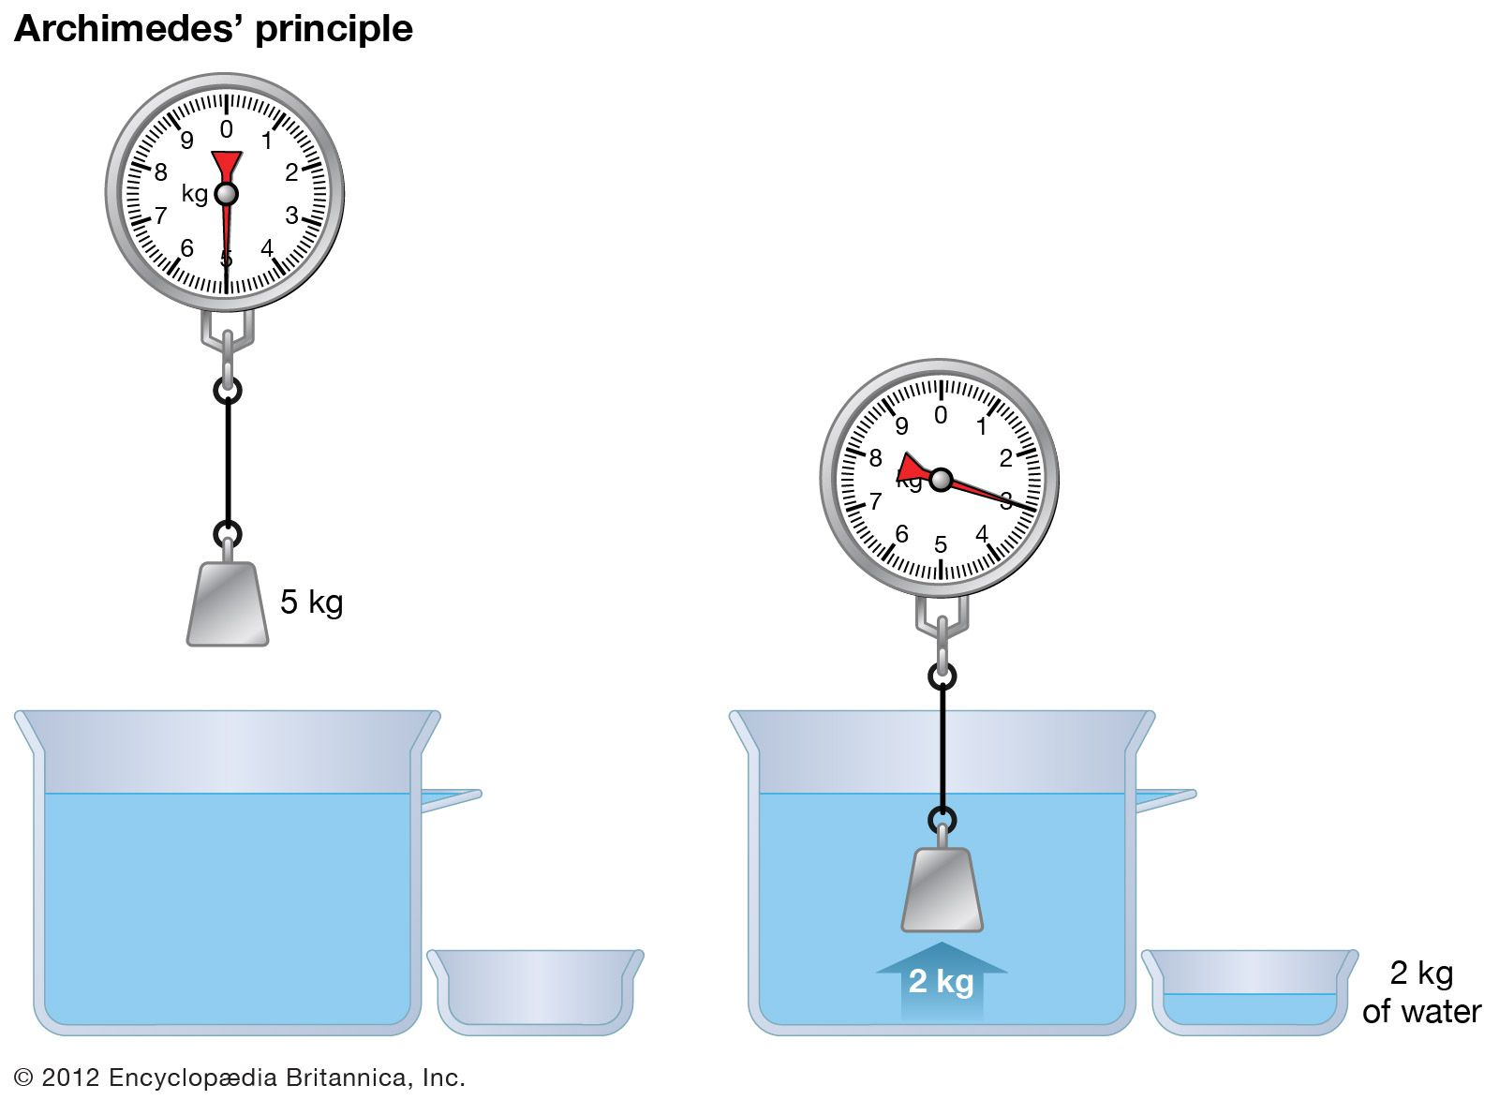
Fluids, Density and upthrust
Archimedes principle
the upward buoyant force on a body immersed in a fluid is equal to the weight of the displaced fluid

Slide 8
Fluids, Density and upthrust
Upthrust: is the upwards force experienced by a submerged object in a fluid.
The lost weight of the submerged object
is equal to the weight of displaced liquid

Slide 9
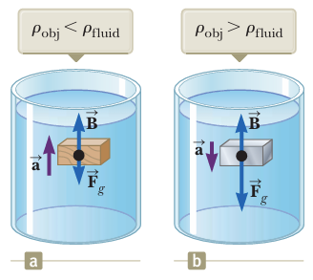

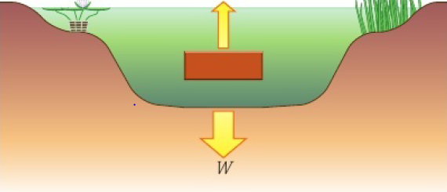
Fluids, Density and upthrust
Upthrust exerted on a body submerged in a fluid, it depends on:
  Volume of the submerged object
  Density of the fluid
  Gravity
Notes:
We can find the mass of the displaced fluid using m = v x p
Since we know the volume of displaced fluid = volume of submerged object.

Slide 10
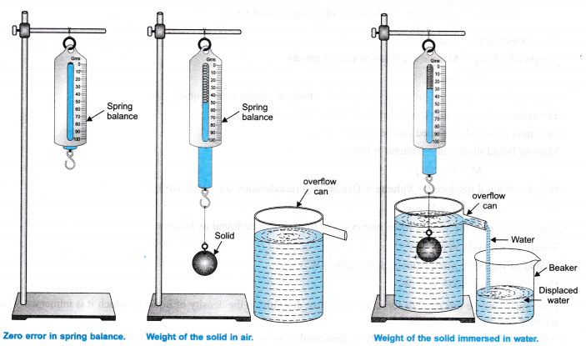
Fluids, Density and upthrust
Archimedes principle
the upward buoyant force on a body immersed in a fluid is equal to the weight of the displaced fluid

Slide 11
Fluids, Density and upthrust
Upthrust exerted on a body submerged in a fluid, it depends on:
  Volume of the submerged object
  Density of the fluid
  Gravity
Notes:
We can find the mass of the displaced fluid using m = v x p
Since we know the volume of displaced fluid = volume of submerged object.

Slide 12
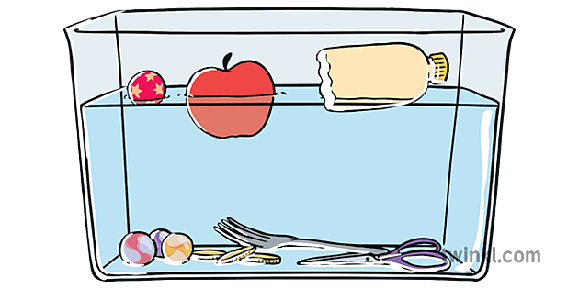
Notes for floating objects:
Fluids, Density and upthrust
The instant the object touches the fluid, there’s NO upthrust on a body being lowered into a fluid
A floating object will have to (partially)sink until it has displaced its own weight in fluid
The Weight of the displaced fluid = the weight of the floating object
The density of the object < the density of the fluid
Notes:
That is because no fluid is being displaced yet.

Slide 13
Fluids, Density and upthrust
Upthrust exerted on a body submerged in a fluid depends on:
  Volume of the submerged object
  Density of the fluid
  Gravity
Page 61
Notes:
We can find the mass of the displaced fluid using m = v x p
Since we know the volume of displaced fluid = volume of submerged object.

Slide 14
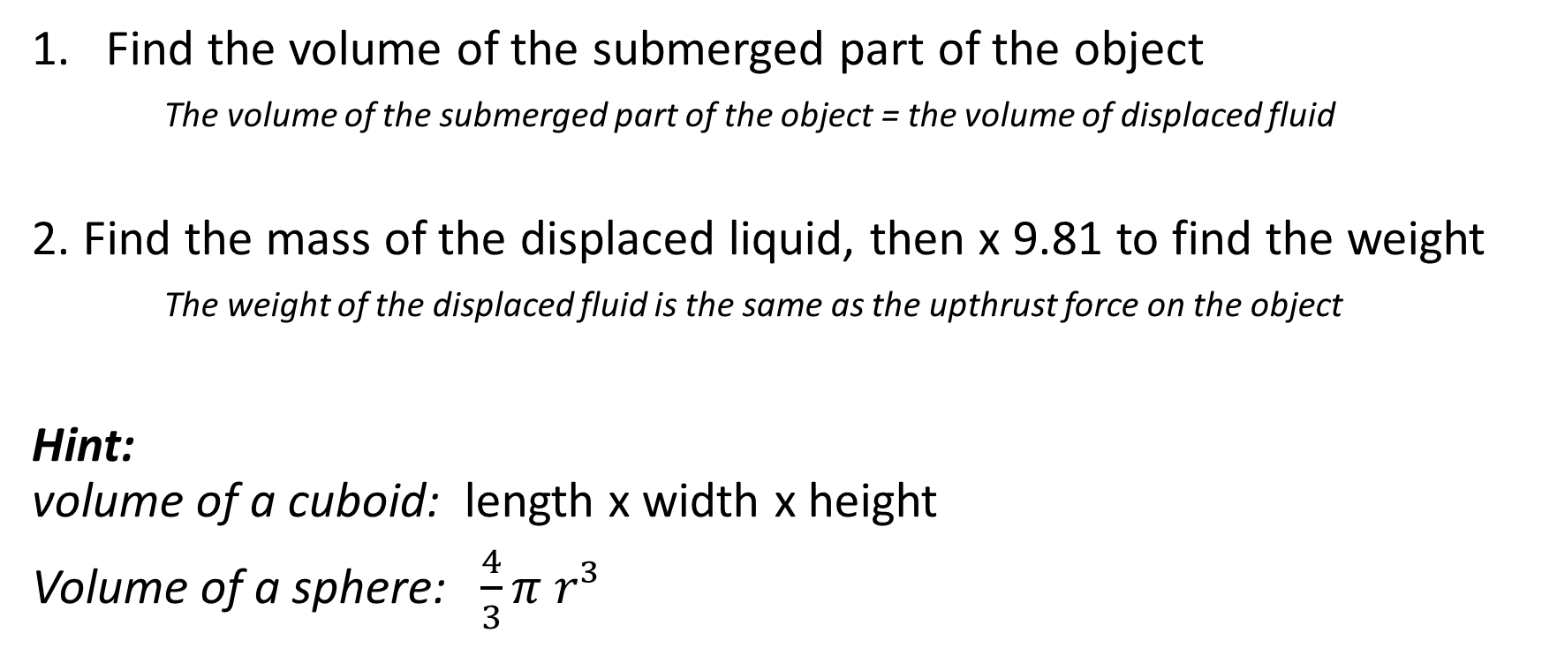
To find the upthrust force on an object:
Fluids, Density and upthrust
Find the volume of the submerged part of the object
The volume of the submerged part of the object = the volume of displaced fluid
2. Find the mass of the displaced liquid, then x 9.81 to find the weight
The weight of the displaced fluid is the same as the upthrust force on the object
Hint:
volume of a cuboid: length x width x height
Volume of a sphere: $\frac{4}{3}π r³$
Notes:
We can find the mass of the displaced fluid using m = v x p
Since we know the volume of displaced fluid = volume of submerged object.

Slide 15
Example
Fluids, Density and upthrust
A diver jumps in seawater (d = 1.03 g/cm³) knowing his volume as 0.075m³, calculate the upthrust on his body
Notes:
Weight of displaced fluid = upthrust
We can find the mass of the displaced fluid using m = v x p
Since we know the volume of displaced fluid = volume of submerged object.

Slide 16
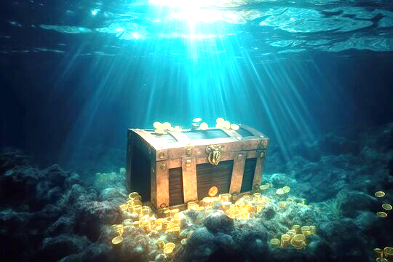
Example
Fluids, Density and upthrust
A treasure box completely submerged in seawater (d=1030 kg/m³)
measures 0.8 m long, 0.3 m wide, and 0.25m high,
calculate the upthrust force acting on it.
Notes:
We can find the mass of the displaced fluid using m = v x p
Since we know the volume of displaced fluid = volume of submerged object.

Slide 17
To find the upthrust force on an object:
Fluids, Density and upthrust
Find the volume of the submerged part of the object
The volume of the submerged part of the object = the volume of displaced fluid
2. Find the mass of the displaced liquid, then x 9.81 to find the weight
The weight of the displaced fluid is the same as the upthrust force on the object
Hint:
volume of a cuboid: length x width x height
Volume of a sphere: $\frac{4}{3}π r³$
Notes:
We can find the mass of the displaced fluid using m = v x p
Since we know the volume of displaced fluid = volume of submerged object.

Slide 18
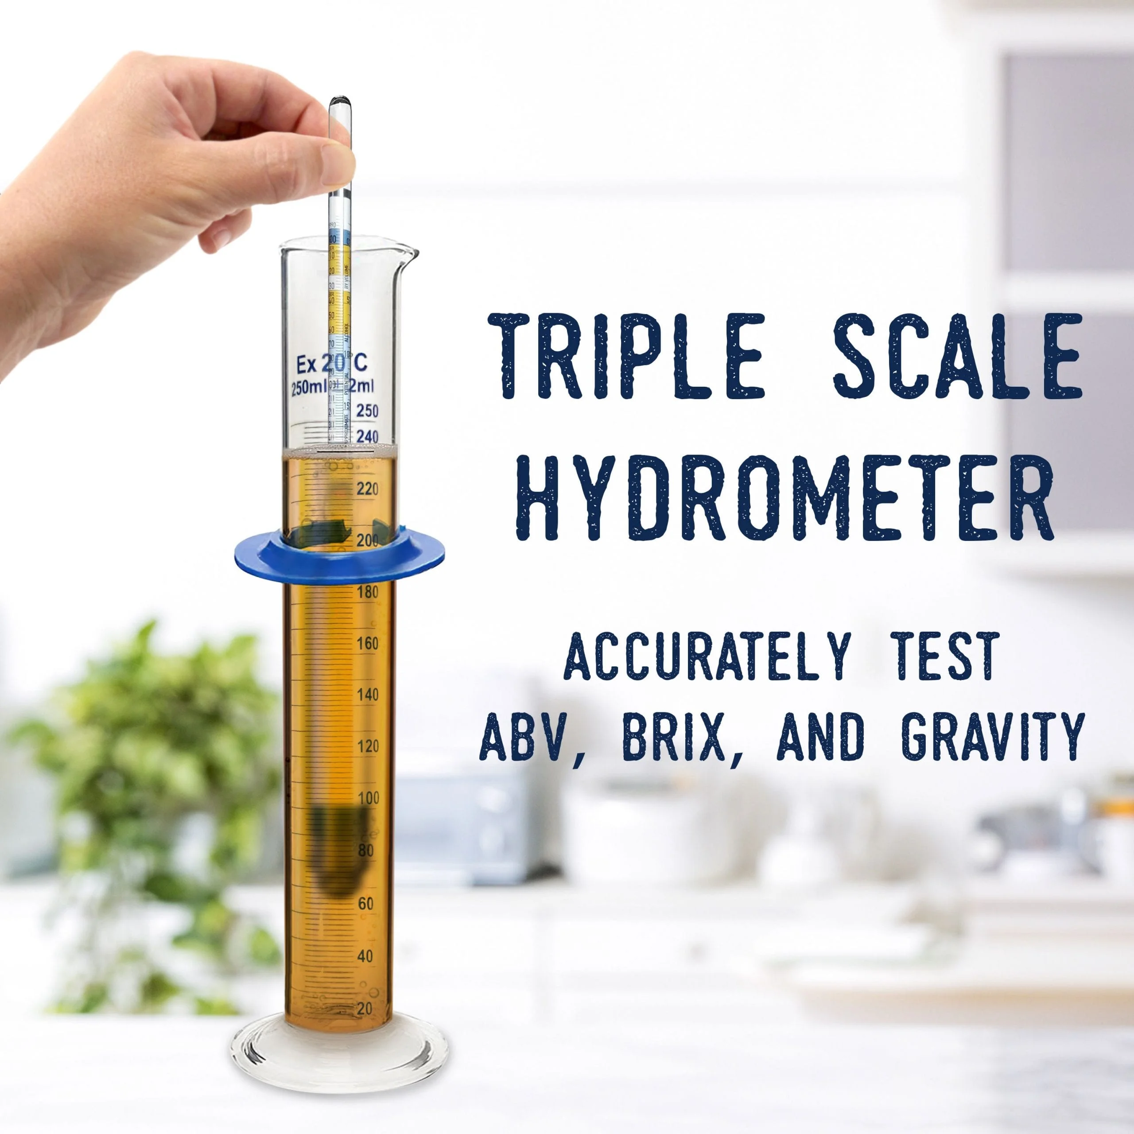
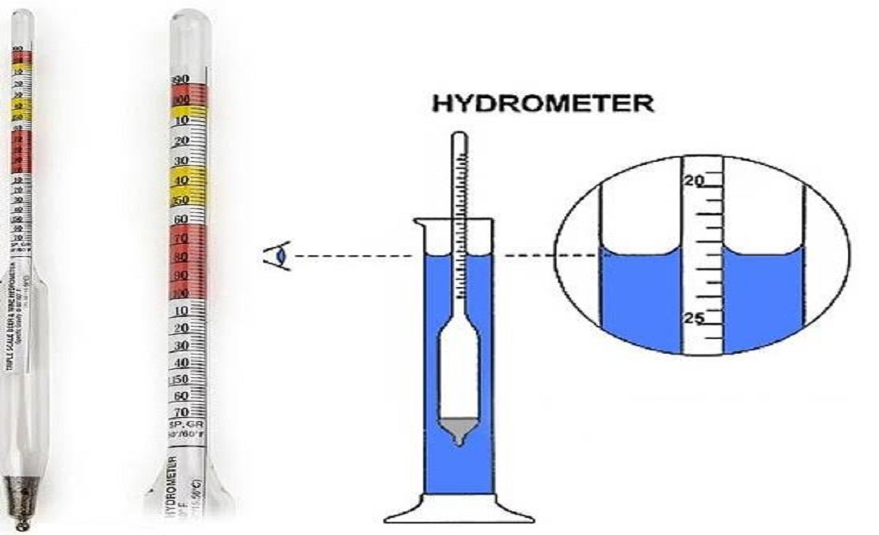
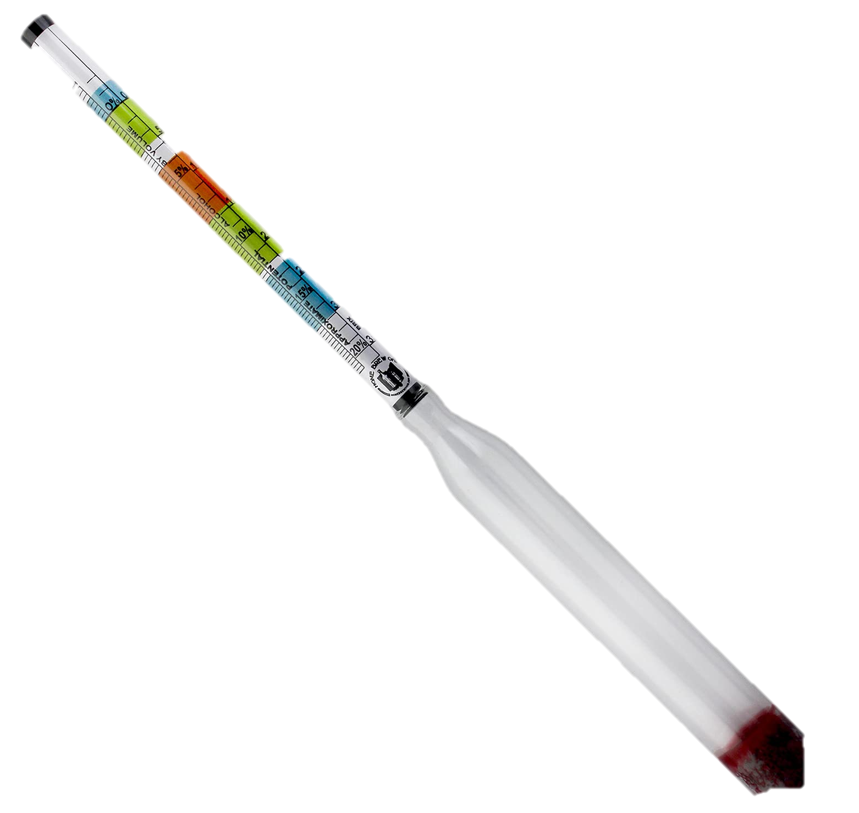
Applications of density and upthrust
Fluids, Density and upthrust
Hydrometer: an instrument used to determine the density of a fluid

