Slide 1
Fluids, Density and upthrust
Fluid: is any substance that can flow
Fluids
Gases
Liquids

Slide 2
Fluids, Density and upthrust
Density: is a measure of mass per unit volume
ρ $= \frac{mass}{volume}$
m
ρ
v

Slide 3
Fluids, Density and upthrust
Example: a tank holding a liquid has a mass of 9300 kg, the tank is 3m high, 2m long and 1.5 m wide, calculate its density.

Slide 4
Fluids, Density and upthrust
Exercise: calculate the mass of a tank holding a liquid, the tank is 0.6m high, 0.8 m long and 0.5 m wide, its density is known to be 2300 kg/m³

Slide 5
Fluids, Density and upthrust
Behaviour of gases and liquids at temperature:
At higher temperatures:
Density of gases decrease (due to volume expansion)
Density of liquids decrease (due to volume expansion)

Slide 6
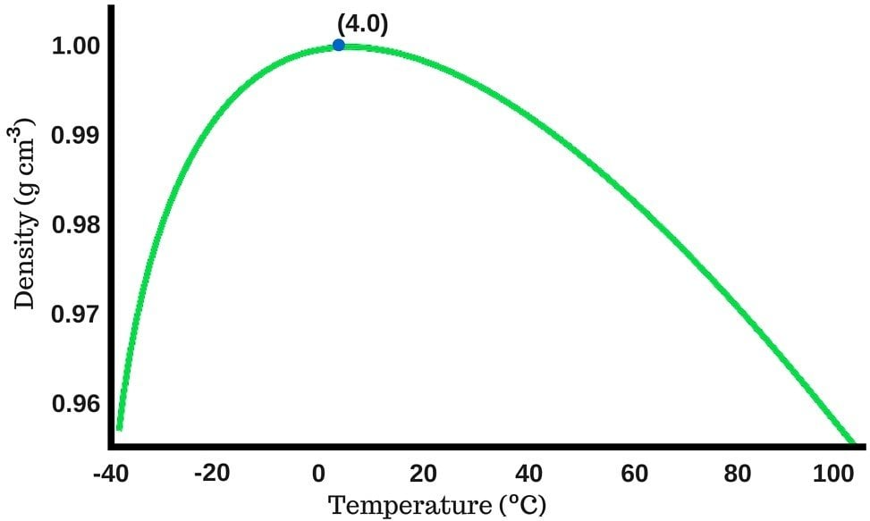
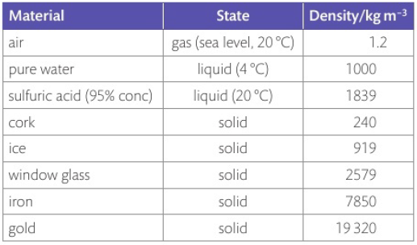
Fluids, Density and upthrust
Behaviour of gases and liquids at temperature:
Behavior of water density at different temperatures
Page 60

Slide 7
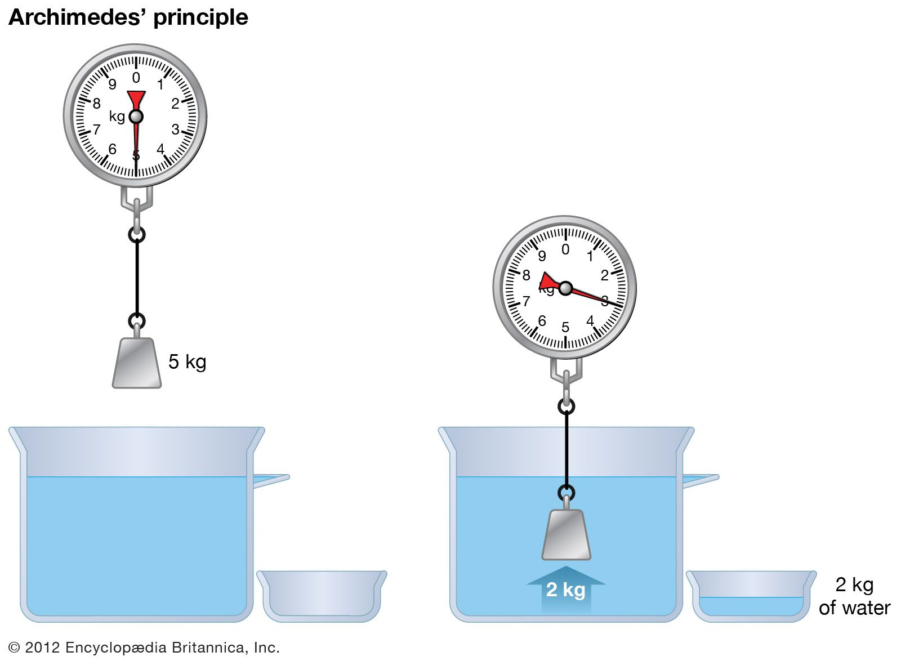
Fluids, Density and upthrust
Archimedes principle
the upward buoyant force on a body immersed in a fluid is equal to the weight of the displaced fluid

Slide 8
Fluids, Density and upthrust
Upthrust: is the upwards force experienced by a submerged object in a fluid.
The lost weight of the submerged object is equal to the weight of displaced liquid

Slide 9
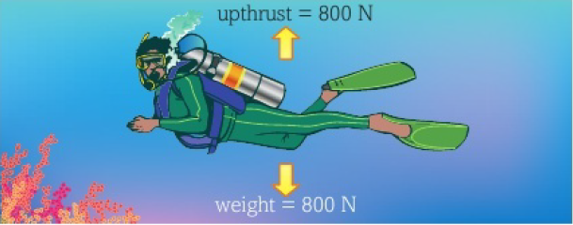
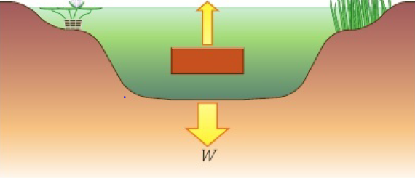
Fluids, Density and upthrust
Upthrust exerted on a body submerged in a fluid depends on:
Volume of the submerged object
Density of the fluid
Gravity
Notes:
We can find the mass of the displaced fluid using m = v x p
Since we know the volume of displaced fluid = volume of submerged object.

Slide 10
Fluids, Density and upthrust
Notes:
We can find the mass of the displaced fluid using m = v x p
Since we know the volume of displaced fluid = volume of submerged object.

Slide 11
Fluids, Density and upthrust
Upthrust exerted on a body submerged in a fluid depends on:
Volume of the submerged object
Density of the fluid
Gravity
Notes:
We can find the mass of the displaced fluid using m = v x p
Since we know the volume of displaced fluid = volume of submerged object.

