Slide 1
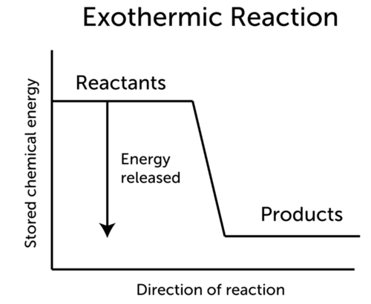
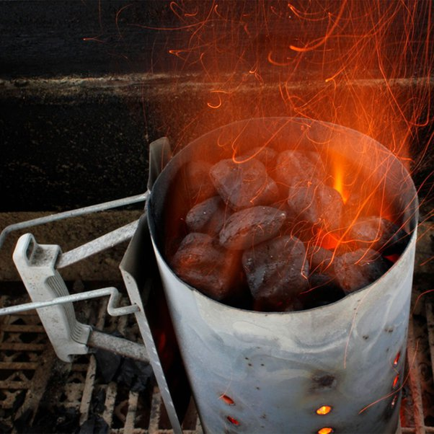
Recap example:
Fission and Fusion
Burning charcoal is an exothermic reaction
$C +O2 → CO2$

Slide 2
Fission and Fusion
Fusion: when lighter atoms are forced to merge together producing energy
Example : ${}_{1}^{3}H + {}_{1}^{2}H → {}_{2}^{4}{He} +n$
Notes:
Ex 8g/cm³×1,000=8,000kg/m³
0.854 g / cm³ = 854 kg / m³

Slide 3
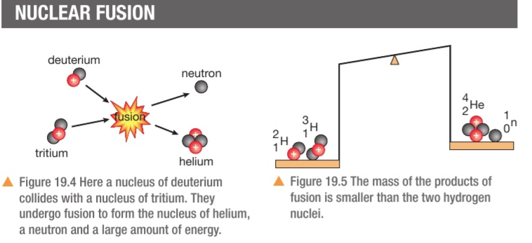
Fission and Fusion
Fusion: when lighter atoms are forced to merge together
Example :

Slide 4
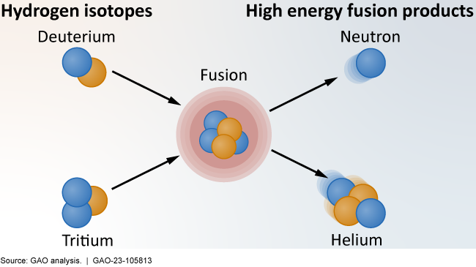
Fission and Fusion
Fusion: when lighter atoms are forced to merge together. It happens in the sun and all the stars

Slide 5
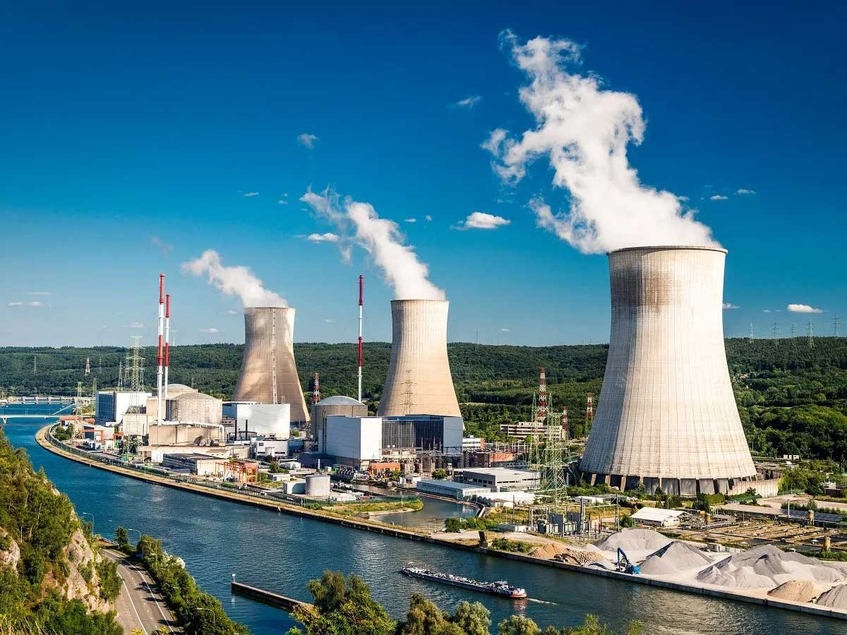
Fission and Fusion
Fission: is the breaking of atoms to generate energy, it happens in nuclear reactors.
https://www.youtube.com/watch?v=jpDRfaWYk3I

Slide 6
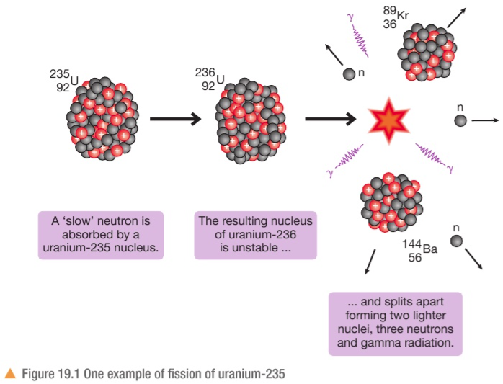
Fission and Fusion
Fission: is the breaking of atoms to generate energy, it happens in nuclear reactors.
https://www.youtube.com/watch?v=jpDRfaWYk3I

Slide 7
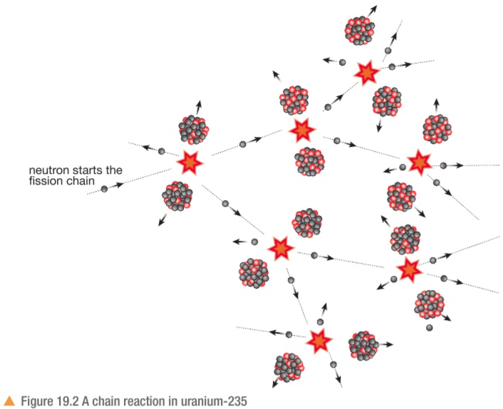
Fission and Fusion
Fission: is the breaking of atoms to generate energy, it happens in nuclear reactors.
https://www.youtube.com/watch?v=jpDRfaWYk3I

Slide 8
Fission and Fusion
Fission: is the breaking of atoms to generate energy, it happens in nuclear reactors.
https://www.youtube.com/watch?v=jpDRfaWYk3I

Slide 9
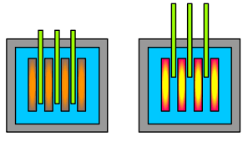
Parts of a nuclear reactor
Fission and Fusion
fuel rods: contain uranium to be used in fission reaction to generate energy
Control rods: contain materials that slow down the nuclear reaction by absorbing neutrons
Steel and concrete : shielding materials to protect the environment from radiation
https://www.youtube.com/watch?v=jpDRfaWYk3I
Notes:
Nuclear reactors do not produce CO2 or acidic gasis or smoke ,
We only need a small amount of uranium to power a nuclear reactor for 10s of years

