Slide 1
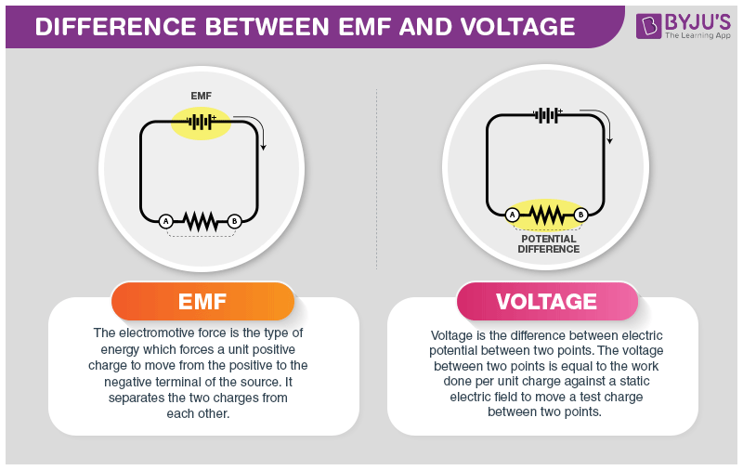
4A.3 Current & voltage
EMF (voltage) drives the current around the circuit
^{Ohm’s law:} $V=I ×R$
Resistance
Current
Voltage

Slide 2
4A.3 Current & voltage
EMF (voltage) drives the current around the circuit
^{Ohm’s law:} $V=I ×R$
In electrical circuits: electrons travel from – to +
Conventional current however, travels from + to -
Resistance
Current
Voltage

Slide 3
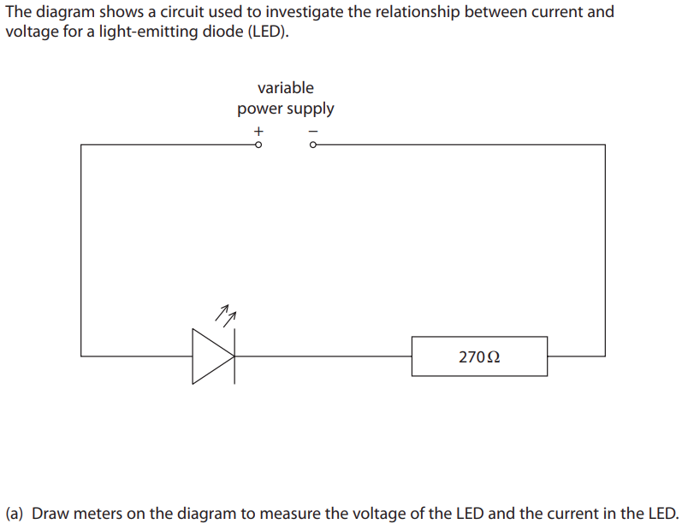
4A.3 Current & voltage
EMF (voltage) drives the current around the circuit
^{Ohm’s law:} $V=I ×R$
Resistance
Current
Voltage

Slide 4
4A.3 Current & voltage
EMF (voltage) drives the current around the circuit
^{Ohm’s law:} $V=I ×R$
Resistance
Current
Voltage
The maximum current that an LED can handle would be 32 mA, what is the maximum voltage of the battery that can be used ?
Notes:
Ohm’s law applies at constant temperatures..

Slide 5
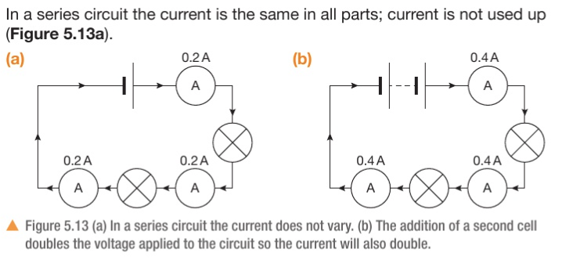
4A.3 Current & voltage
EMF (voltage) drives the current around the circuit
^{Ohm’s law:} $V=I ×R$
Resistance
Current
Voltage
Notes:
See page 156 for linearity of v-I graphs
https://phet.colorado.edu/sims/html/circuit-construction-kit-dc/latest/circuit-construction-kit-dc_all.html

Slide 6
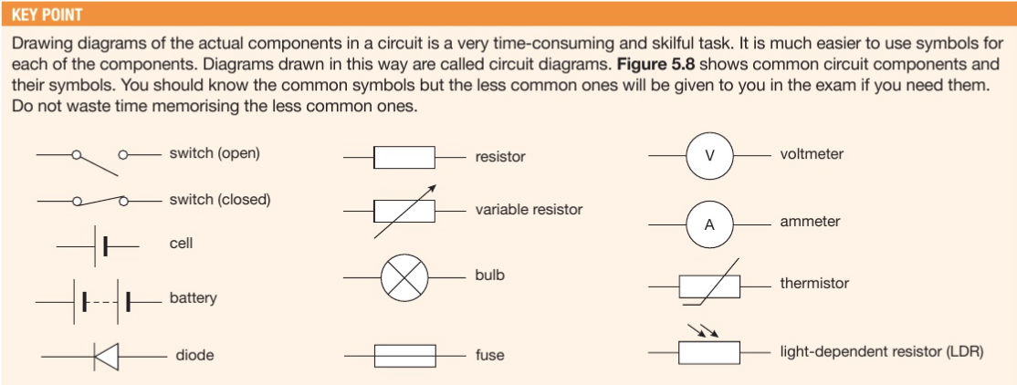
4A.3 Current & voltage
EMF (voltage) drives the current around the circuit
^{Ohm’s law:} $V=I ×R$
Resistance
Current
Voltage
Notes:
See page 156 for linearity of v-I graphs. It will be a questions in ws, but wont say R = 1/m.
It’s a good idea to memorize the shapes

Slide 7
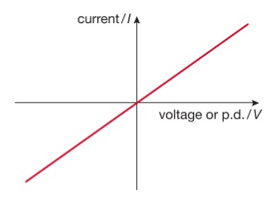
4A.3 Current & voltage
EMF (voltage) drives the current around the circuit
^{Ohm’s law:} $V=I ×R$
Normal wires and resistors follow Ohm’s law
The gradient represents conductivity
The steeper the slope The smaller the resistance
Resistance
Current
Voltage
The curve for a simple resistor (or a wire) is linear
Notes:
See page 156 for linearity of v-I graphs
As the voltage is increased, more electrons flow through the wire, causing more vibrations of the atoms and heating them up.
NOTE: the steeper the slope, the smaller the resistance
https://phet.colorado.edu/sims/html/circuit-construction-kit-dc/latest/circuit-construction-kit-dc_all.html

Slide 8
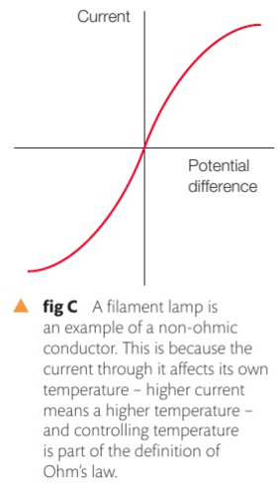
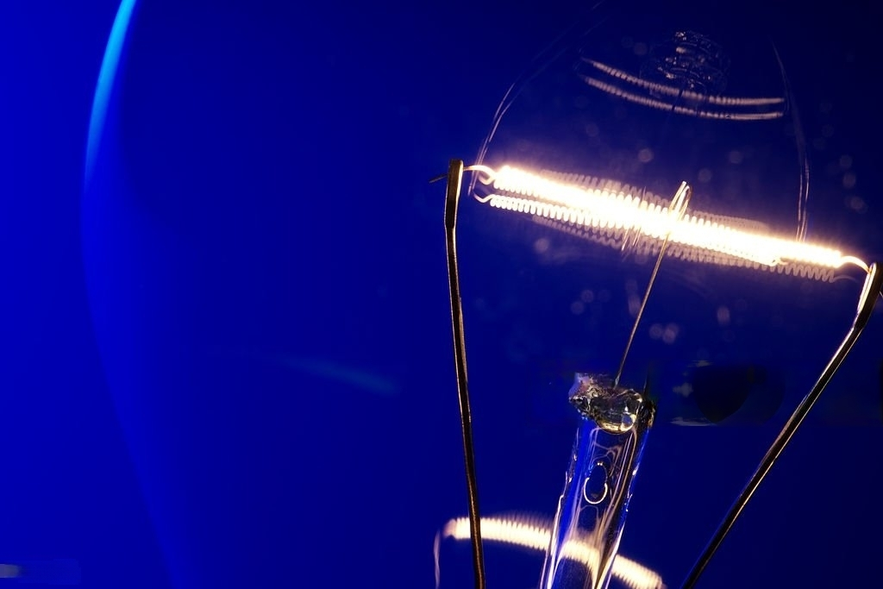
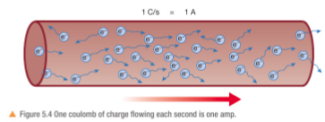
4A.3 Current & voltage
EMF (voltage) drives the current around the circuit
^{Ohm’s law:} $V=I ×R$
As the voltage is increased, more electrons flow through the wire, causing more vibrations of the atoms and heating them up, thus slowing down the flow of electrons.
Resistance
Current
Voltage
Notes:
See page 156 for linearity of v-I graphs
https://phet.colorado.edu/sims/html/circuit-construction-kit-dc/latest/circuit-construction-kit-dc_all.html

Slide 9
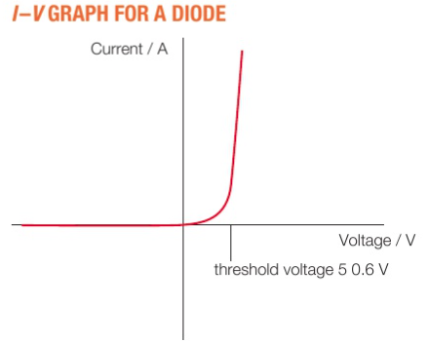
4A.3 Current & voltage
EMF (voltage) drives the current around the circuit
^{Ohm’s law:} $V=I ×R$
Diodes allow current to pass in only one direction but not the other. Note: Diodes have a drop-down (threshold) voltage
Resistance
Current
Voltage
Voltage after a diode = Voltage before diode – threshold voltage
Notes:
See page 156 for linearity of v-I graphs
https://phet.colorado.edu/sims/html/circuit-construction-kit-dc/latest/circuit-construction-kit-dc_all.html

Slide 10
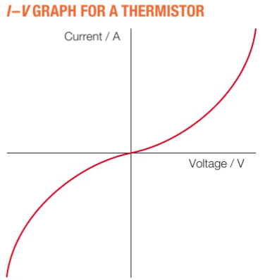
4A.3 Current & voltage
EMF (voltage) drives the current around the circuit
^{Ohm’s law:} $V=I ×R$
thermistors allow more current to pass through. as the voltage increases their resistance drops (opposite to a filament bulb)
What would be a use of a thermistor ?
Resistance
Current
Voltage
Notes:
See page 156 for linearity of v-I graphs
https://phet.colorado.edu/sims/html/circuit-construction-kit-dc/latest/circuit-construction-kit-dc_all.html

Slide 11
4A.3 Current & voltage
EMF (voltage) drives the current around the circuit
^{Ohm’s law:} $V=I ×R$
thermistors allow more current to pass through. as the voltage increases their resistance drops (opposite to a filament bulb)
What would be a use of a thermistor ?
Resistance
Current
Voltage
A common misconception is that students mix-up IV graph for a thermistor , with a filament lamp, make sure you know the difference
Notes:
See page 156 for linearity of v-I graphs
https://phet.colorado.edu/sims/html/circuit-construction-kit-dc/latest/circuit-construction-kit-dc_all.html

Slide 12
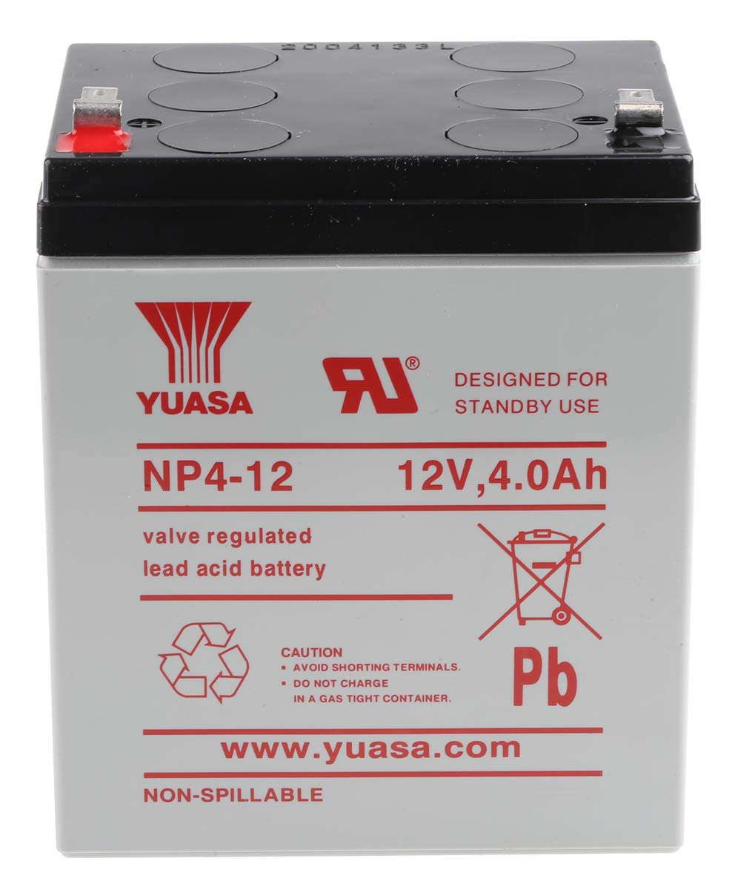
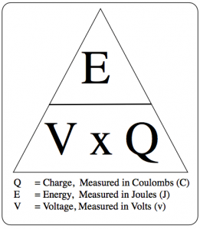
4A.4 Resistivity
4A.3 Current & voltage
Example: How much energy is stored in a battery ??
A 12V, 4 Ah battery is (ideally) capable of delivering 4 Amperes at 12 volts for one hour, calculate the energy stored in the battery in Joules ?
Relevant laws: $Volt= \frac{Joule}{Coulomb}$ , Current = $\frac{Coulomb}{Second}$
4 Ah –> 4 $\frac{Coulomb}{Second} ×$ 3600 = 14400 C
$12= \frac{Joule}{14400 C}$ = 172800 Joule
4 Ampere-hour = 4 ampere for an hour
Notes:
See page 156 for linearity of v-I graphs
Start by writing on the board that 1 ampere = 1 coulomb per second
https://phet.colorado.edu/sims/html/circuit-construction-kit-dc/latest/circuit-construction-kit-dc_all.html

Slide 13
4A.4 Resistivity
4A.3 Current & voltage
Example: How much energy is stored in a battery ??
A battery is (ideally) capable of delivering 2600 mAh at 3.7 volts for one hour, calculate the energy stored in the battery in Joules ?
Relevant laws: $Volt= \frac{Joule}{Coulomb}$ , Current = $\frac{Coulomb}{Second}$
4 Ampere-hour = 4 ampere for an hour
Notes:
See page 156 for linearity of v-I graphs
https://phet.colorado.edu/sims/html/circuit-construction-kit-dc/latest/circuit-construction-kit-dc_all.html

Slide 14
4A.4 Resistivity
4A.3 Current & voltage
Example: How much energy is stored in a battery ??
A battery is (ideally) capable of delivering 2600 mAh at 3.7 volts for one hour, calculate the energy stored in the battery in Joules ?
Relevant laws: $Volt= \frac{Joule}{Coulomb}$ , Current = $\frac{Coulomb}{Second}$
2.6 Ah x 3600 second = 9360 C
3.7 V x 9360 C = 34632 J
4 Ampere-hour = 4 ampere for an hour
Notes:
See page 156 for linearity of v-I graphs
https://phet.colorado.edu/sims/html/circuit-construction-kit-dc/latest/circuit-construction-kit-dc_all.html

Slide 15
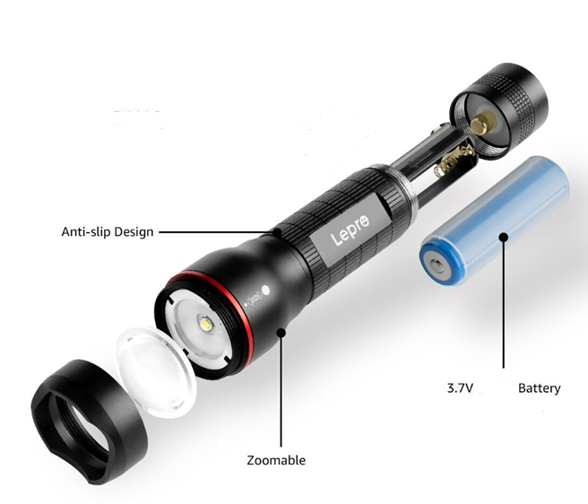
4A.4 Resistivity
4A.3 Current & voltage
A flashlight is used to illuminate a path at night, it is runs for 4 minutes, knowing that it consumes 0.8 Amperes while running from a 3.7 V battery, calculate the work done during that period of time.
Notes:
See page 156 for linearity of v-I graphs
https://phet.colorado.edu/sims/html/circuit-construction-kit-dc/latest/circuit-construction-kit-dc_all.html

Slide 16
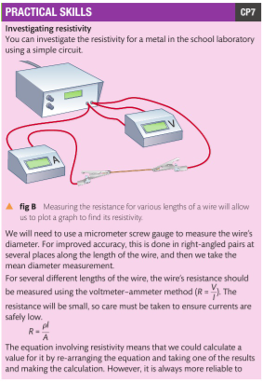
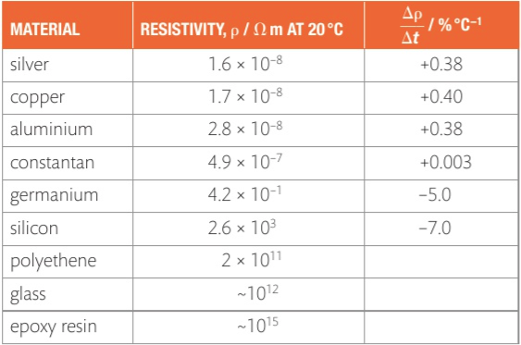
4A.4 Resistivity
Resistivity ρ is the general property of a material to resist the flow of electric current.
Resistance of a wire $Resistance=\frac{Resistivity \text{ρ}×length of the wire m }{Cross−sectional area m²}$
Notes:
Page 158
Resistivity is an inherent property of a material

Slide 17
4A.4 Resistivity
Resistivity ρ is the general property of a material to resist the flow of electric current.
$Resistance=\frac{Resistivity \text{ρ}×length of the wire m }{Cross−sectional area m²}$
A piece of copper wire has a cross-sectional area of 4mm² and a length of 2m, calculate:
The resistance of the wire
The potential difference across the wire when 10A are flowing through it
Notes:
Page 158
Resistivity is an inherent property of a material
See checkpoint

Slide 18
Notes:
https://phet.colorado.edu/sims/html/circuit-construction-kit-dc/latest/circuit-construction-kit-dc_all.html

