Slide 1
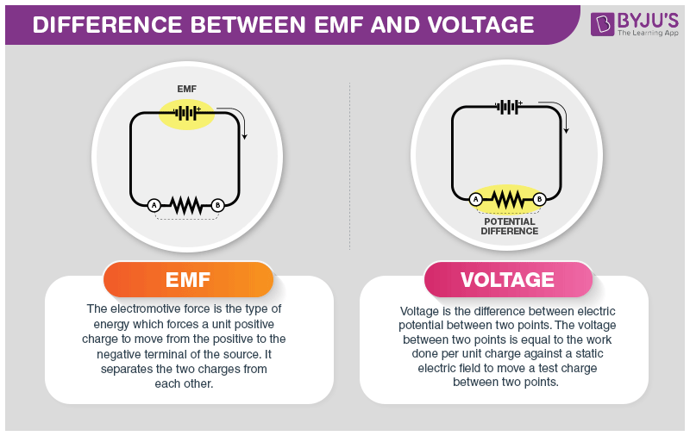
4A.3 Current & voltage
EMF (voltage) drives the current around the circuit
^{Ohm’s law:} $V=I ×R$
Resistance
Current
Voltage

Slide 2
4A.3 Current & voltage
EMF (voltage) drives the current around the circuit
^{Ohm’s law:} $V=I ×R$
In electrical circuits: electrons travel from – to +
Conventional current however, travels from + to -
Resistance
Current
Voltage

Slide 3
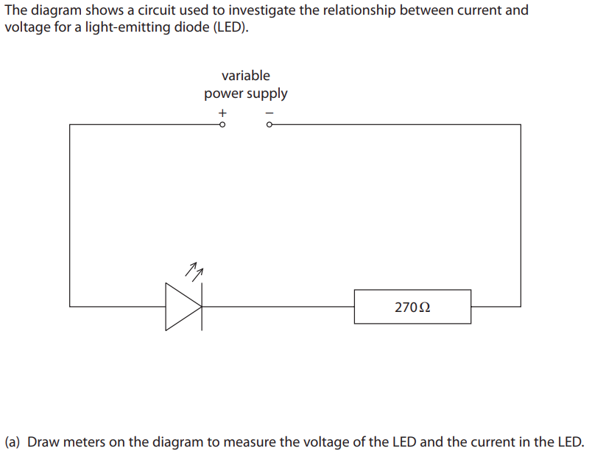
4A.3 Current & voltage
EMF (voltage) drives the current around the circuit
^{Ohm’s law:} $V=I ×R$
Resistance
Current
Voltage

Slide 4
4A.3 Current & voltage
EMF (voltage) drives the current around the circuit
^{Ohm’s law:} $V=I ×R$
Resistance
Current
Voltage
The maximum current that an LED can handle would be 32 mA, what is the maximum voltage of the battery that can be used ?
Notes:
Ohm’s law applies at constant temperatures..

Slide 5
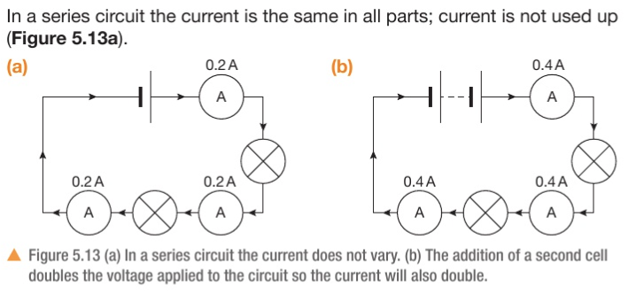
4A.3 Current & voltage
EMF (voltage) drives the current around the circuit
^{Ohm’s law:} $V=I ×R$
Resistance
Current
Voltage
Notes:
See page 156 for linearity of v-I graphs
https://phet.colorado.edu/sims/html/circuit-construction-kit-dc/latest/circuit-construction-kit-dc_all.html

Slide 6
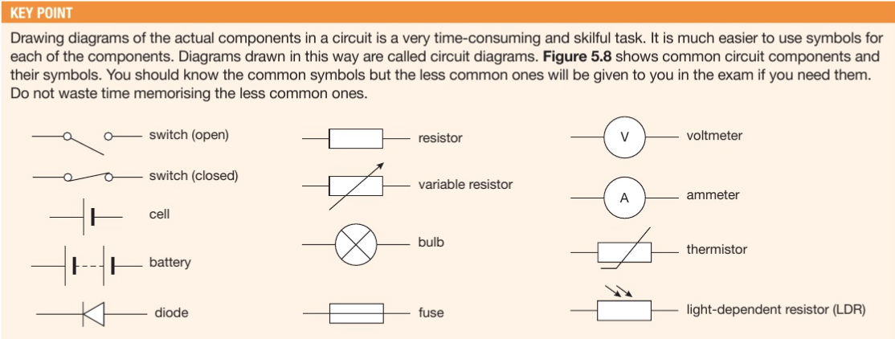
4A.3 Current & voltage
EMF (voltage) drives the current around the circuit
^{Ohm’s law:} $V=I ×R$
Resistance
Current
Voltage
Notes:
See page 156 for linearity of v-I graphs. It will be a questions in ws, but wont say R = 1/m.
It’s a good idea to memorize the shapes

Slide 7
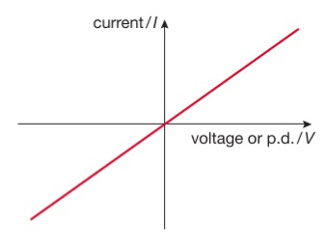
4A.3 Current & voltage
EMF (voltage) drives the current around the circuit
^{Ohm’s law:} $V=I ×R$
Normal wires and resistors follow Ohm’s law
The gradient represents conductivity
The steeper the slope The smaller the resistance
Resistance
Current
Voltage
The curve for a simple resistor (or a wire) is linear
Notes:
See page 156 for linearity of v-I graphs
As the voltage is increased, more electrons flow through the wire, causing more vibrations of the atoms and heating them up.
NOTE: the steeper the slope, the smaller the resistance
https://phet.colorado.edu/sims/html/circuit-construction-kit-dc/latest/circuit-construction-kit-dc_all.html

Slide 8
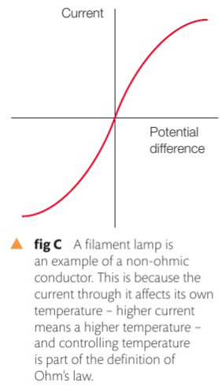
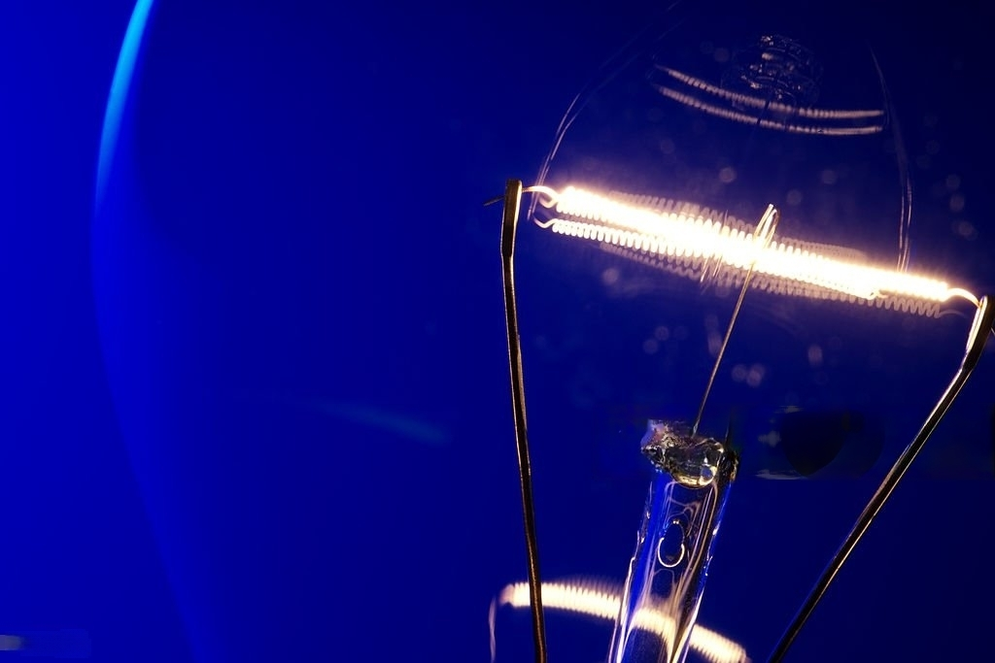
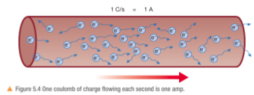
4A.3 Current & voltage
EMF (voltage) drives the current around the circuit
^{Ohm’s law:} $V=I ×R$
As the voltage is increased, more electrons flow through the wire, causing more vibrations of the atoms and heating them up, thus slowing down the flow of electrons.
Resistance
Current
Voltage
Notes:
See page 156 for linearity of v-I graphs
https://phet.colorado.edu/sims/html/circuit-construction-kit-dc/latest/circuit-construction-kit-dc_all.html

Slide 9
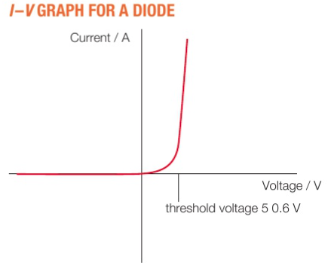
4A.3 Current & voltage
EMF (voltage) drives the current around the circuit
^{Ohm’s law:} $V=I ×R$
Diodes allow current to pass in only one direction but not the other. Note: Diodes have a drop-down (threshold) voltage
Resistance
Current
Voltage
Voltage after a diode = Voltage before diode – threshold voltage
Notes:
See page 156 for linearity of v-I graphs
https://phet.colorado.edu/sims/html/circuit-construction-kit-dc/latest/circuit-construction-kit-dc_all.html

Slide 10
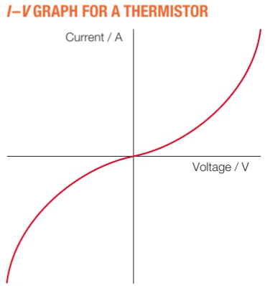
4A.3 Current & voltage
EMF (voltage) drives the current around the circuit
^{Ohm’s law:} $V=I ×R$
thermistors allow more current to pass through. as the voltage increases their resistance drops (opposite to a filament bulb)
What would be a use of a thermistor ?
Resistance
Current
Voltage
Notes:
See page 156 for linearity of v-I graphs
https://phet.colorado.edu/sims/html/circuit-construction-kit-dc/latest/circuit-construction-kit-dc_all.html

Slide 11
4A.3 Current & voltage
Notes:
See page 156 for linearity of v-I graphs
https://phet.colorado.edu/sims/html/circuit-construction-kit-dc/latest/circuit-construction-kit-dc_all.html

Slide 12
Notes:
https://phet.colorado.edu/sims/html/circuit-construction-kit-dc/latest/circuit-construction-kit-dc_all.html

