Slide 1
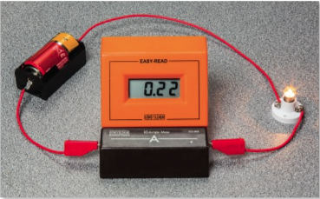
4A Electrical Quantities
Coulomb = unit of charge , 1 e = 1.602x10⁻¹⁹ C
Current: is the rate of movement of charge 1 Ampere is 1 Coulomb / second
$Current \left(A\right)=\frac{ Q (charge in coulomb)}{time (seconds)}$ =
So, 1 Coulomb = 6.242x10¹⁸ e
Normally, electrons are the charge carriers, but…

Slide 2
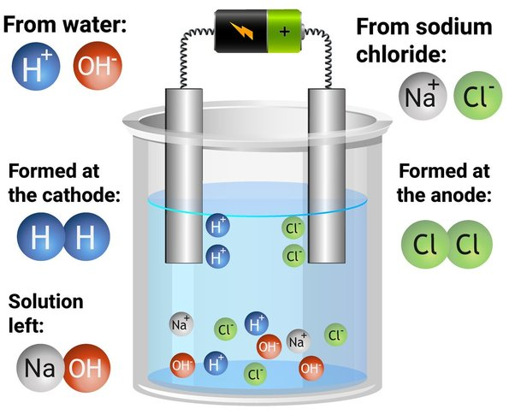
4A Electrical Quantities
Ions can also carry current especially in ionic solutions
^{Example: Bauxite}

Slide 3
4A Electrical Quantities
Voltage: is a measure of the amount of energy per unit charge
We can think about voltage as the pressure pushing the electron through the wire
Voltage = $\frac{Energy (Joules)}{Charge (Coulomb)}$
1 V = 1 Joule / Coulomb
Note : EMF = Voltage = Potential difference
Notes:
Page 152

Slide 4
4A Electrical Quantities
Notes:
Draw triangle for v e/q
Joules of energy also means work.

Slide 5
4A Electrical Quantities
Notes:
Draw triangle for v e/q
Joules of energy also means work.

Slide 6
4A Electrical Quantities
The electron Volt (eV) – is a unit of energy that is generally used with sub-atomic particles.
Voltage = $\frac{Energy (Joules)}{1.602x 10−19}$
Notes:
Draw triangle for v e/q
Joules of energy also means work.
But.. EMF is supply voltage, PD = consuming device dropping voltage
Talk about voltage.
HW: phet

Slide 7
4A Electrical Quantities
labwork:
https://phet.colorado.edu/sims/html/circuit-construction-kit-dc-virtual-lab/latest/circuit-construction-kit-dc-virtual-lab_all.html
Build a circuit using 2 batteries, a resistor and a light bulb.
Total voltage: 18 V
Total current: 1.13 Ampere
Use voltmeter and ammeter from the right to measure current and voltage
Notes:
Draw triangle for v e/q
Joules of energy also means work.
But.. EMF is supply voltage, PD = consuming device dropping voltage
Talk about voltage.
HW: phet

Slide 8
4A Electrical Quantities
labwork:
https://phet.colorado.edu/sims/html/circuit-construction-kit-dc-virtual-lab/latest/circuit-construction-kit-dc-virtual-lab_all.html
Build a circuit using 2 batteries, a resistor and a light bulb.
Total voltage: 18 V
Total current: 1.13 Ampere
Use voltmeter and ammeter from the right to measure current and voltage
Notes:
Draw triangle for v e/q
Joules of energy also means work.
But.. EMF is supply voltage, PD = consuming device dropping voltage
Talk about voltage.
HW: phet

