Slide 1
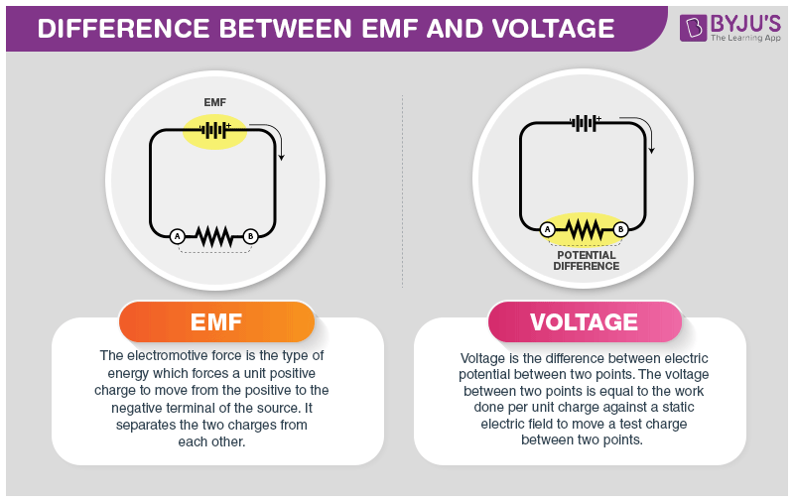
4B.1 series and parallel
EMF (voltage) drives the current around the circuit
^{Ohm’s law:} $V=I ×R$
Resistance
Current
Voltage
Notes:
Write A= C/s
V = W/C

Slide 2
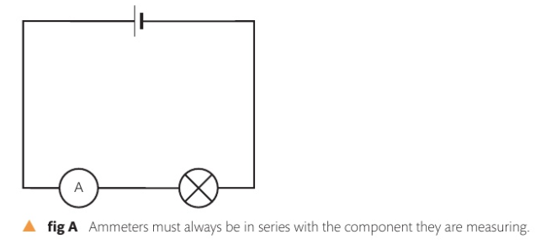
4B.1 series and parallel
EMF (voltage) drives the current around the circuit
^{Ohm’s law:} $V=I ×R$
In electrical circuits: electrons travel from – to +
Conventional current however, travels from + to -
Resistance
Current
Voltage
Electrical current prefers to follow the path of least resistance. Ammeters are conductors of current (low resistance)
Notes:
p. 174

Slide 3
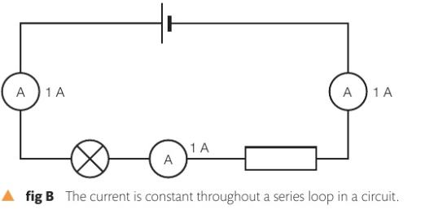
4B.1 series and parallel
The current is the same throughout the circuit if its connected in series,
there’s only one path for the current to flow

Slide 4
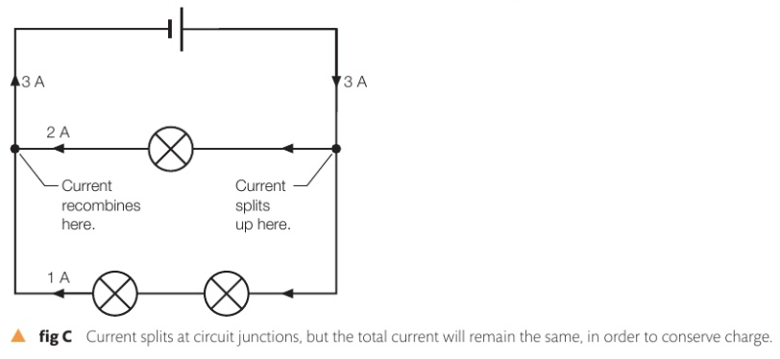
4B.1 series and parallel
If the circuit is in parallel, the current splits in two paths (or more), the current flows more in the path of least resistance.
The total current is conserved

Slide 5
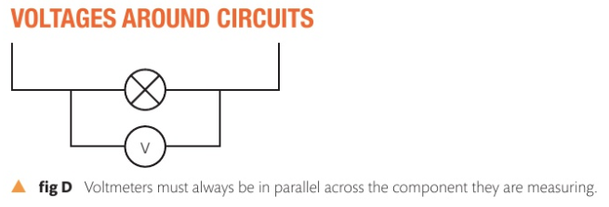
4B.1 series and parallel
Voltmeters
Voltmeters have very high resistance (ideally near infinite) , they do not conduct current
Voltmeters can be connected across a battery or cell to find EMF (Electromotive Force), or across a component to find the potential difference (P.D)
The total voltage is conserved
Notes:
V = emf = pd

Slide 6
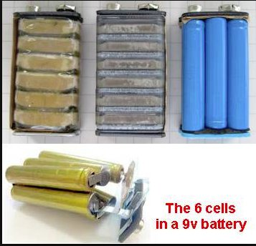
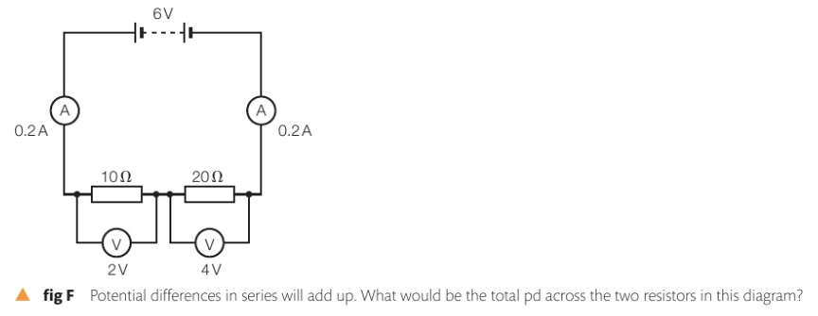
4B.1 series and parallel
Voltmeters
Batteries are made of cells in series to increase the EMF
When resistors are used, the total voltage is conserved
Notes:
V = emf = pd

Slide 7
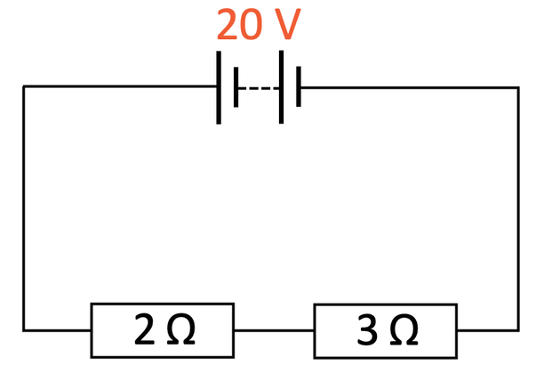
4B.1 series and parallel
Calculating for resistors in series:
The total resistance of resistors in series adds up,
$R_{Total}=R_{1}+R_{2}+R_{3}$
$R_{Total}$= $\frac{{Voltage }_{Total}}{I }$
The current is the same in any part of the circuit with resistor in series
Notes:
V = emf = pd

Slide 8
4B.1 series and parallel
Calculating for (P.D) Voltage with resistors in series:
The total P.D is conserved in a circuit, it is only divided across the resistors
Using $R_{Total}$= $\frac{{Voltage }_{Total}}{I }$
We can then find the P.D across any resistor.
Example: Find the P.D across each of the shown resistors
Answer) ${Voltage }_{Total}$ = ${Current }_{Total}$ x Resistance → I = $\frac{V}{R}=\frac{20}{5}=4 A$
Voltage across 3 Ω resistor = $V=I x R → V=4 ∗3\text{Ω}=12V$
Voltage across 2 Ω resistor = V = I x R → V = 4 A x 2Ω = 8 V
Hint: The idea here is to find the total resistance, the total voltage, and total current, then use Ohm’s law for individual resistors.
Notes:
V = emf = pd

Slide 9
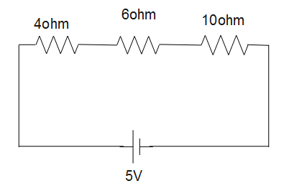
4B.1 series and parallel
Calculating for (P.D) Voltage with resistors in series:
Example: calculate the P.D. across each of these resistors
Hint: The idea here is to find the total resistance, then total voltage and total current, then use Ohm’s law for individual resistors.
Notes:
V = emf = pd

Slide 10
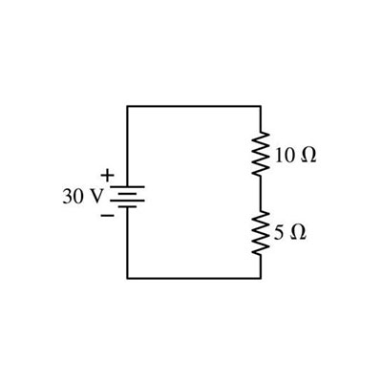
4B.1 series and parallel
Calculating for (P.D) Voltage with resistors in series:
Example: calculate the P.D. across each of these resistors
Hint: The idea here is to find the total resistance, then total voltage and total current, then use Ohm’s law for individual resistors.
Notes:
V = emf = pd

Slide 11
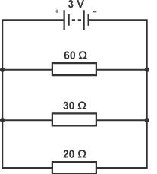
4B.1 series and parallel
Calculating for resistance in Parallel :
To find the total (equivalent) resistance of two resistor in parallel:
$\frac{1}{R_{Total}^{}}=\frac{1}{R_{1}^{}}$ + $\frac{1}{R_{2}^{}}$ + $\frac{1}{R_{3}^{}} …$
Example: calculate the total resistance and the current in this circuit:
$\frac{1}{R_{Total}^{}}=\frac{1}{60}$ + $\frac{1}{30}$ + $\frac{1}{20}$ = $\frac{1}{10}$
To find$R_{Total}^{}, use \frac{1}{\frac{1}{10}}$ = 10 $\text{Ω}$
This is $\frac{1}{Rtotal}$ not Rtotal !
Hint: The more the resistances are in parallel, the less the equivalent resistance.
Don’t forget to flip 1/Rtotal to get the total resistance.
Notes:
V = emf = pd

Slide 12
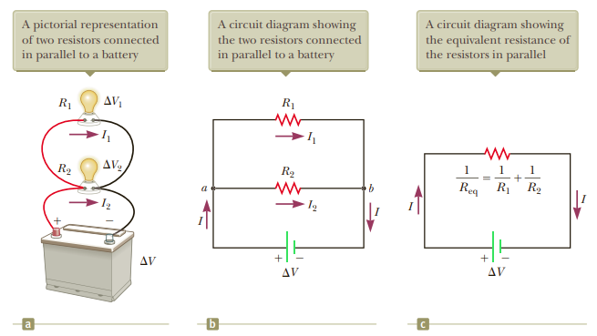
4B.1 series and parallel
Calculating for resistance in Parallel :
Hint: The more the resistances are in parallel, the less the equivalent resistance.
Don’t forget to flip 1/Rtotal to get the total resistance.
Notes:
V = emf = pd

Slide 13
4B.1 series and parallel
Calculating for resistance in Parallel :
To find the total (equivalent) resistance of two resistor in parallel:
$\frac{1}{R_{Total}^{}}=\frac{1}{R_{1}^{}}$ + $\frac{1}{R_{2}^{}}$ + $\frac{1}{R_{3}^{}} …$
Example: calculate the total resistance and the current in this circuit:
$\frac{1}{R_{Total}^{}}=\frac{1}{60}$ + $\frac{1}{30}$ + $\frac{1}{20}$ = $\frac{1}{10}$
To find$R_{Total}^{}, use \frac{1}{\frac{1}{10}}$ = 10 $\text{Ω}$
This is $\frac{1}{Rtotal}$ not Rtotal !
Hint: The more the resistances are in parallel, the less the equivalent resistance.
Don’t forget to flip 1/Rtotal to get the total resistance.
Notes:
V = emf = pd

Slide 14
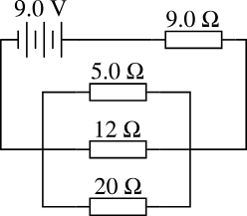
4B.1 series and parallel
Calculating for resistance in Parallel :
To find the total (equivalent) resistance of two resistor in parallel:
Exercise: calculate the total
current in the following circuit, then find the P.D across each resistor
Hint: When given Parallel + Series circuits, always try to combine the parallel resistors first as possible.
The P.D across parallel resistors is the same (since it can be combined as 1 resistor)
Notes:
1- find equivalent resistance of parallel circuits (R total)
2- combine them as 1 series resistor 0.75A
3- add up V = IR
4- reuse v=ir

Slide 15
4B.1 series and parallel
Calculating for resistance in Parallel :
To find the total (equivalent) resistance of two resistor in parallel:
Exercise: calculate the total current in the following circuit, then find the P.D across each resistor
Hint: When given Parallel + Series circuits, always try to combine the parallel resistors first as possible
Notes:
1- find equivalent resistance of parallel circuits (R total)
2- combine them as 1 series resistor 0.75A
3- add up V = IR
4- reuse v=ir
<> U can think of a wire as a potentiometer

Slide 16
4B.1 series and parallel
Calculating for resistance in Parallel :
To find the total (equivalent) resistance of two resistor in parallel:
Exercise: calculate the total current in the following circuit, then find the P.D across each resistor
Hint: When given Parallel + Series circuits, always try to combine the parallel resistors first as possible
Notes:
1- find equivalent resistance of parallel circuits (R total)
2- combine them as 1 series resistor 0.75A
3- add up V = IR
4- reuse v=ir
<> U can think of a wire as a potentiometer

Slide 17
4B.1 series and parallel
Power in an electrical circuit:
$P=V×I$
$P=I^{2} ×R$
Notes:
1- find equivalent resistance of parallel circuits (R total)
2- combine them as 1 series resistor 0.75A
3- add up V = IR
4- reuse v=ir
<> U can think of a wire as a potentiometer

