Slide 1
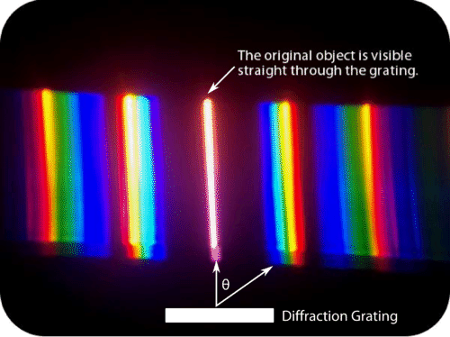
3B waves diffraction
Wave diffraction: the spreading of the wave as it passes an opening or a gap.
Diffraction changes the direction of the wave (light)
For diffraction to happen, the size of the gap must be nearly equal or smaller to the wavelength.
Notes:
The best gap is the same size as the wavelength

Slide 2
3B waves diffraction
Wave diffraction: the spreading of the wave as it passes an opening or a gap.
Diffraction changes the direction of the wave (light)
For best diffraction to happen, the size of the gap must be nearly equal or smaller to the wavelength.
Much larger gaps than wavelengths do not produce diffraction as the wave can move through it easily
Notes:
The best gap is the same size as the wavelength

Slide 3
3B waves diffraction
Wave diffraction: the spreading of the wave as it passes an opening or a gap.
Diffraction occurs when a wave encounters an obstacle or a non-uniformity in its medium. For light waves, this could include passing through a small opening, around corners, or over an edge.
When multiple waves overlap, they may interfere constructively or destructively, resulting in patterns of bright and dark regions.
A path difference of half a wavelength leads to destructive interference, while a full wavelength results in constructive interference
Notes:
The best gap is the same size as the wavelength

Slide 4
Law of diffraction
3B waves diffraction
Spacing between the slits (in meter)
Order of diffraction (unitless 1st, 2nd, …#)
n λ = d sinϴ
sin of the angle of diffraction
wavelength (in meter)
2nd
1st
0th
1st
2nd
d
ϴ
Notes:
The best gap is the same size as the wavelength

Slide 5
Law of diffraction
3B waves diffraction
Spacing between the slits (in meter)
Order of diffraction (unitless 1st, 2nd, …#)
n λ = d sinϴ
sin of the angle of diffraction
wavelength (in meter)
2nd
1st
0th
1st
2nd
d
ϴ
Notes:
The best gap is the same size as the wavelength

Slide 6
Law of diffraction
3B waves diffraction
Spacing between the slits (in meter)
Order of diffraction (unitless 1st, 2nd, …#)
n λ = d sinϴ
sin of the angle of diffraction
wavelength (in meter)
2nd
1st
0th
1st
2nd
d
ϴ
Notes:
Factors affecting diffraction in a diffraction grating: wavelength (m) , slit spacing in the diffraction grating , which order

Slide 7
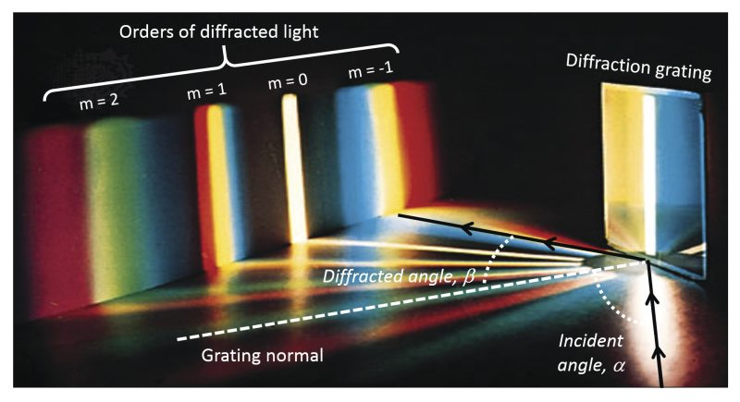
3B waves diffraction
Color of light is a property of its wavelength
Different wavelengths of light diffract at different angles
Shorter wavelengths diffract less and have shorter gaps between them
Notes:
https://phet.colorado.edu/sims/html/wave-interference/latest/wave-interference_all.html

Slide 8
Example
3B waves diffraction
A grating with 1000 lines per millimeter is illuminated by monochromatic light of wavelength 500 nanometers. What is the angle of the first-order diffraction?
n λ = d sinϴ
1 x 500 x 10⁻⁹ = $\frac{\text{10}\text{00 }\text{x} \text{10-3}}{1000}$ Sinϴ
sinϴ = $\frac{500 x {10}_{}^{−9}}{\text{1 }\text{x} {10}_{}^{−6}}$ = 0.5
arcsin 0.5 = 30°
Notes:
https://phet.colorado.edu/sims/html/wave-interference/latest/wave-interference_all.html

Slide 9
Example
3B waves diffraction
A grating with 1000 lines per millimeter is illuminated by monochromatic light of wavelength 500 nanometers. What is the angle of the first-order diffraction?
n λ = d sinϴ
1 x 500 x 10⁻⁹ = $\frac{\text{10}\text{00 }\text{x} {10}_{}^{−3}}{1000}$ Sinϴ
sinϴ = $\frac{500 x {10}_{}^{−9}}{\text{1 }\text{x} {10}_{}^{−6}}$ = 0.5
arcsin 0.5 = 30°
Notes:
https://phet.colorado.edu/sims/html/wave-interference/latest/wave-interference_all.html

Slide 10
Example
3B waves diffraction
A grating with 1000 lines per millimeter is illuminated by monochromatic light of wavelength 500 nanometers. What is the angle of the second-order diffraction?
n λ = d sinϴ
Notes:
https://phet.colorado.edu/sims/html/wave-interference/latest/wave-interference_all.html

Slide 11
Example
3B waves diffraction
A grating with 1000 lines per millimeter is illuminated by monochromatic light of wavelength 500 nanometers. What is the angle of the second-order diffraction?
n λ = d sinϴ
2 x 500 x 10⁻⁹ = $\frac{\text{10}\text{00 }\text{x} {10}_{}^{−3}}{1000}$ Sinϴ
sinϴ = $\frac{1000 x {10}_{}^{−9}}{\text{1 }\text{x} {10}_{}^{−6}}$ = 1
arcsin 1 = 90°
Notes:
https://phet.colorado.edu/sims/html/wave-interference/latest/wave-interference_all.html

Slide 12
Example
3B waves diffraction
A grating with 1000 lines per millimeter is illuminated by monochromatic light of wavelength 500 nanometers. What is the angle of the second-order diffraction?
n λ = d sinϴ
2 x 500 x 10⁻⁹ = $\frac{\text{10}\text{00 }\text{x} {10}_{}^{−3}}{1000}$ Sinϴ
sinϴ = $\frac{1000 x {10}_{}^{−9}}{\text{1 }\text{x} {10}_{}^{−6}}$ = 1
arcsin 1 = 90°
Notes:
https://phet.colorado.edu/sims/html/wave-interference/latest/wave-interference_all.html

Slide 13
Example
3B waves diffraction
A grating with 900 lines per millimeter what is the spacing (in meters) between the slits ?
Notes:
https://phet.colorado.edu/sims/html/wave-interference/latest/wave-interference_all.html

Slide 14
Example
3B waves diffraction
Notes:
https://phet.colorado.edu/sims/html/wave-interference/latest/wave-interference_all.html

Slide 15
Example
3B waves diffraction
Notes:
https://www.physicsandmathstutor.com/pdf-pages/?pdf=https%3A%2F%2Fpmt.physicsandmathstutor.com%2Fdownload%2FPhysics%2FA-level%2FTopic-Qs%2FEdexcel%2F05-Waves-and-Particle-Nature-of-Light%2FSet-N%2FInterference%2520and%2520Diffraction.pdf

