Slide 1
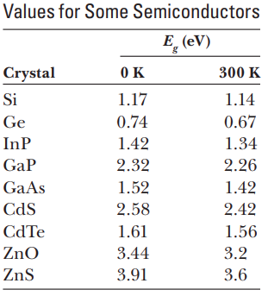
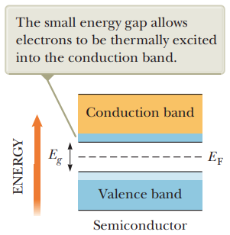
4A.6 Semiconductors
Semiconductors: are materials that can be both insulators and conductors,
they have a small number of delocalized electrons.
Example: silicon , germanium
Notes:
the same type of band structure as an insulator, but the energy gap is much smaller, on the order of 1 eV.

Slide 2
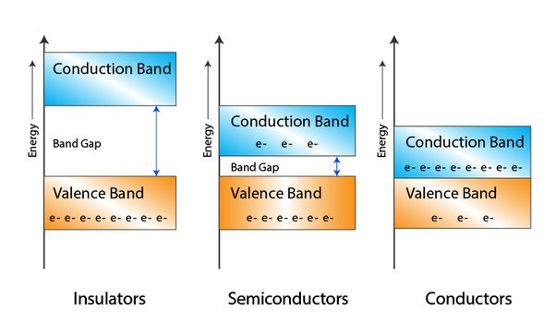
4A.6 Semiconductors
Semiconductors: are materials that can be both insulators and conductors,
they have a small number of delocalized electrons.
Example: silicon , germanium
the energy band gap for insulator is much larger than that of semiconductors and conductors, hence why it’s difficult for electrons to move to the conduction band.
Notes:
the same type of band structure as an insulator, but the energy gap is much smaller, on the order of 1 eV.

Slide 3
4A.6 Semiconductors
Semiconductors: are materials that can be both insulators and conductors,
they have a small number of delocalized electrons.
Example: silicon , germanium
Sample question: Why does the band gap of semiconductors decrease as temperature increase (in contrast to conductors).
Or why do semiconductors become more conductive at higher temperatures ?
A: Because as temperature is increased, more energy is available for the electrons to jump to the conduction band.
[this is because heat imparts vibrations to the atoms and electrons, which makes its easier for electrons to jump to the conduction band]
Notes:
the same type of band structure as an insulator, but the energy gap is much smaller, on the order of 1 eV.

Slide 4
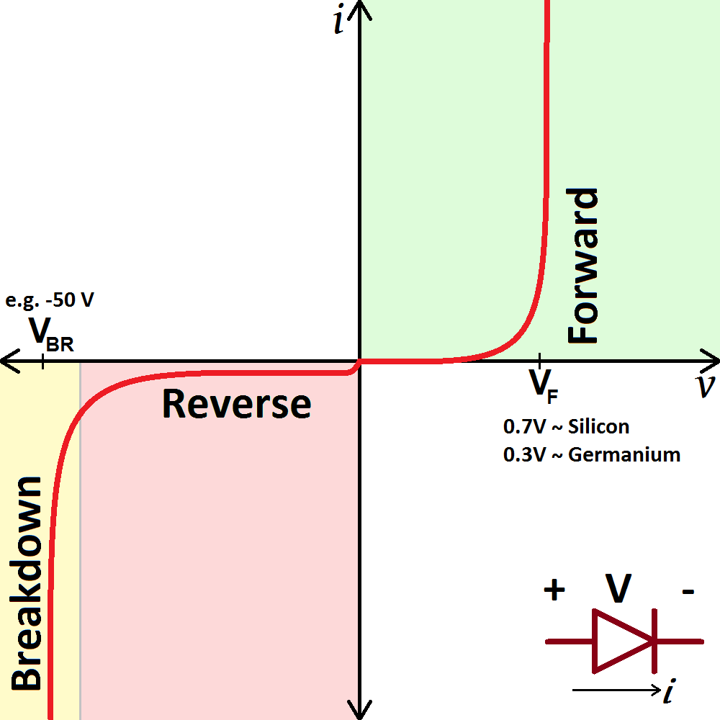
4A.6 Semiconductors
I-V curve for a diode: Example of semiconducting component: - Diode - LED - Transistor - thermistor

Slide 5
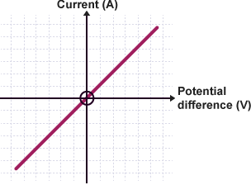
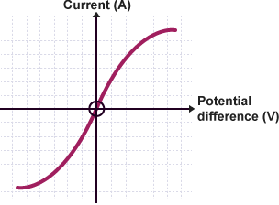
4A.6 Semiconductors
I-V curve for various components:

Slide 6
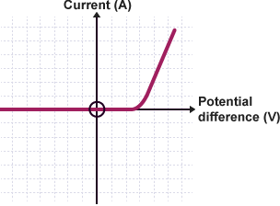
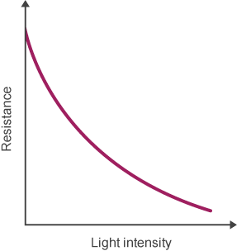
4A.6 Semiconductors
I-V curve for various components:
Think about it… Why does the resistance of a thermistor decreases with increased temperature ? (Hint: it’s a semiconductor)

Slide 7
4A.6 Semiconductors
Electron hole pairs: in semiconductors, the electrons jump from valence to conduction band leaving holes behind them. These electrons (and holes) are what allow movement of current.
Reminder: In solutions, it is not only the electrons that can conduct current, but ions as well.
Notes:
The electrons are attracted towards the + , the holes towards the –
Note: a hole is not the ion (H+ or Si+) rather, it is the absence of an electron

Slide 8
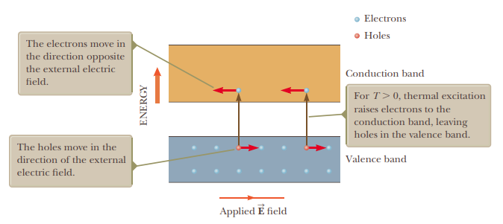
4A.6 Semiconductors
Electron hole pairs: in semiconductors, the electrons jump from valence to conduction band leaving holes behind them. These electrons (and holes) are what allow movement of current.
Reminder: In solutions, it is not only the electrons that can conduct current, but ions as well.
Notes:
The electrons are attracted towards the + , the holes towards the –
Note: a hole is not the ion (H+ or Si+) rather, it is the absence of an electron

Slide 9
4A.6 Semiconductors
Superconductivity: as a conductor (metal) is cooled to very low temperatures, the metal becomes a better and better conductor, below some critical temperature, the resistance drops to Zero, the metal exhibits superconductivity.
Some ceramics exhibit superconductivity at higher temperatures than metals
Uses:
MRI where powerful currents are needed for the magnetic fields
LHC & accelerators
Notes:
Lk 99

