Slide 1
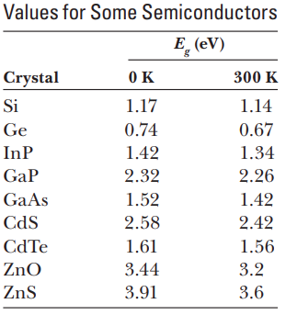
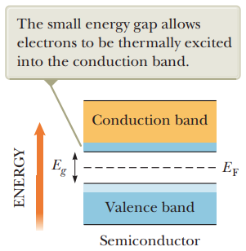
4A.6 Semiconductors
Semiconductors: are materials that can be both insulators and conductors,
they have a small number of delocalized electrons.
Example: silicon , germanium
Notes:
the same type of band structure as an insulator, but the energy gap is much smaller, on the order of 1 eV.

Slide 2
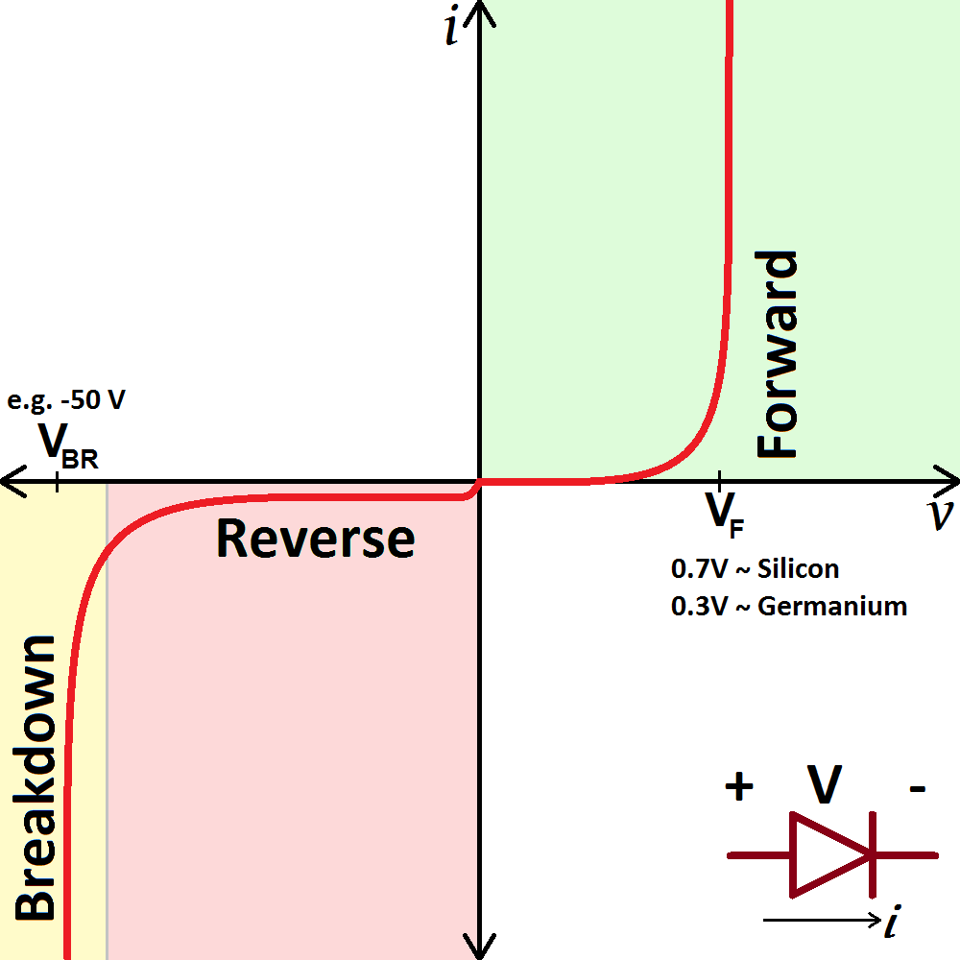
4A.6 Semiconductors

