Slide 1
phase
Wave phase
The phase of a wave refers to a position in its cycle, it indicates the wave's progress, Or a certain position in its cycle.
It indicates specific point in its cycle and how far it has progressed through a complete oscillation
It is measured in degrees or radians
Notes:
Book, page 101.
We can use degrees or radians, from a circle to define any point on a graph. A full circle = 360Θ = 2pi

Slide 2
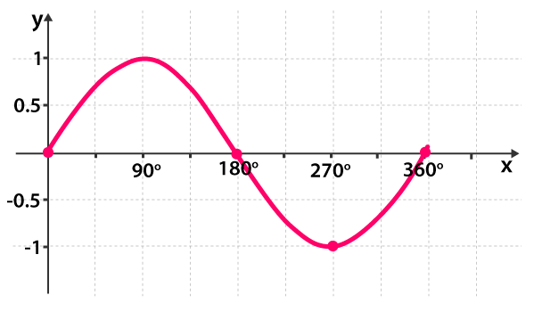
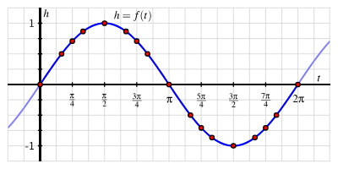
phase
Wave phase
Representing phase of a wave using radians:
In degrees | In radians
0° | 0π
90° | 1/2π
180° | π
270° | 3/2π
360° | π
Notes:
A sin wave can be used to represent
https://www.mathsisfun.com/algebra/trig-sin-cos-tan-graphs.html
We can use degrees or radians, from a circle to define any point on a graph. A full circle = 360Θ = 2pi
Lets continue till 450 degrees, 450 and 90 are in phase. Any 2 points together are known as in phase
To get a whole rotation, say.. Is it divisible by 360 ?
Half rotation, is it divisible by 180 ?

Slide 3
phase
Wave phase
Representing phase of a wave using radians:
In degrees | In radians
0° | 0π
90° | 1/2π
180° | π
270° | 3/2π
360° | π
Notes:
A sin wave can be used to represent
https://www.mathsisfun.com/algebra/trig-sin-cos-tan-graphs.html
We can use degrees or radians, from a circle to define any point on a graph. A full circle = 360Θ = 2pi
Lets continue till 450 degrees, 450 and 90 are in phase. Any 2 points together are known as in phase
To get a whole rotation, say.. Is it divisible by 360 ?
Half rotation, is it divisible by 180 ?

Slide 4
phase
Wave phase
Representing phase of a wave using radians:
In degrees | In radians
0° | 0π
90° | 1/2π
180° | π
270° | 3/2π
360° | π
Notes:
A sin wave can be used to represent
https://www.mathsisfun.com/algebra/trig-sin-cos-tan-graphs.html
We can use degrees or radians, from a circle to define any point on a graph. A full circle = 360Θ = 2pi
Lets continue till 450 degrees, 450 and 90 are in phase. Any 2 points together are known as in phase
To get a whole rotation, say.. Is it divisible by 360 ?
Half rotation, is it divisible by 180 ?

Slide 5
phase
Wave phase
Exercise: convert the following to radians
(450° , 720°, 1440°, 120°, 60°, 45°)
Radians = Degrees×$\frac{π}{180}$
Multiply by $π$, then divide by 180
Notes:
45 = pi/4
60 degrees = pi/3

Slide 6
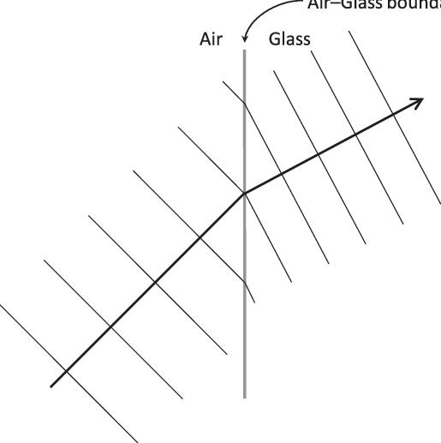
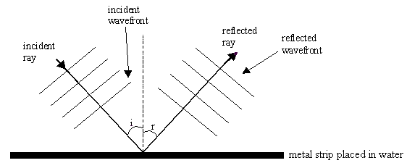
Wavefronts
Wavefronts
are described as lines that represent points in the same phase on a wave and are often used to illustrate how waves propagate through space
Notes:
Wavefront, parallel lines may represent crest.
Arrows represent the ray

Slide 7
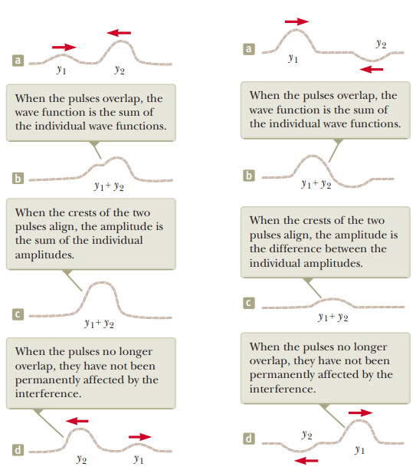
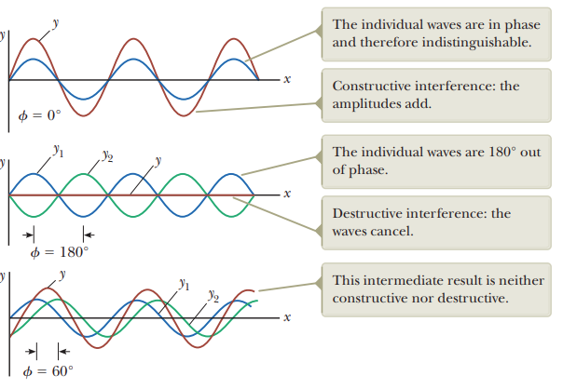
Wave superposition
Wavefronts
Notes:
Must show phet ,See checkpoint after this slide
Btw, constructive, same side of rope, no tension on end of rope
destructive, waves meet on opposite side of rope/

Slide 8
Wave superposition
Wavefronts
Notes:
Must show phet ,See checkpoint after this slide
Btw, constructive, same side of rope, no tension on end of rope
destructive, waves meet on opposite side of rope/

Slide 9
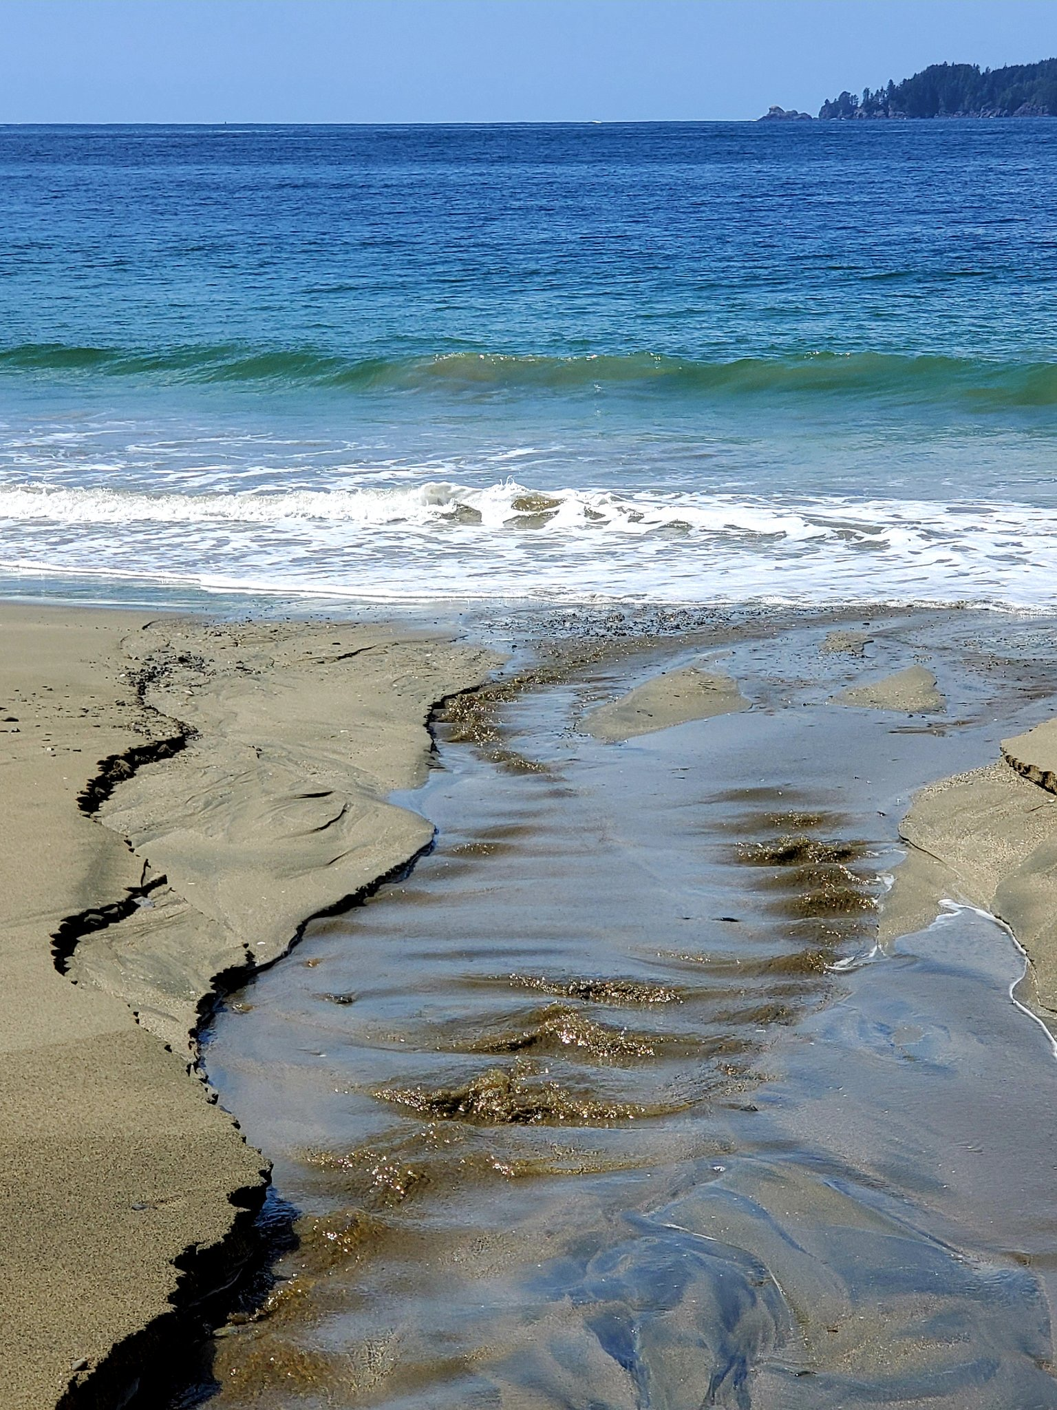
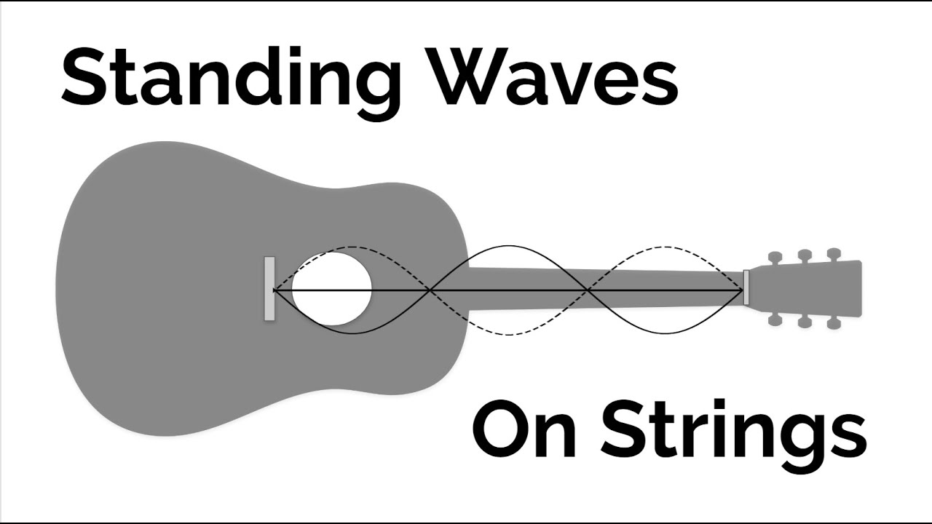
2 Stationary (standing) waves
Wavefronts
Is the continuous superposition of opposite waves
* They have the same speed, frequency, amplitude
Notes:
P104-105

Slide 10
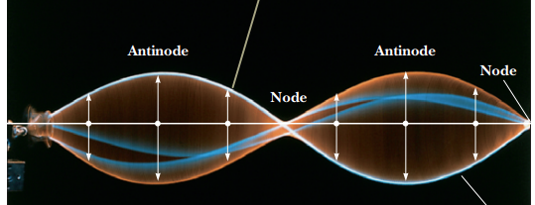
2 Stationary (standing) waves
Wavefronts
Is the continuous superposition of opposite waves
* They have the same speed, frequency, amplitude
* The wave does not move, it only oscillates
* Energy isn’t transferred along the wave
Notes:
P104-105
https://www.youtube.com/watch?v=-UEj0wcgeUk
https://www.youtube.com/watch?v=iWKFPTgkpXo
Xmdemo
Distance between 2 antinodes = 1/2lambda
Distance between 2 nodes = 1/2lambda

Slide 11
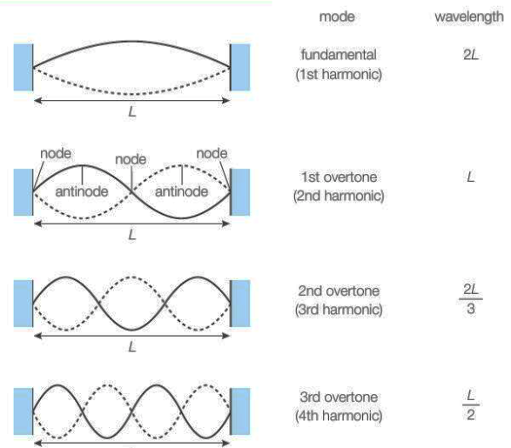
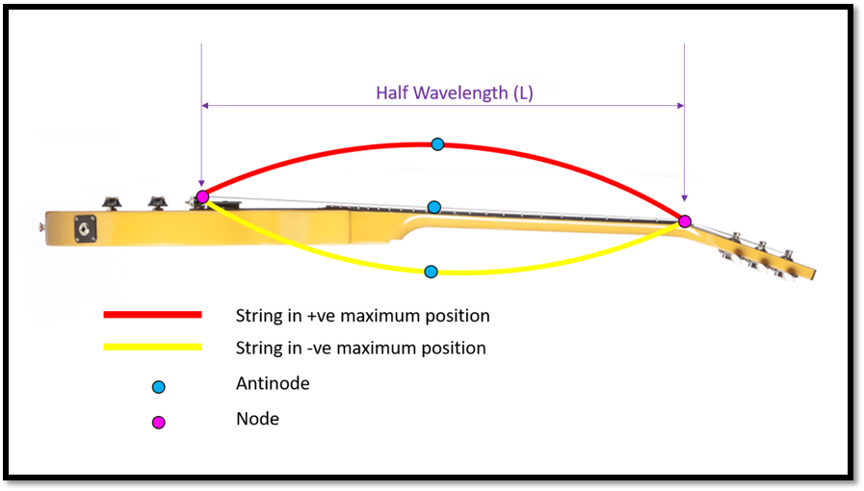
2 Stationary (standing) waves
Wavefronts
λ = 2L (Length of string) for 1st harmonic
Notes:
Example, guitar, the wavelength of the emitted wave should always be 2x that of the string
https://medium.com/@fretsuccess/how-do-guitar-strings-produce-their-sound-471cf870ebe

Slide 12
2 Stationary (standing) waves
Wavefronts
λ = 2L (Length of string)
Notes:
Example, guitar, the wavelength of the emitted wave should always be 2x that of the string
https://medium.com/@fretsuccess/how-do-guitar-strings-produce-their-sound-471cf870ebe
Practice
105 cm contrabass = 172 Hz
33 cm ukelele,. 548 Hz
After this, see book

Slide 13
2 Stationary (standing) waves
Wavefronts
A drainage pipe is 1.23 m in length, it makes a noise when wind blows through it, determine the frequency of the 1st, 2nd and 3rd harmonics. speed of sound in air is 343 m/s
Notes:
1st = 139 Hz
2nd = 279 Hz
3rd = 418 Hz

Slide 14
2 Stationary (standing) waves
Wavefronts
The speed of a wave generated on a string travel at a speed that depends on:
The Tension Force attached on the spring (can sometimes be a weight at the end of the spring)
The mass per unit length (or linear density) µ
$$v= \sqrt{\frac{T}{\text{µ }}}$$
Notes:
P104-105

Slide 15
2 Stationary (standing) waves
Wavefronts
The speed of a wave generated on a string travel at a speed that depends on:
The Tension Force attached on the spring (can sometimes be a weight at the end of the spring)
The mass per unit length (or linear density) µ
$$v= \sqrt{\frac{T}{\text{µ }}}$$
$$f x \text{λ}= \sqrt{\frac{T}{\text{µ }}}$$
$$f = \frac{1}{\text{λ}}\sqrt{\frac{T}{\text{µ }}}$$
Notes:
P106-107
T in N
Mu in kg/m

Slide 16
2 Stationary (standing) waves
Wavefronts
The speed of a wave generated on a string travel at a speed that depends on:
The Tension Force attached on the spring (can sometimes be a weight at the end of the spring)
The mass per unit length (or linear density) µ
$$v= \sqrt{\frac{T}{\text{µ }}}$$
$$f x \text{λ}= \sqrt{\frac{T}{\text{µ }}}$$
$$f = \frac{1}{\text{λ}}\sqrt{\frac{T}{\text{µ }}}$$
Notes:
P106-107
T in N
Mu in kg/m

Slide 17
2 Stationary (standing) waves
Wavefronts
Exercise: A string that is 30.0 cm long and has a mass per unit length of 9.00x10⁻³kg/m is stretched to a tension of 20.0 N. Find
(a) the fundamental frequency
(b) The second and third harmonics
Notes:
P104-105

Slide 18
2 Stationary (standing) waves
Wavefronts
Notes:
P104-105

