Slide 1
phase
Wave phase
The phase of a wave refers to a position in its cycle, it indicates the wave's progress, Or a certain position in its cycle.
It indicates specific point in its cycle and how far it has progressed through a complete oscillation
It is measured in degrees or radians
Notes:
Book, page 101.
We can use degrees or radians, from a circle to define any point on a graph. A full circle = 360Θ = 2pi

Slide 2
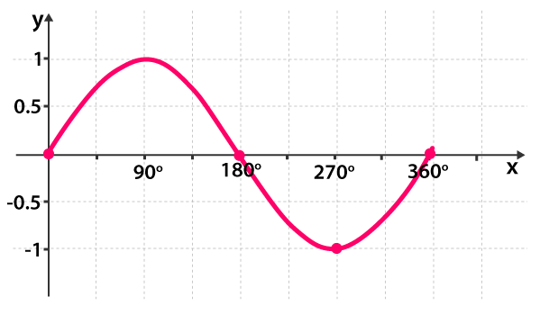
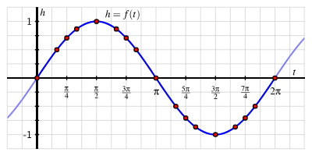
phase
Wave phase
Representing phase of a wave using radians:
In degrees | In radians
0° | 0π
90° | 1/2π
180° | π
270° | 3/2π
360° | π
Notes:
A sin wave can be used to represent
https://www.mathsisfun.com/algebra/trig-sin-cos-tan-graphs.html
We can use degrees or radians, from a circle to define any point on a graph. A full circle = 360Θ = 2pi
Lets continue till 450 degrees, 450 and 90 are in phase. Any 2 points together are known as in phase
To get a whole rotation, say.. Is it divisible by 360 ?
Half rotation, is it divisible by 180 ?

Slide 3
phase
Wave phase
Representing phase of a wave using radians:
In degrees | In radians
0° | 0π
90° | 1/2π
180° | π
270° | 3/2π
360° | π
Notes:
A sin wave can be used to represent
https://www.mathsisfun.com/algebra/trig-sin-cos-tan-graphs.html
We can use degrees or radians, from a circle to define any point on a graph. A full circle = 360Θ = 2pi
Lets continue till 450 degrees, 450 and 90 are in phase. Any 2 points together are known as in phase
To get a whole rotation, say.. Is it divisible by 360 ?
Half rotation, is it divisible by 180 ?

Slide 4
phase
Wave phase
Representing phase of a wave using radians:
In degrees | In radians
0° | 0π
90° | 1/2π
180° | π
270° | 3/2π
360° | π
Notes:
A sin wave can be used to represent
https://www.mathsisfun.com/algebra/trig-sin-cos-tan-graphs.html
We can use degrees or radians, from a circle to define any point on a graph. A full circle = 360Θ = 2pi
Lets continue till 450 degrees, 450 and 90 are in phase. Any 2 points together are known as in phase
To get a whole rotation, say.. Is it divisible by 360 ?
Half rotation, is it divisible by 180 ?

Slide 5
phase
Wave phase
Exercise: convert the following to radians
(450° , 720°, 1440°, 120°, 60°, 45°)
Radians = Degrees×$\frac{π}{180}$
Multiply by $π$, then divide by 180
Notes:
45 = pi/4
60 degrees = pi/3

Slide 6
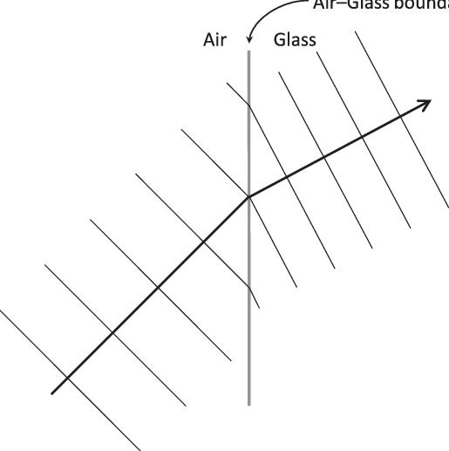
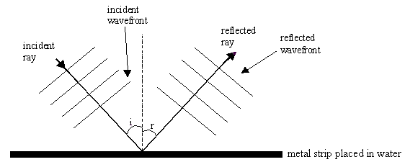
Wavefronts
Wavefronts
are described as lines that represent points in the same phase on a wave and are often used to illustrate how waves propagate through space
Notes:
Wavefront, parallel lines may represent crest.
Arrows represent the ray

Slide 7
Wave superposition
Wavefronts
When two waves meet, their vectors are summed
Waves can interact constructively, with a larger sum wave
The waves are said to be in-phase
Waves can interact destructively, with a lower/cancelled sum wave
The waves are said to be in anti-phase (180 degrees or π) apart
Notes:
If both waves are at a peak when they meet, they add to make an even higher peak; if one is at a peak and the other at a trough, they can cancel each other out.
See figure D

